Slide 1
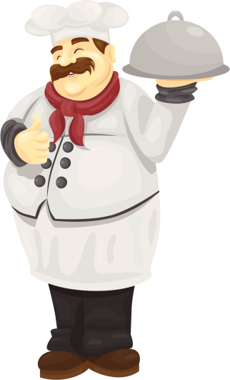
THE CHEF'S UNIFORM

Slide 2

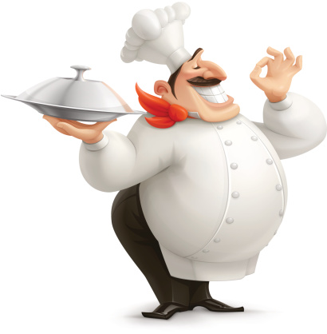
tick
a cook needs to wear his uniform for:
safety
special
economical
historical
hygienic
cultural
reasons

Slide 3
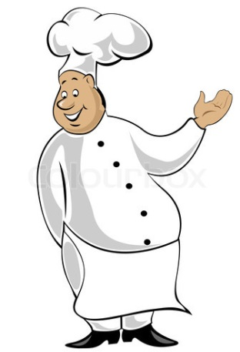
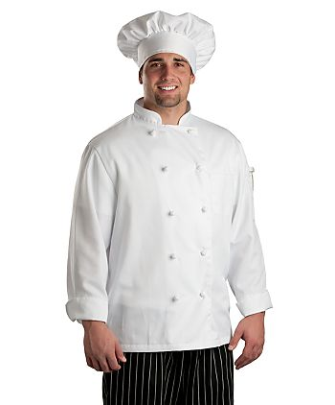
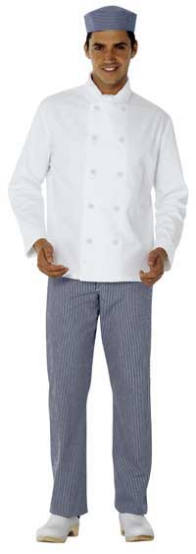
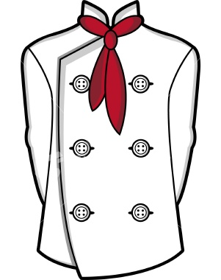
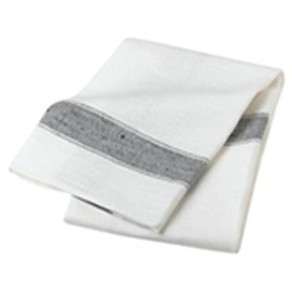
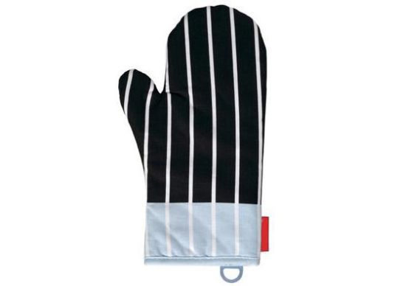
match
white waist apron
kitchen cloth
clogs
necktie|neckerchief
long sleeves
double cuffs
chef's jacket
sweatband
black and white checked trousers - slacks
double breasted
knotted buttons
chef's hat

Slide 4
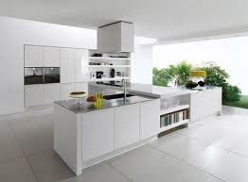
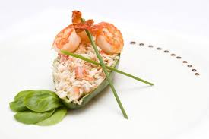
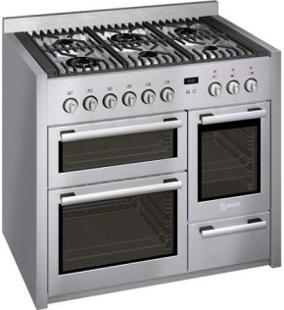
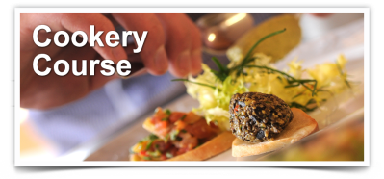
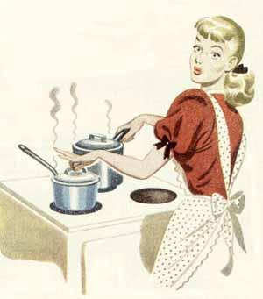
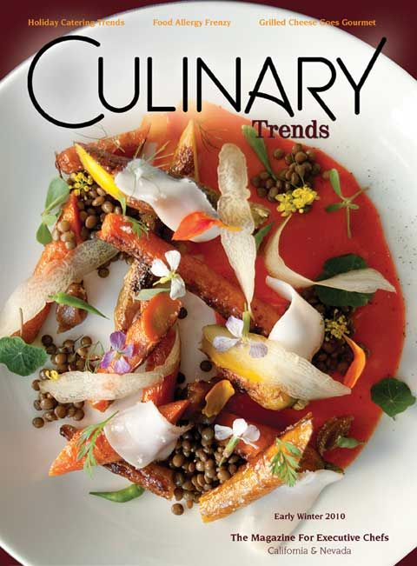
match
the Art of cooking and the discipline
the adjective related to the act of cooking food
the piece of equipment where you cook
culinary
the place where you work
cuisine
the act of cooking food
cooker
the style you cook
cookery
cooking
kitchen

Slide 5
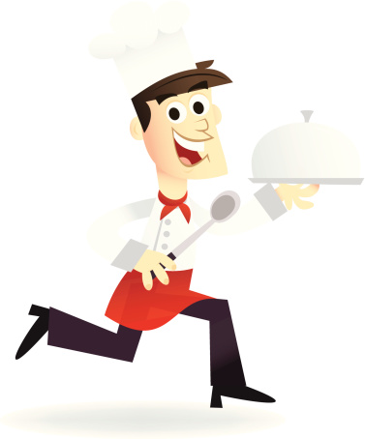
find the intruder
1
sweatband
pink skirt
chef's hat
necktie|neckerchief
2
black blouse
long sleeves
knotted buttons
kitchen cloth
3
chef's jacket
black shoes
black and white checked trousers
clogs

Slide 6
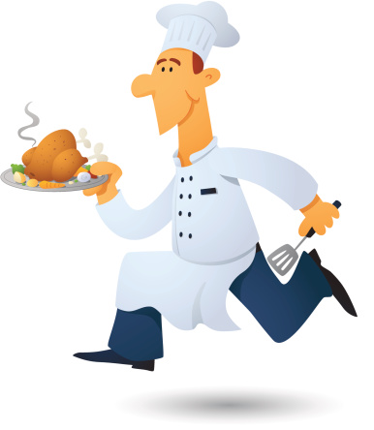
complete
1
2
3
4
5
6
the cook's uniform ___________ from burns and heat
the chef's hat has a sweatband to absorb ___________
the chef's jacket is ___________ to hide stains
the chef's jacket has ___________ sleeves and ___________ buttons
the chef's ___________ are black and white checked
the chef's clogs are no ___________ shoes

Slide 7
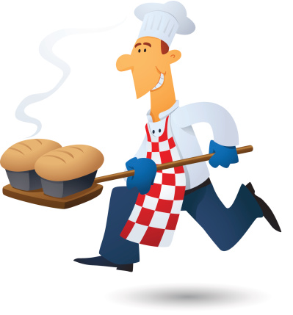
correct mistakes
1
2
3
4
5
the cook wears a uniform to protect the body with heat and burns
the cook wears a uniform to look dirty
Toque is the Spanish word for the chef's hat
the chef's jacket is single breasted
the necktie is an optional item

Slide 8
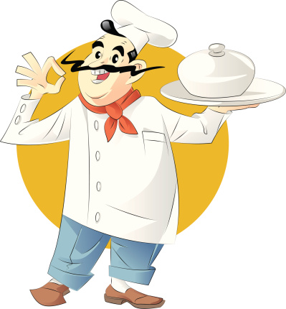
rearrange
O
A
P
N
R
G
L
O
C
S
K
C
E
N
I
E
T
U
F
C
S
F
E
A
C
T
J
K
S
A
E
B
W
A
T
D
N
T
T
N
S
B
U
O
O
H
T
C
L
H
T
A
T
S
S
R
R
O
U
E

