Slide 1
HACCP

Slide 2
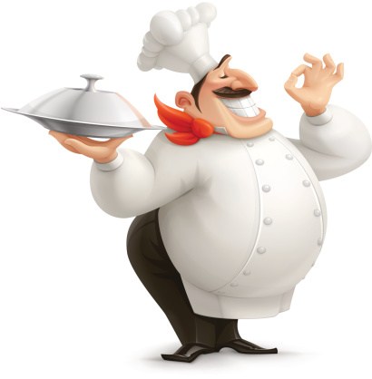
tick
the acronym HACCP stands for
Hazard Analysis and Critical Culinary Points
Hazard Analyses and Culinary Control Points
Hazard Analysis and Critical Control Points

Slide 3
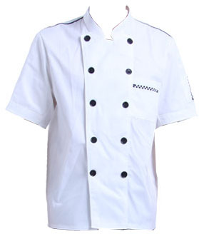
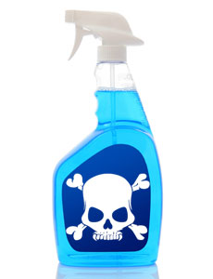
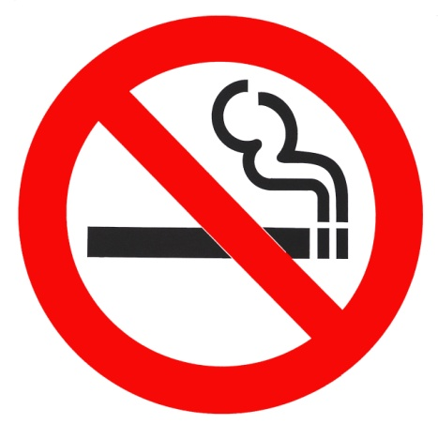
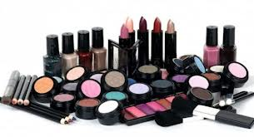
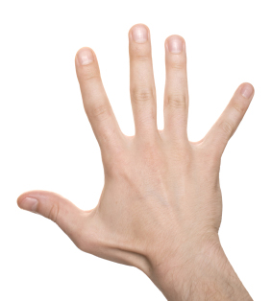
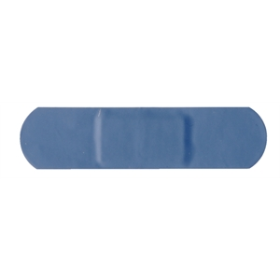
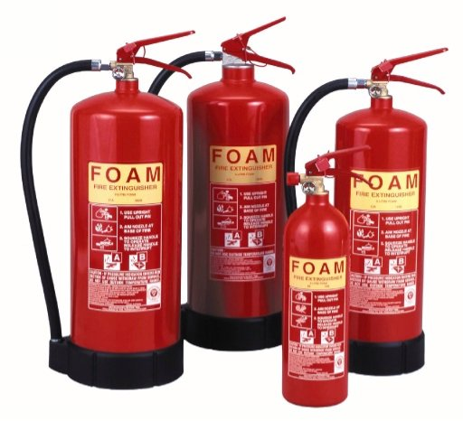
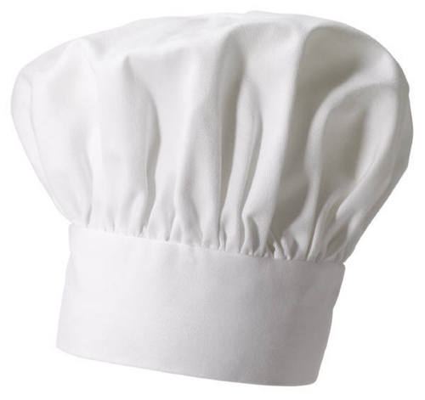
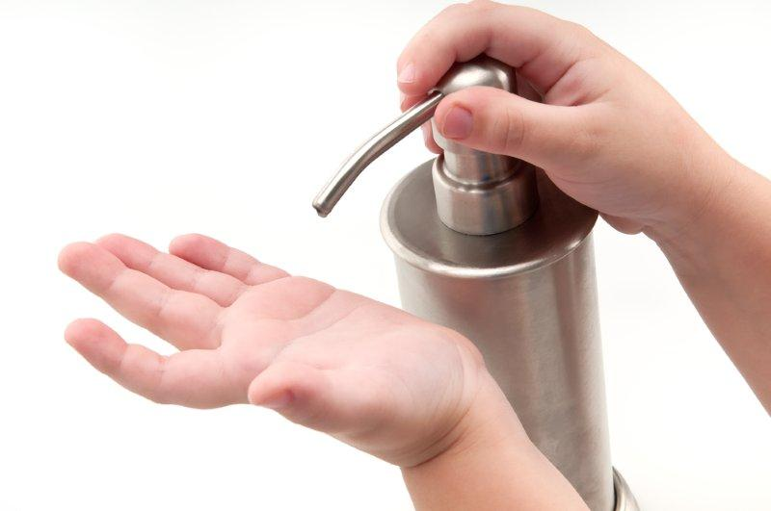
match
cover your wounds with a blue waterproof plaster
never smoke at work
wear correct, clean, protective clothing
wear a hat or net if necessary
avoid jewellery
keep your nails short and clean
avoid heavy make up and nail polish
avoid strong perfumes and deodorants
know location of fire extinguishers
store food away from any chemical and toxic cleaners
wash your hands regularly with soap and sanitizer

Slide 4
find the intruder
1
risk
safety
danger
hazard
2
clean
neat
hygienic
dirty
3
illness
hygiene
grooming
cleaning

Slide 5
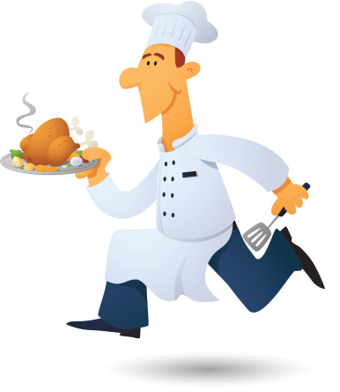
complete
1
2
3
4
5
6
7
8
9
10
clean means hygienic and s___________ in a kitchen
everything should be shining and c__________ in a kitchen
a chef is a food h____________
HACCP is a strict h_____________ analysis system
grooming means caring for your personal appearance, h________ and clothing
to g_________ a high standard of food hygiene and safety, Food Legislation carries out a strict hazard analysis system, called H.A.C.C.P.
a professional cook needs to be w_________-groomed
we must use a new s________ when we taste food
food hygiene and s______ is the first responsibility in catering.
HACCP is a Control System used to safeguard the h_______ of consumers.

Slide 6
complete
In recent years there is a greater public awareness about __________ linked to food and food safety thanks to a widespread ____________ education.
Moreover, _____________ borne illnesses have increased.
High standards of food safety are necessary to bring benefits to ___________, employees, and business proprietors and to enjoy food without any _____________.
risks
food
consumers
illnesses
health

Slide 7
rearrange
L
E
C
N
A
S
I
R
K
Z
A
H
R
D
A
H
G
N
E
E
Y
I
H
A
E
T
L
H
O
O
I
G
G
R
M
N
A
S
F
E

