Slide 1
THE KITCHEN BRIGADE

Slide 2
complete
The Kitchen s______ is based on the S_______ or D____________ system. Nowadays a complete kitchen B__________ includes the following sections:
S __ __C __ SECTION
S __ __ P SECTION
R __ __ __ T SECTION
F __ __ __ SECTION
V __ __ __ __ __ B __ __ SECTION
L __ __ D __ __ SECTION
P __ __ __ __ Y SECTION
Every section has a S ________ H ______

Slide 3
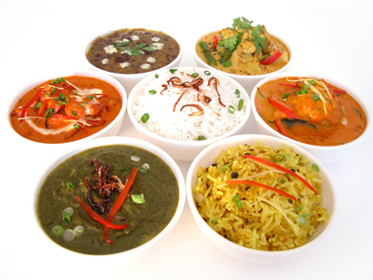
match
the Head Chef / Executive Chef ...
creates
menus
hires
staff
dishes
food
the work in the kitchen
plans
orders
controls and coordinates

Slide 4
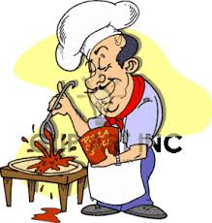
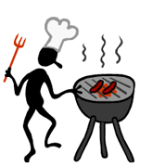
match
the Pastry Cook
the Sauce Cook
the Grill Cook
the Soup Cook
the Fish Cook
the Larder Cook
the Vegetable Cook
the Roast Cook

Slide 5
all the vegetables and eggs, pasta & rice dishes
sauces
fish dishes and sauces
complete the grid
all cold foods, buffet and cocktail dishes
soups and stocks
hot and cold desserts, fresh pasta & bread
grilled food
roasted and fried food
the Sauce Cook | Chef Saucier | is in charge of | the preparation of
the Soup Cook | Chef Potager | is in charge of | the preparation of
the Fish Cook | Chef Poissonier | is in charge of | the preparation of
the Roast Cook | Chef Rotisseur | is in charge of | the preparation of
the Grill Cook | Chef Grillardin | is responsible for | the preparation of
the Vegetable & Noodle Cook | Chef Entremetier | is responsible for | the preparation of
the Larder Cook | Chef Garde-Manger | is responsible for | the preparation of
the Pastry Cook | Chef Pâtissier | is responsible for | the preparation of

Slide 6
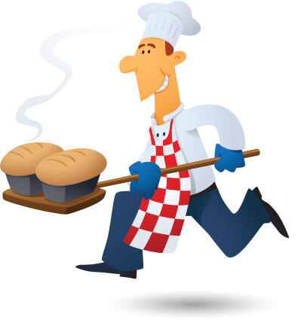
True False
in a kitchen ...
T F
1
2
3
4
5
the cook who oversees the work in the kitchen is the Head Cook
the cook who prepares shrimp cocktails is the Roast Cook
the cook who performs various tasks as needed is the Under Cook
the cook who substitutes the Head Chef is the Tournant
the cook who makes your life sweeter is the Pastry Cook

Slide 7
rearrange
1
2
3
4
Sous Chef
the
Head Chef's
first
is
Under Cook
or
assistant
the
Chef Tournant
the
help
needed
to
Swing Cook
where
or
runs
Chefs
Commis
Apprentices
young
assist
and
who
job
the
are
learn
Auguste Escoffier
in
the
century
the
developed
System
Brigade
modern
19th

