Slide 1
KITCHEN LAY OUT AND EQUIPMENT

Slide 2
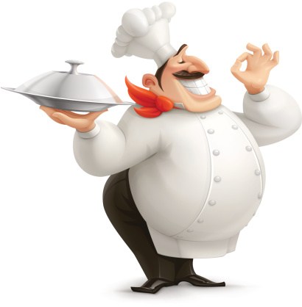
complete
the main activities in the kitchen are
D___LIV___RY
STOR___GE
___OOD PR___PARATI___N
COO___ING
___OLDING
SE___VICE
W___S___ING ___P
W___ST___ D___SPOS___L

Slide 3
reorder
in the kitchen food is ...
prepared
cooked
delivered
stored
cleaned

Slide 4
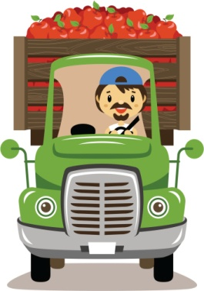
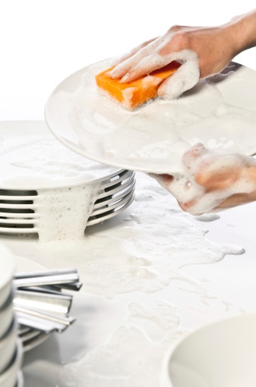
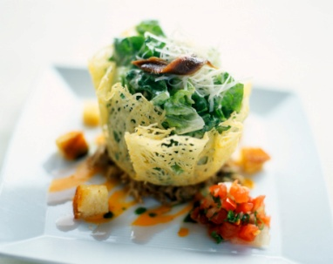
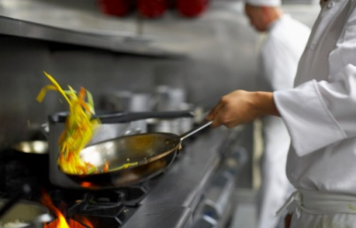
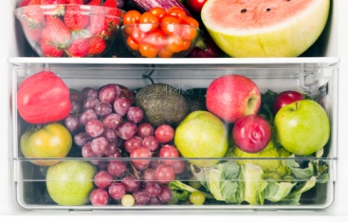
match
STORAGE
DELIVERY
SERVICE
FOOD PREPARATION
COOKING
HOLDING
WASHING UP
WASTE DISPOSAL

Slide 5
find the intruder
1
cooking
roasting
grilling
boiling
frying
2
pastry section
hot holding
chilled holding
waste
3
cleaned
store
cooked
delivered
prepared

Slide 6
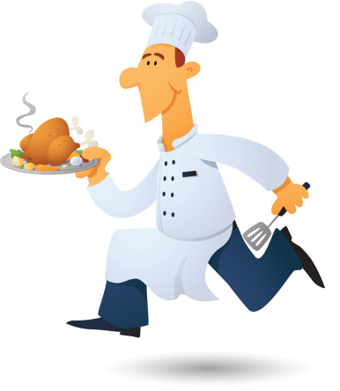
complete
1
2
3
4
5
6
the main activities in the kitchen are carried out in __________different areas
food is cooked in the ______________________ area
food is delivered and stored in the ______________________ area
food is cleaned and prepared in the ______________________ area
the first area is called "______________________ in"
we can find a waste disposal in the ______________________ area

Slide 7
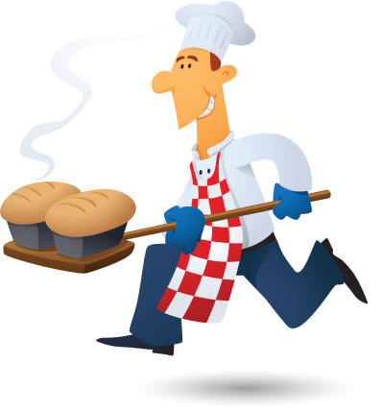
True False
in a kitchen ...
T F
1
2
3
4
5
in the first area food is stored in freezers and storage cabinets
the second area is near the back entrance
the integrated cooking appliances are in the second area
pasta is stored in the first area
vegetables are trimmed in the second area

Slide 8
rearrange
1
2
3
4
5
needs
professional
layout
a
well
the
kitchen
designed
in
second
cleaned
food
and
prepared
cooking
area
the
is
for
food
the
in
first
freezers
is
delivered
in
area
stored
and
cooked
food
third
the
is
area
in
area
waste
disposed
second
the
is
in

Slide 9
word search
W | A | S | H | K | M | H | C | O | L | D
A | F | I | S | H | B | E | A | I | D | R
S | M | H | I | T | N | A | A | T | E | Y
T | E | O | D | I | C | C | K | T | L | G
E | A | T | S | H | L | S | E | E | E | O
E | N | I | P | L | E | A | T | S | R | O
C | U | L | I | N | A | R | Y | N | Y | D
C | D | I | N | I | N | G | R | O | O | M
MEAT
PLEATS
SEE
WASTE
WASH
BAKE
CLEAN
COLD
CUISINE
CULINARY
DISH
DINING ROOM
DRY GOOD
EAT
FISH
HAT
HOT
MEAN

Slide 10
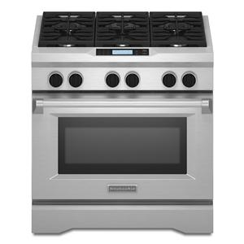
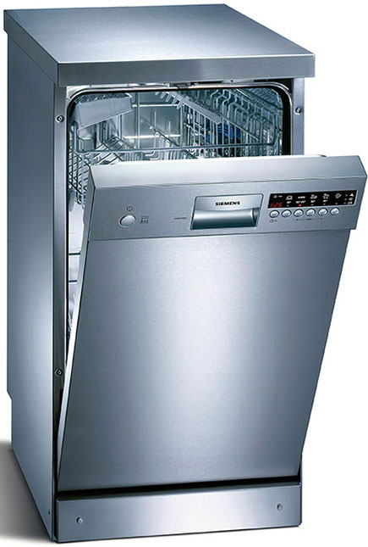
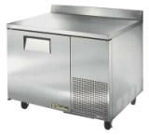
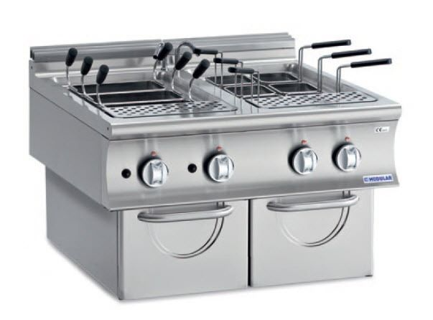
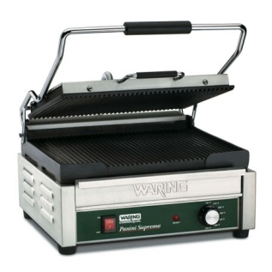
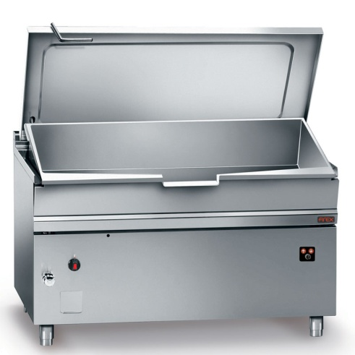
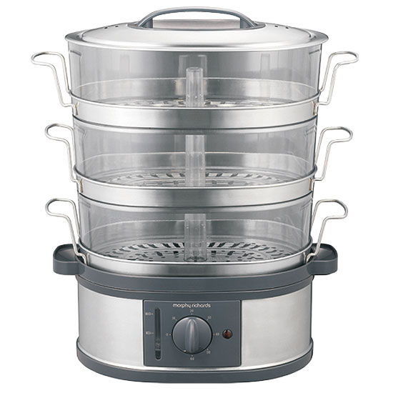
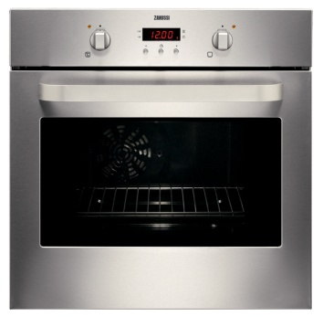
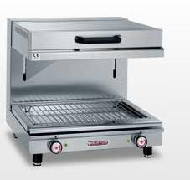
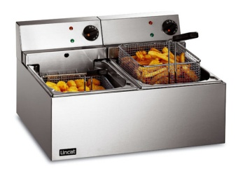
match
thanks to the latest technological innovations modular kitchen equipment includes:
gas or electric ranges with open burners or radiant plates
pasta cookers
fryers
grills and griddles
ovens
steamers
bratt pans or braising pans
salamanders
food preparation worktops
dish-washers

Slide 11
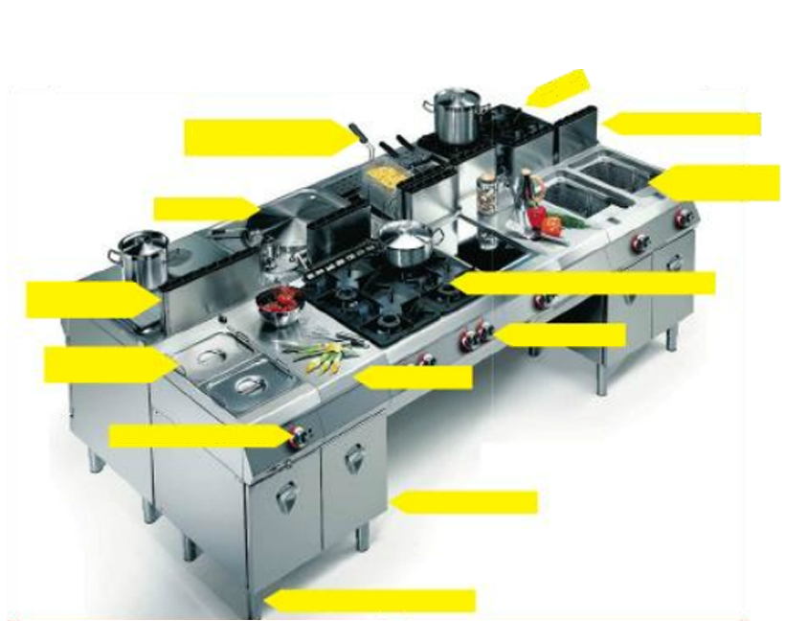
bain marie appliances
neutral unit
match
internal shelves
temperature control
legs with adjustable feet
fry top with radiant plates
fryers with basket lifting
backsplash panels
boiling pan
hob with open burners and grates
range
pasta cookers with basket lifting
control knobs

Slide 12
is used
are used
complete sentences
1
2
3
4
5
6
7
8
pasta cooker
to adapt the height of a table
storage units
as a worktop while cooking
to place the pans on them
control knob
to store oil, salt, etc.
to reduce or raise the heat
range grates
to remove the food from oil
bain marie appliances
to cook by steam
to cook pasta
basket lifting
neutral unit
adjustable feet

Slide 13
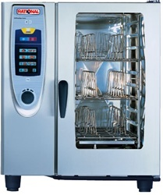
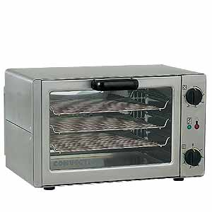
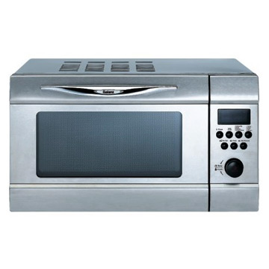
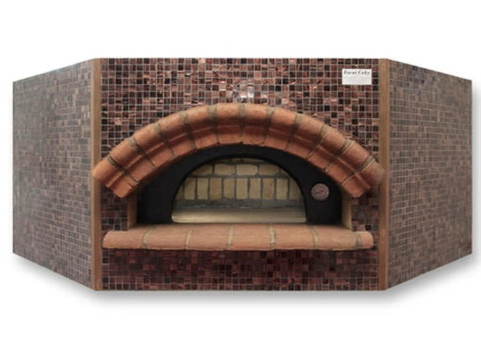
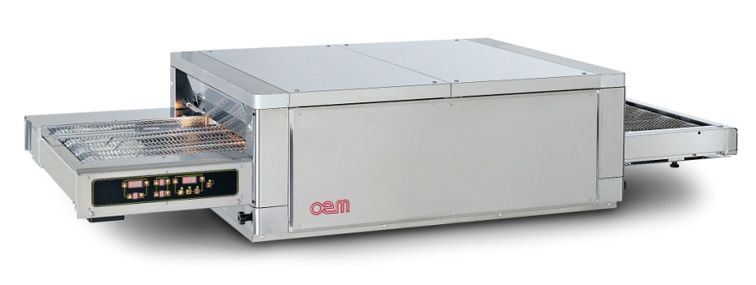
match
there are several types of oven to perform specific cooking functions
convection oven
conveyor or tunnel oven
microwave oven
dry air combined cooking steam oven
pizza oven
ideal for hot sandwiches
ideal for quick and efficient cooking
ideal for pizza
ideal for baked dishes
ideal to vacuum, steam, hold, stew, boil, etc.

Slide 14
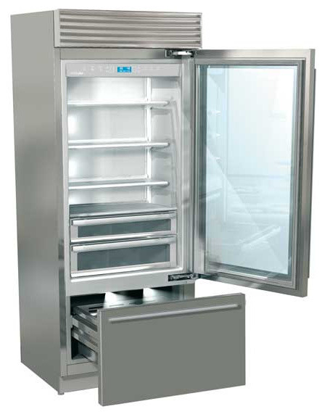
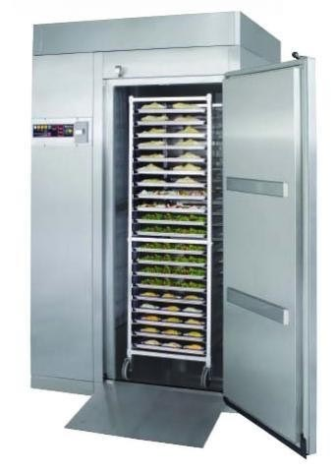
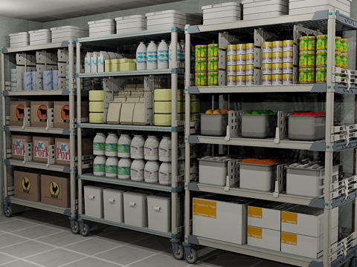
cold storing
match
refrigerators/blast chillers/blast freezers
roll-in blast chillers/blast freezers
walk-in freezer

Slide 15
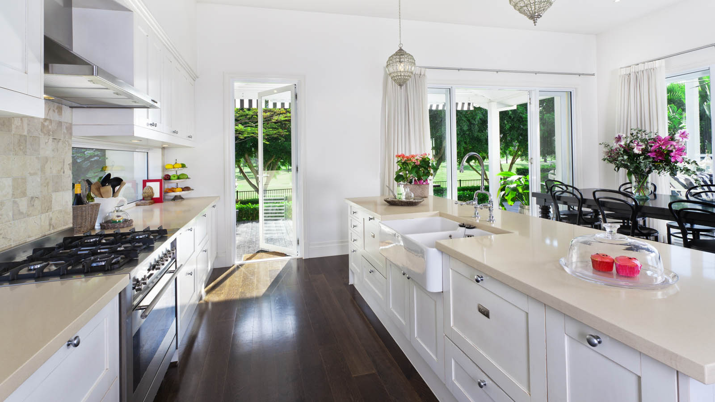
drain board
storage drawer
open gas burners
storage cabinet
match
knob
work top
water mixer
sink
oven
floor
hood
sink well

