Slide 1
KITCHEN UTENSILS

Slide 2
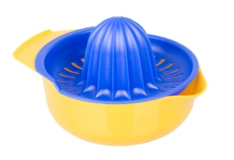
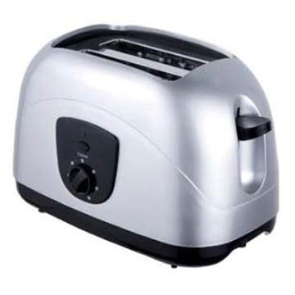
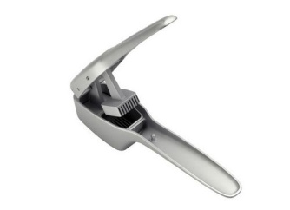
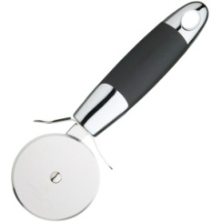
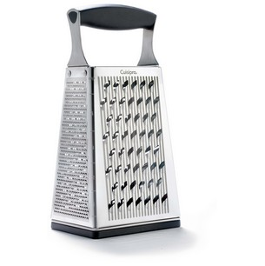
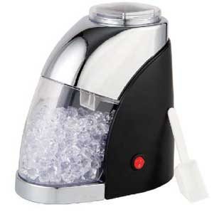
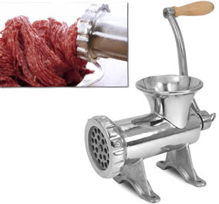
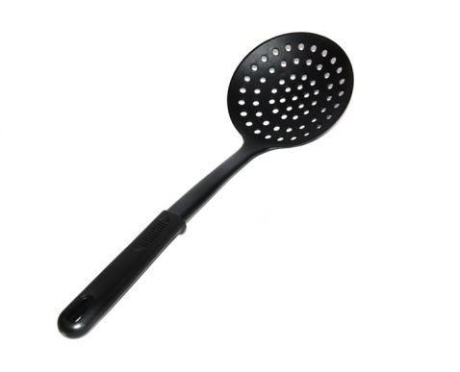
ice crusher
match
is used to toast bread
pizza cutter
is used to crush garlic
garlic crusher
is used to squeeze oranges and prepare a fresh orange juice
skimmer
is used to mince different meats and make meat balls
mincer
is used to grate parmesan
squeezer
toaster
is used to cut pizza
grater
is used to crush ice
is used to remove the fat from the sauce

Slide 3
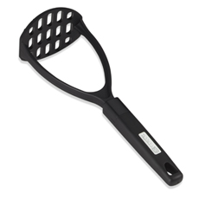
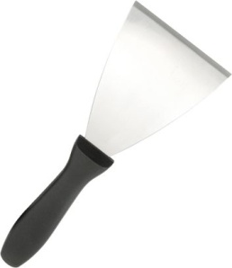
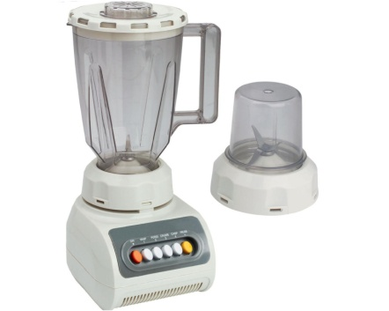
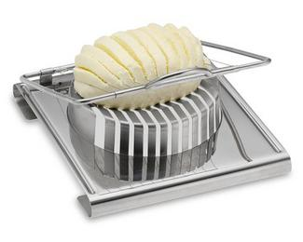
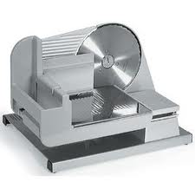
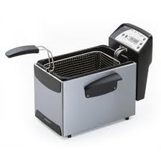
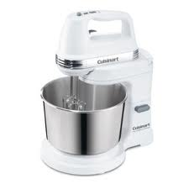
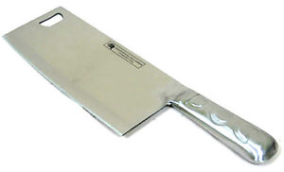
chopper
match
pastry scraper
blender
egg slicer
potato masher
fryer
electric mixer
slicer
is used to slice ham
is used to remove the sticky dough from the worktop
is used to cut the boiled eggs into rounds
is used to mash potatoes
is used to make chips
is used to mix food
is used to chop food
is used to blend food

Slide 4
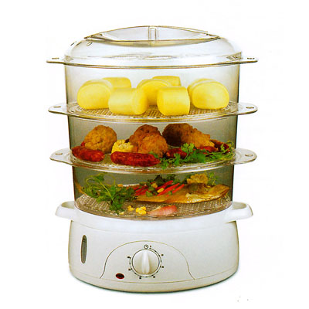
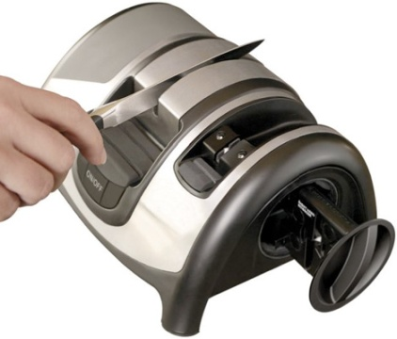
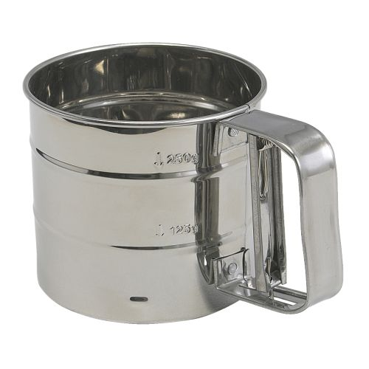
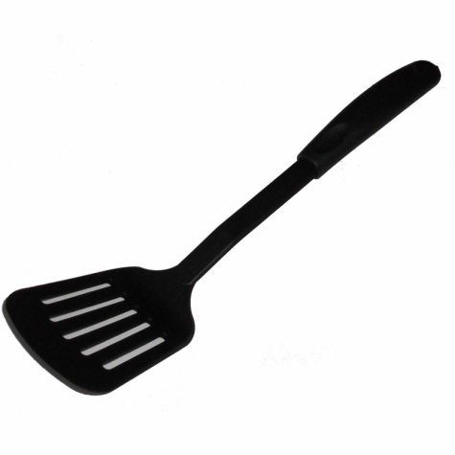
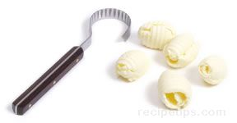
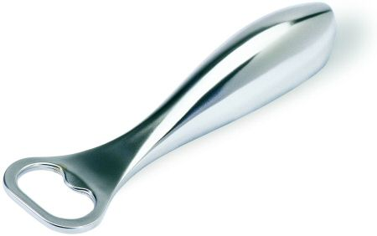
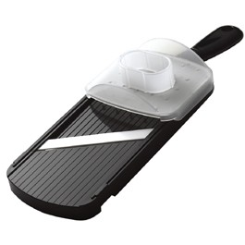
mandoline hand slicer
match
flour sifter
knife sharpener
slotted turner
butter curler
bottle opener
steamer
is used to make thin slices of fruits
is used to steam vegetables
is used to open bottles
is used to make lovely curls of butter
is used to sharpen knives
is used to sift flour
is used to turn and serve food (allows liquids to drain)

Slide 5
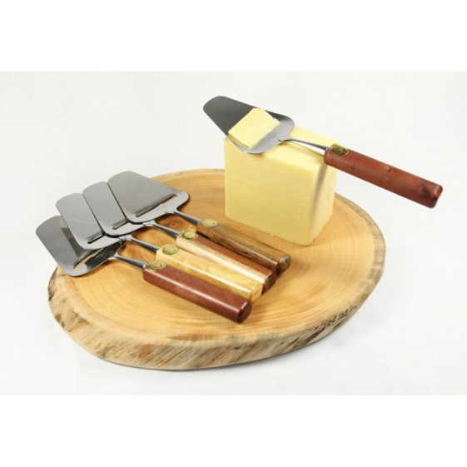
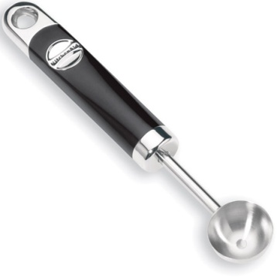
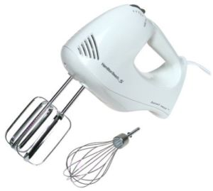
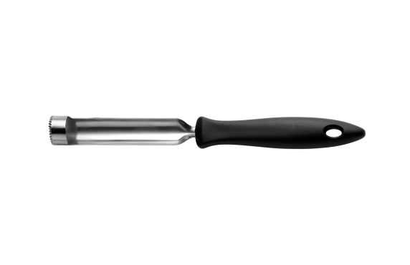
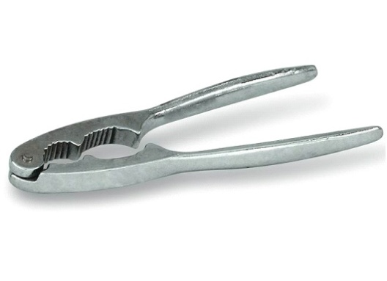
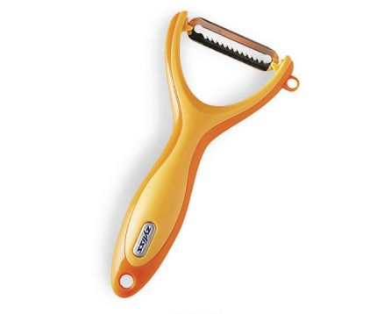
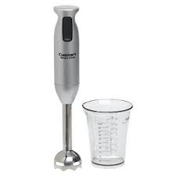
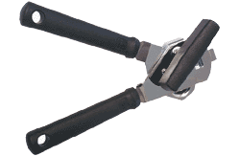
tin opener
nutcracker
match
melon baller
cheese slicer
hand beater
immersion blender
peeler
corer
is used to peel potatoes
is used to create an oval shaped sphere from various fruits
is used to remove the internal part of food
is used to beat eggs
is used to crack nuts
is used to prepare thin slices of cheese
is used to open tins
is used to make a creamy soup

