Slide 1
PANS AND POTS

Slide 2
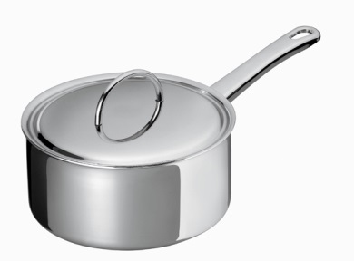
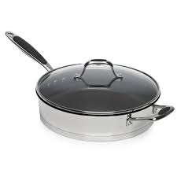
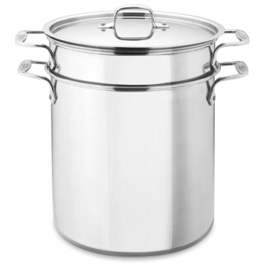
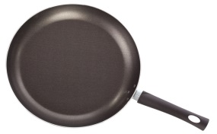
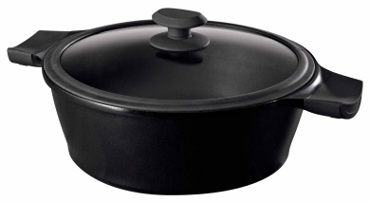
FRYING PAN
match
STOCKPOT
CASSEROLE, SAUCE POT OR DUTCH OVEN
SAUTE’ PAN
SAUCEPAN
It is used to make stews, soups, casseroles, roasts with long cooking times
it is used to simmer stocks and soups, pastas, vegetables and lobsters
It is used to prevent steam. It is ideal for scrambling and shallow frying
It is used to lightly, quickly fry in a little fat or for browning meats, poultry, fish
it is used to make sauces, cook vegetables, soups. Lids fit tightly to accelerate cooking

Slide 3
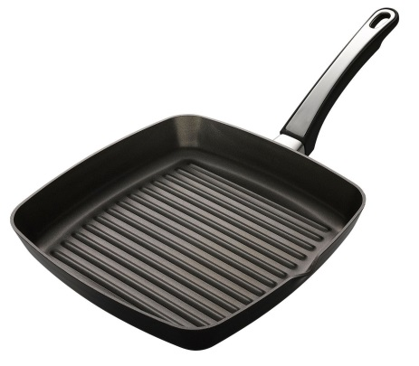
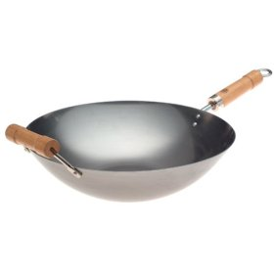
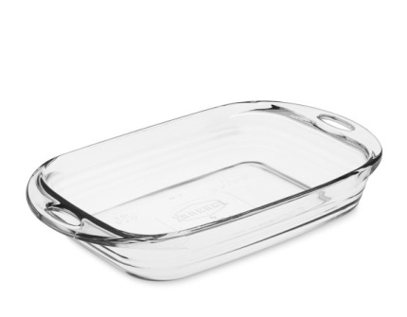
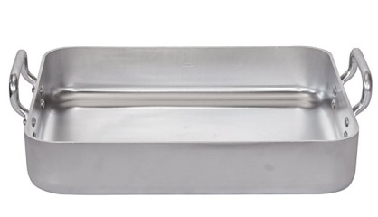
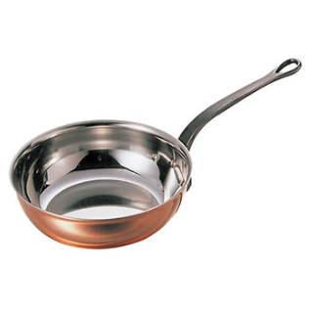
match
WOK
BAKING DISH
ROASTING PAN
Evasée OR CHEF'S PAN
GRILL PAN
It is used to roast meats and it makes outsides crunchy and insides moist.
it is used to heat quickly on the stovetop or in the oven. It has stay-cool stainless steel handles.
it is used to get the same cooking results as on a grill
It means “big spoon” in Chinese. it has a rounded shape which allows food to cook quickly in a minimum of fat at a high temperature to retain ll flavor and nutritional value
It is a new hybrid pan. It is used to do everything! You can sauté, brown, poach, stir-fry and make a sauce. Rounded sides allow to whisk ingredients. Flat bottom facilitates browning, and the high sides are deep to toss vegetables and small cuts of meats and fish without splling liquids.

