Slide 1

THE HUMAN RIGHTS
And the Council of Europe

Slide 2


WHAT IS IT?
The Council of Europe seeks to develop throughout Europe common and democratic principles based on the European Convention on Human Rights and other reference texts on the protection of individuals.

Slide 3

What is it fightning for?
Share the
reality, now.
Without edges.
FREEDOM
HUMAN
RIGHTS
NO
WAR

Slide 4
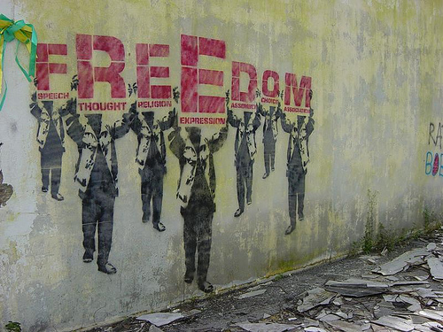
A DREAM
ESPRESSION
EQUALITY
Love
RELIGION
FREEDOM
BROTHERHOOD
I’M A DREAMER.
BUT I’ M NOT THE ONLY ONE.

Slide 5

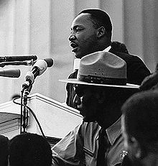
I HAVE A DREAM
The right…
to be, to express themselves,
to speak!
JUSTICE
FREEDOM
I have a dream where dreams and love can overtake each edge about religion, race and diversity.
I hope all
turns into
an oasis of
freedom and justice

Slide 6

JUST A
BETTER WORLD

Slide 7

WE FIGHT FOR THESE REASONS!
HUMAN RIGHTS.

