Slide 1
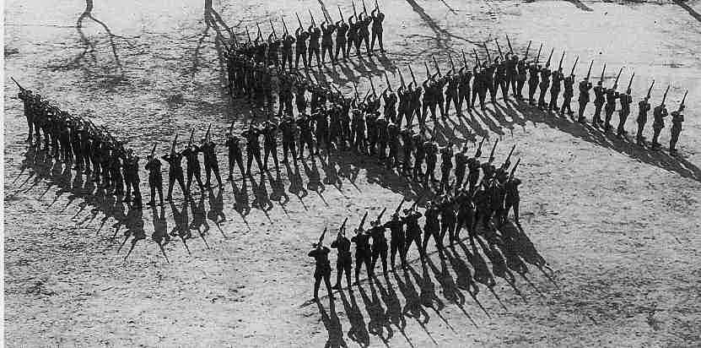
HOLOCAUST
During the war the Germans began to persecute Jews and other races: homosexuals, criminals, gypsies, communists, considered inferior by sending them to concentration camps where they worked and were killed in gas chambers. Prisoners were obliged to wear fabric triangles on their uniforms, painted in different colours according to the category they belonged to in order to be immediately identified.

Slide 3
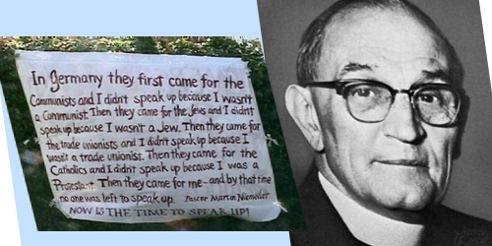
They came first for the Communists, and I didn't speak up because I wasn't a Communist.
Then they came for the trade unionists, and I didn't speak up because I wasn't a trade unionist.
Then they came for the Jews, and I didn't speak up because I wasn't a Jew.
Then they came for me and by that time no one was left to speak up.
Pastor Martin Niemoller (1892-1984)

Slide 4
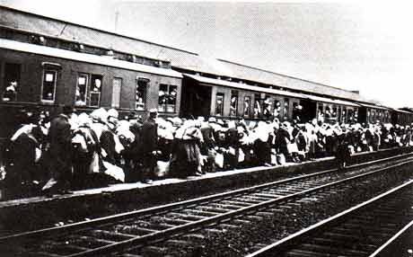
THE MESSAGE OF POEM
The poem descibes
a very sad moment of the Second World War and how people were deported and killed. The poet says that he didn’t speak when they came for the Communists,
the trade unionists or the Jews, but when Nazists took him no
one was left to speak up. This poem is very deep and meaningful and it makes us reflect on the past reality.

Slide 5
Yellow triangle
Black triangle, pink triangle, green triangle, red triangle, blue triangle, lilac triangle, And they wore the yellow triangle.
When first they came for the criminals, I did not speak. Then they began to take the Jews, When they fetched the people who were members of trade unions, I did not speak. When they took the Bible students, Rounded up the homosexuals, Then they gathered up the immigrants and the gypsies, I did not speak. Eventually they came for me And there was no one left to speak.
Christy Moore
Homosexuals
Jehova’s
Witnesses
Criminals
A-socials
Jews
Political Prisoners
War Prisoners

Slide 6
The message of the song
This song talks about the victims of concentration camps. The speaker is a prisoner of a concentration camp and he describes what happened: the prisoners wore triangles of different colours, for example Jews wore a yellow triangle overlapped by a David Star.

Slide 7
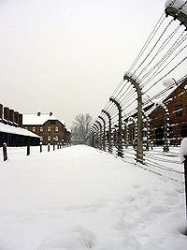
ACROSTIC
Hitler
Outrageous
Lilac triangle
Oskar Schindler
Concentrations camps
A-socials
Unfortunate
Sin
Terrible

Slide 8
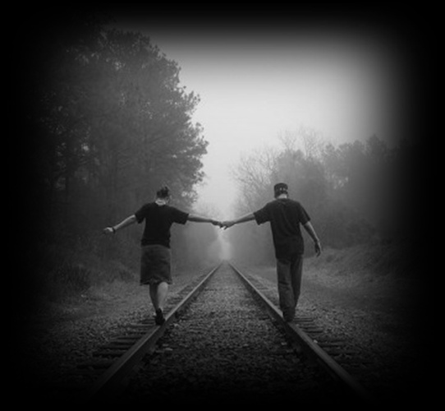
Our Dream…
Holocaust has been terrible, but it helps remember what happened. All that remains imprinted in our hearts and we hope that one day all people hold hands, to promote peace and equality among all, with no difference.

Slide 9
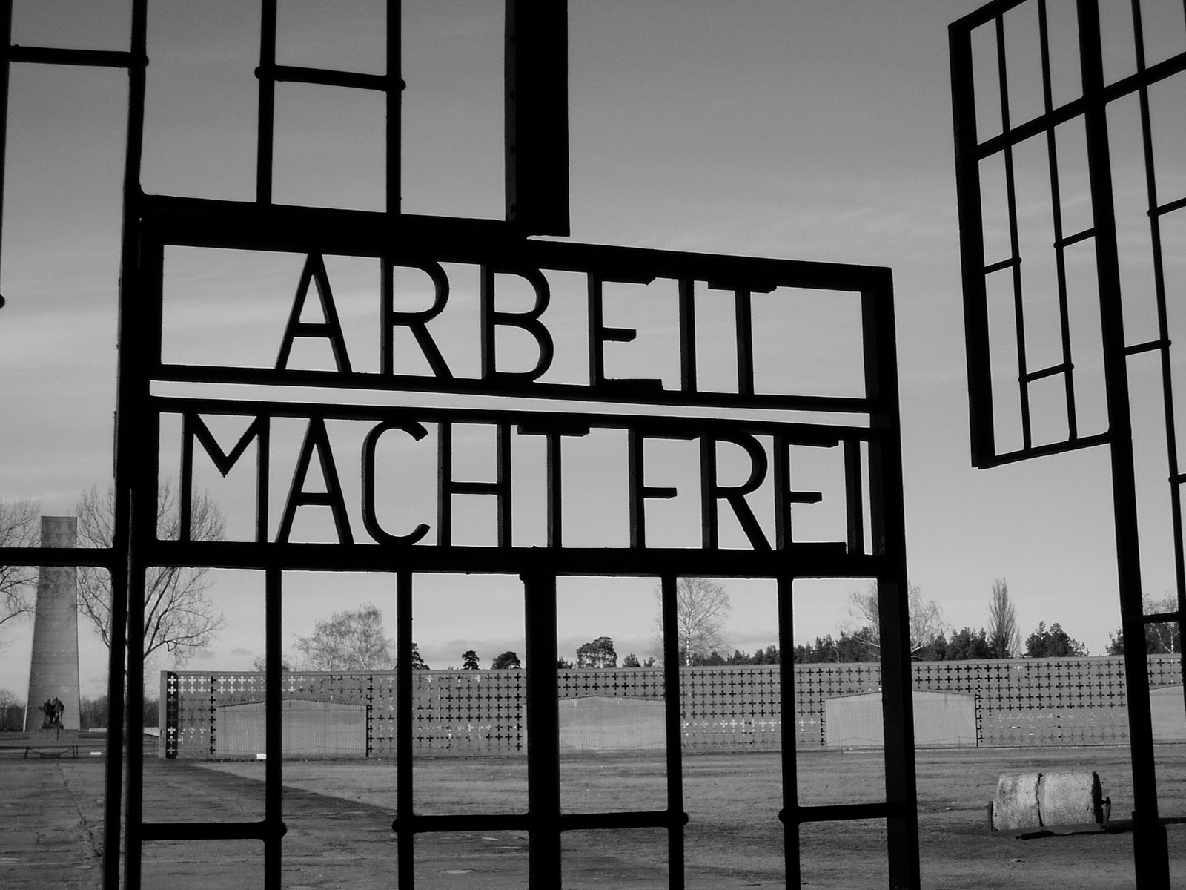
We all live with the objective of being happy, our lives are different, yet equal.
Anna Frank

