Slide 1
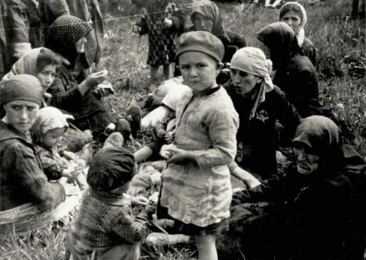
Holocaust

Slide 2
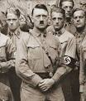
Keywords
Hitler

Slide 3
Poems
They came first for the Communists,
and I didn't speak up because I wasn't a Communist.
Then they came for the trade unionists,
and I didn't speak up because I wasn't a trade unionist.
Then they came for the Jews,
and I didn't speak up because I wasn't a Jew.
Then they came for me
and by that time no one was left to speak up.
‐ Pastor Martin Niemöller (1892‐1984)

Slide 4
Message
This poem says that when the Nazis came to take other people the poet spoke up to save them, but when the Nazis came to take him no one spoke up for him.

Slide 5
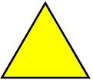
Christy Moore-Yellow Triangle
The black triangle The pink triangle The green triangle The red triangle The blue triangle The black triangle And they wore the yellow triangle When first they came for the criminals I did not speak Then they began to take the jews When they fetched the people who were member s of trades unions I did not speak Then they took the bible students Round they took the homosexuals Then they gathered up the students and the gypsies I did not speak I did not speak Eventually they came for me there was no one left to speak The black triangle The pink triangle The green triangle The red triangle The blue triangle The black triangle And they wore the yellow triangle And they wore the yellow triangle And they wore the yellow triangle And they wore the yellow triangle

Slide 6
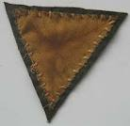
Message
This song is a tribute to Holocaust to remember the millions of Jews killed by Nazis and talks about the different colours of the triangles which the different kinds of people in concentration camps wore.

Slide 7
Acrostic
Hitler
Oppressed the Jews forced to
Leave in
Other
Countries
After they went
Unexpectedly,
Surprisingly,
Towards death

Slide 8
The End
By Carlo
And
Francesco

