Slide 1
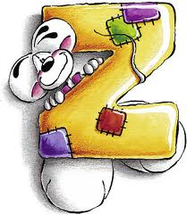
An
To
Of Internet

Slide 2
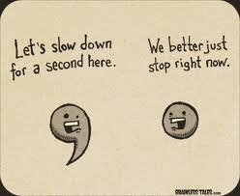
All email addresses have this symbol (at in English).
Comma in English
Dot in English

Slide 3
is a type of diary on Internet.

Slide 4
You click with the mouse
To make your computer
Do something.

Slide 5
Download means take
Something from internet
Like text, music and video.

Slide 6
You use email to send and receive messages on your computer via internet.

Slide 7
You can keep a list of favourites on your computer.

Slide 8
You click go to start a search on the internet.

Slide 9
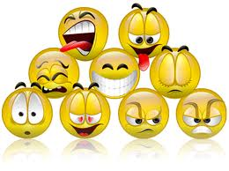
You can use symbols to add humour to your email messages.

Slide 10
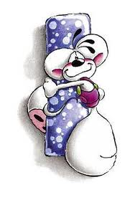
You can use internet for instant messaging: it’s like a written conversation.

Slide 11
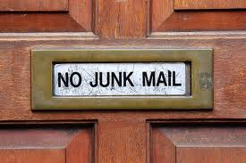
You sometimes receive emails that you didn’t want. This is junk mail or spam.

Slide 12
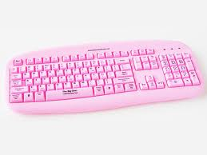
You use the keyboard to type messages.

Slide 13
connects one web page to another. It’s usually a word or a phrase in blue and underlined.

Slide 14
You use the mouse to move around the screen of your computer.

Slide 15
The net is another word of internet.

Slide 16
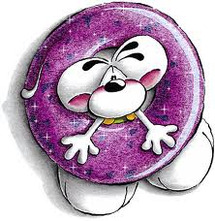
Online means connected to internet.

Slide 17
You can download a podcast from internet and play it on your iPod.

Slide 18
When you quit a computer program, you close it.

Slide 19
You send a message and you receive a reply.

Slide 20
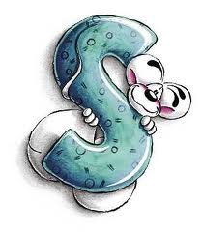
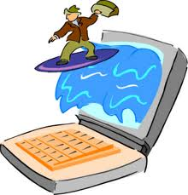
You surf internet to find information.

Slide 21
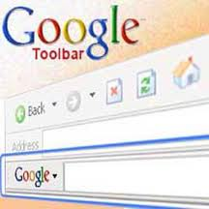
are in toolbar.

Slide 22
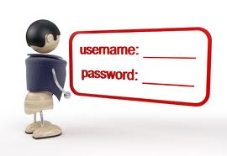
Your username is your email name.

Slide 23
Type “virtual tour of London” into Google and explore the capital of Great Britain!

Slide 24
A webcam is a camera connected to a computer.

Slide 25
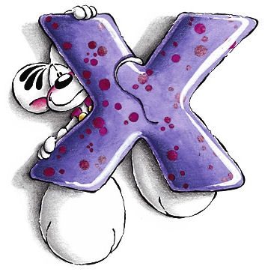
You can write the letter X at the end of your emails to send a kiss.

Slide 26
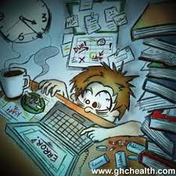
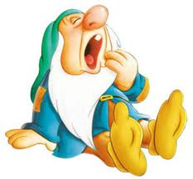
Don’t stay up late surfing internet. GO TO BED!!!!

Slide 27
Thank you
For your
Vision
Chiara Baldi
II A

