Slide 1
IMPROVE
READING
SKILLS

Slide 2

SKIMMING
Skimming is used to quickli gather the most important information, or “gist”.
Run your eyes over the text noting important information.

Slide 3
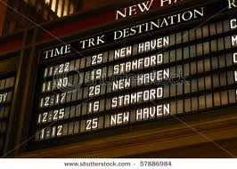
SCANNING
Scanning is used to find a particular piece of information.
Run your eyes over the text looking for the specific piece of information you need.

Slide 4

EXTENSIVE READINGS
Extensive reading is used to obtain understendig of a subject and includes reading longer texts for pleasure…

Slide 5

INTENSIVE READINGS
Intensive reading is used on shorter texts in order to extract information. It includes very close accurate reading for detail…

