Slide 1
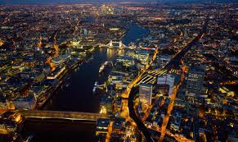
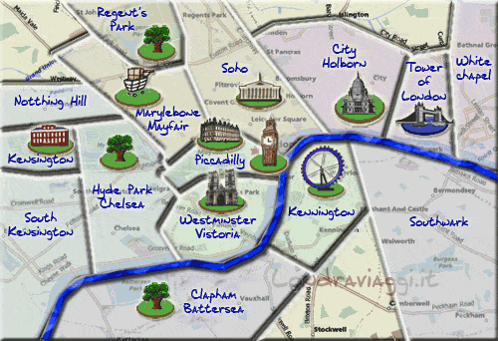
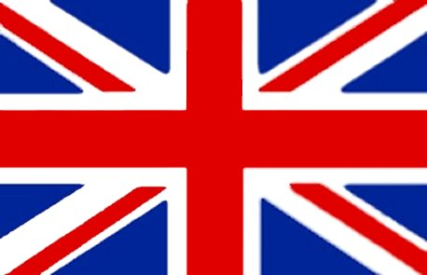
Hi!
This is LONDON,
The capital of England and of the United Kingdom.
It is the largest metropolis with a population of 14 million people.

Slide 2
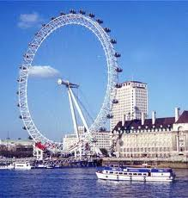
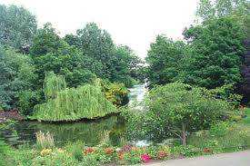
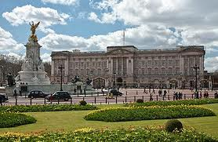
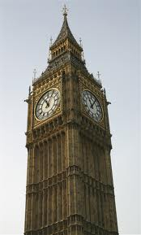
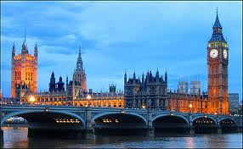
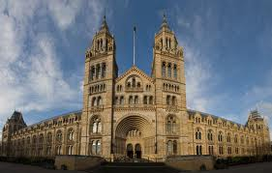
London is a major tourist attraction
The most famous tourist attractions are:
-BIG BEN
-THE HOUSES OF PARLIAMENT
- BUCKINGHAM PALACE
LONDON EYE
Lots of museums
Lots of parks

Slide 3
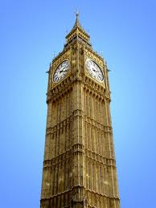
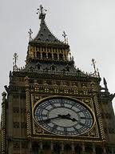
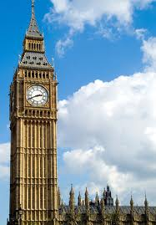
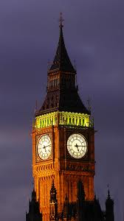
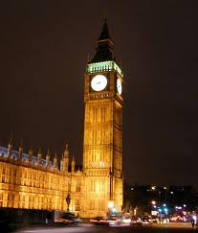
The Big Ben isn’t the clock on the tower, but just the bell inside it.

Slide 4
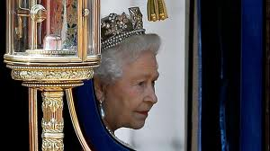
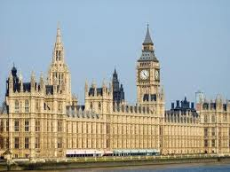
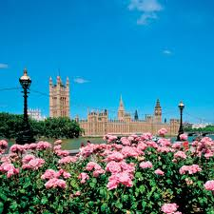
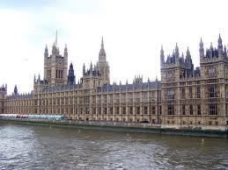
The HOUSES OF PARLIAMENT is where the two Houses of the Parliament (Houses of Commons and Lords) meet for political purposes.

Slide 5
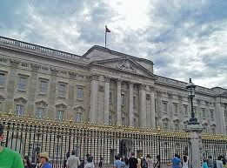
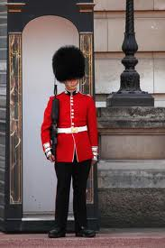
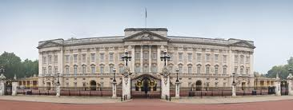
BUCKINGHAM PALACE is the official home of the British Monarch in London. Every morning at half past eleven, people all over the world come to see the changing of the guards. The guards protect the Queen. They wear red uniforms and black bearskin

Slide 6
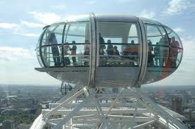
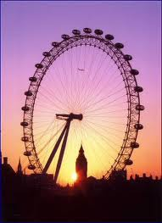
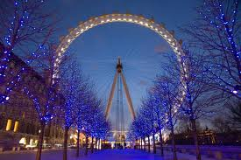
The LONDON EYE was built in 1999 and it is a giant wheel. It is 170 m high and you can see a beautiful London skyline from the top.

Slide 7
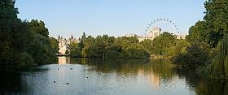
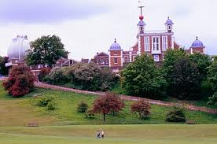
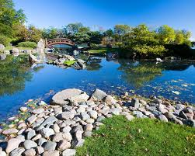
The parks are Hyde Park, where people love swimming, fishing, St James’s, with birds and squirrels, Greenwich park. People often have lunch in these parks, spend their free time.

Slide 8
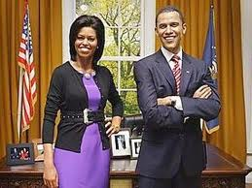
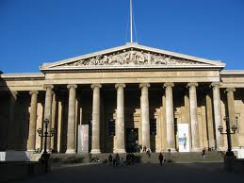
The most important museums are
Madame Tussad’s: in this museum there are wax statues of famous people;
British Museum: it contains collections of mummified skeletons and Greek sculptures from the Parthenon in Athens;
The National Gallery: it is one of the most important art galleries in the world.

Slide 9
THE END
Bye Bye
Cristiana Paglietta IA

