Slide 1
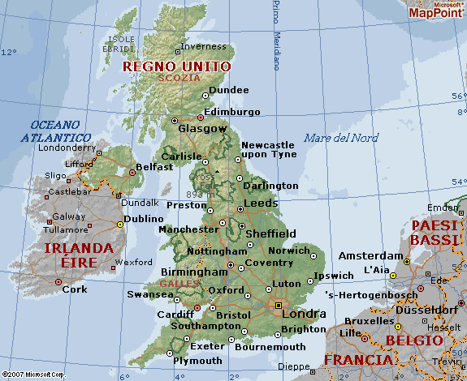
The capital of England is London.

Slide 2
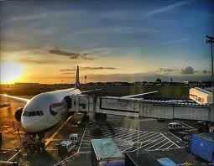
It has got 5 airports and the biggest airport is Heathrow.

Slide 3
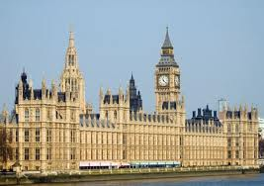
The most famous attractions are: the Houses of Parliament,

Slide 4
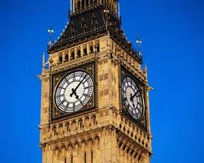
The Big Ben,

Slide 5
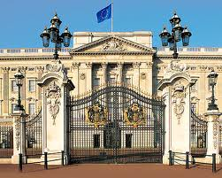
The Buckingham Palace.

Slide 6
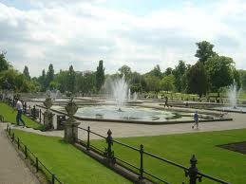
The most famous parks are: Hyde Park,

Slide 7
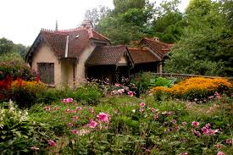
St. James Park,

Slide 8
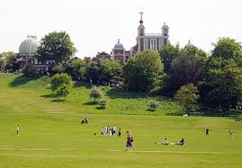
Greenwich Park.

Slide 9
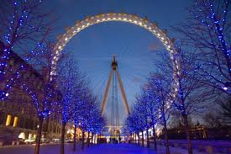
The London Eye is a giant wheel.

Slide 10
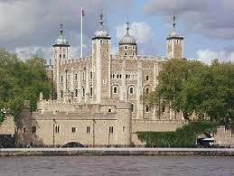
The Tower of London is a historic tower and it is in the centre of London.

Slide 11
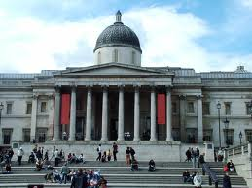
There is, besides, the National Gallery that is an important art gallery.

Slide 12
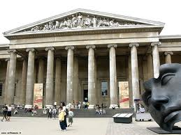
The British Museum contains the Greek sculptures from the Pantheon.

Slide 13
Credits: Adolfo Pagano 1A

