Slide 1
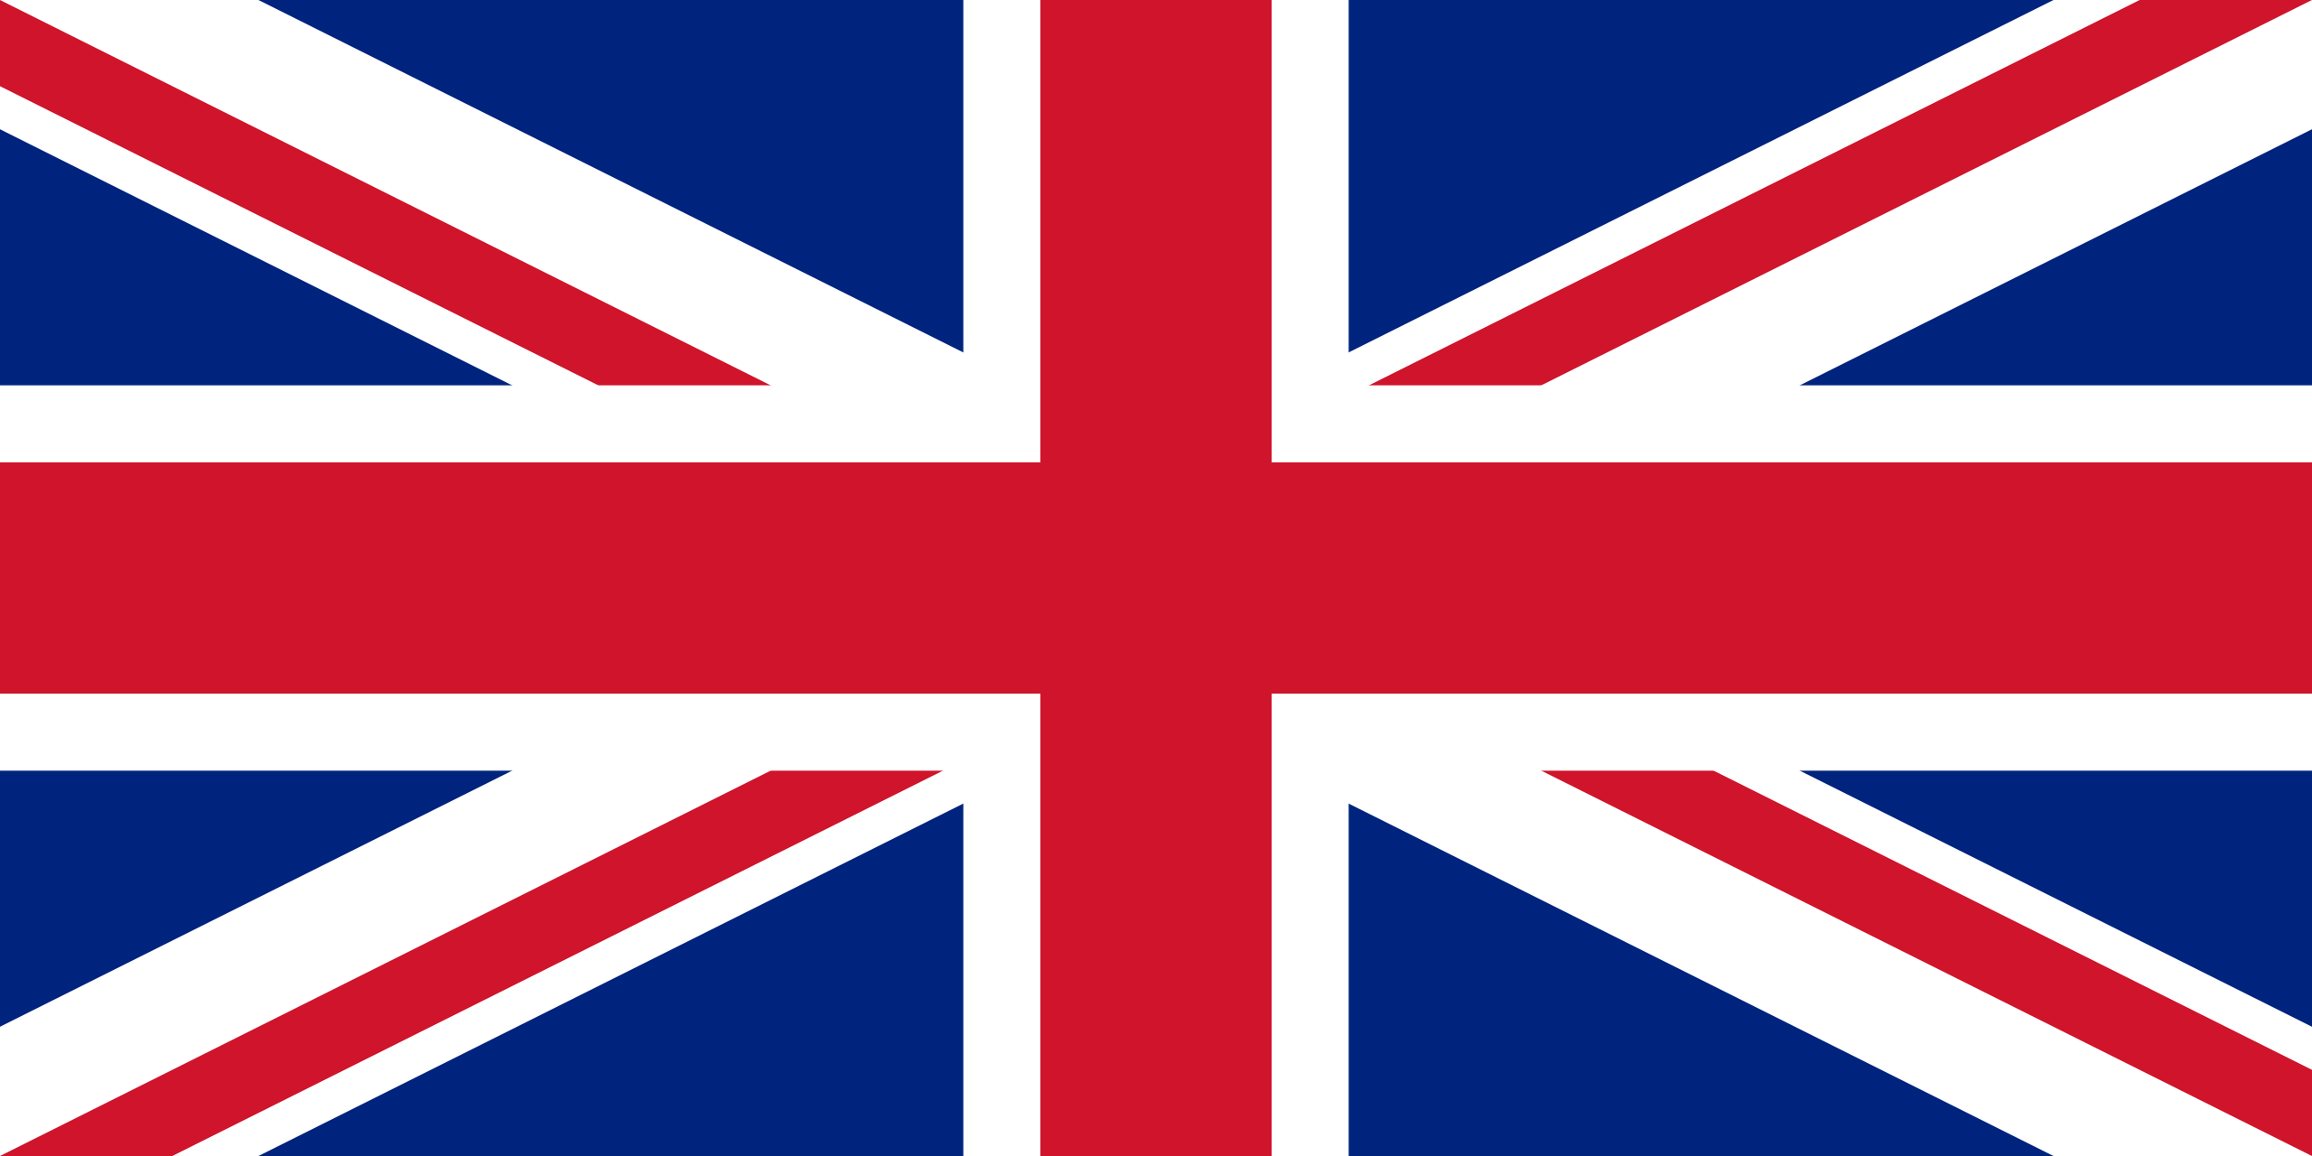
The United Kingdom of Great Britain
by:Francesco De Sio
Carlo Adinolfi

Slide 2
The Union Jack
The Union Flag, also known as the Union Jack, is
the flag of United Kingdom. It is composed of :
St. George’s Cross England
St. Andrew’s Cross Scotland
St. Patrick’s Cross Northen Ireland

Slide 3
United Kingdom

Slide 4
England

Slide 5
Scotland

Slide 6
Northern Ireland

Slide 7
Wales

Slide 8
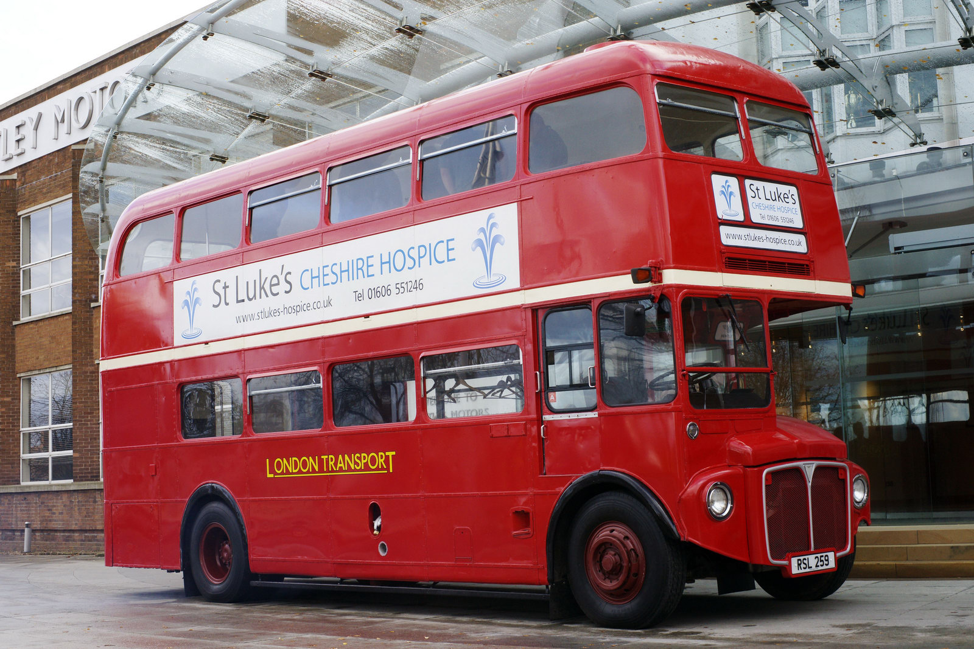
London
London is the capital of England and of the United Kingdom.
London is also the largest metropolis in Europe.
The tourist attraction of London are: the Big Ben, House of Parliament , Buckingham Palace, London Dungeon, Madame Tussaud’s, Tower of London, National Gallery, British Museum, Science Museum and Natural History Museum.
The most important river is Thames.
There are also a lot of parks, the most famous is Hyde Park because there are the Serpentine, a fountain dedicated to Lady Diana and the speaker corner.
The most beauty statues are Peter Pan in Hyde Park, Eros in Piccadilly Circus and Charlie Chaplin in Leicester Square

Slide 9
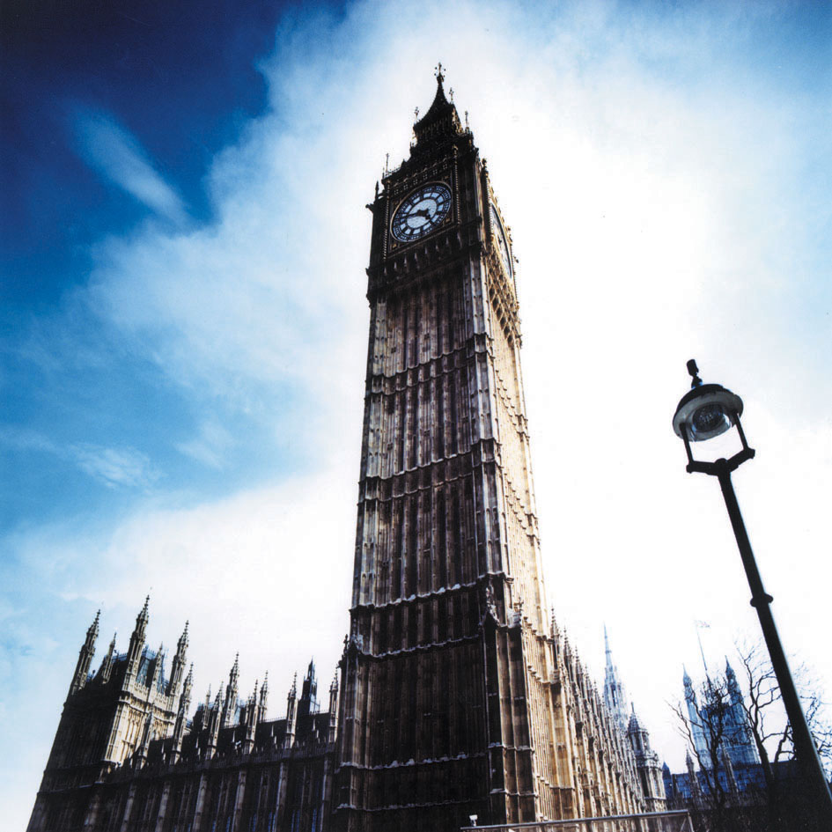
Big Ben
Big Ben isn’t the clock but just the bell inside it
The main bell weighs 13.5 tons. Sounding every quarter of an hour, and its sound is heard in a radius of about two kilometers. The dials measure 8 feet in diameter, the hour hand and minute 2.7 m 4.3. The authors of the site "Big Ben - The World's Most Famous Clock" claim to have personally counted 312 panes of glass, placed in each quadrant, denying it a widespread myth that is believed to have installed 365 plates, one for each day of 'years. Since its entry into operation, the clock was stopped in 3 occasions. Instead he was "dumb" (he remain functional, but lacks the ringing of bells) on several occasions, for reasons of maintenance, in particular for two months in 1934 for 6 months in 1956 and for about a month in 2007.

Slide 10
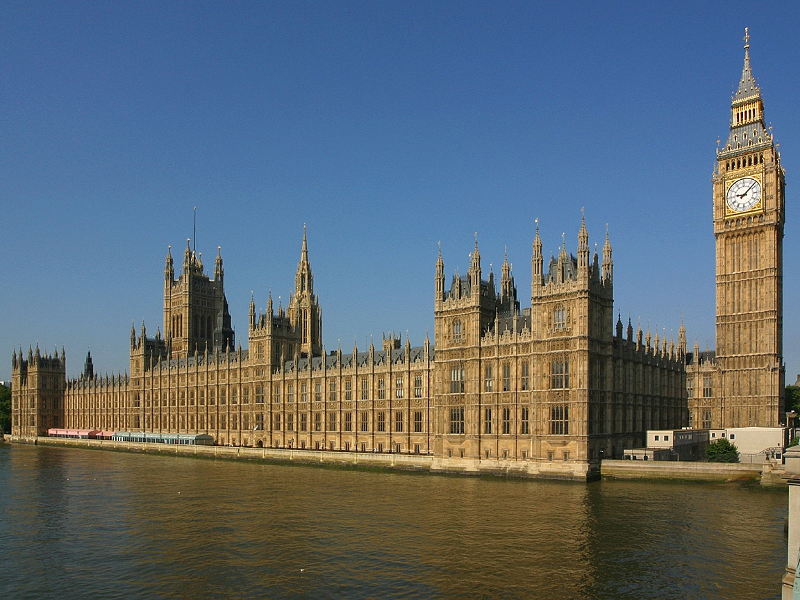
Houses of Parliamient
The Houses of Parliament building in London is the place where they have the two chambers of Parliament of the United Kingdom .It is located on the north bank of the Thames in the City of Westminster, close to other government buildings of Whitehall. The oldest part of the Palace still in existence, Westminster Hall, dates back to 1097. The original purpose of the palace was the royal residence, but no monarch has more than lived there since the sixteenth century. Most of the present structure dates from the nineteenth century, when the building was entirely rebuilt after being destroyed by fire in 1834. The architects responsible for the reconstruction of the palace were Sir Charles Barry and Augustus Welby Northmore Pugin, and the building is an example of Gothic. One of the most famous building is the clock tower, a major tourist attraction that houses the famous Big Ben. The building includes more than 1000 rooms, of which the most important are undoubtedly the House of Lords and the House of Commons

Slide 11
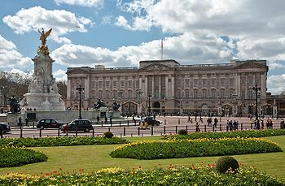
Buckingham Palace
The Buckingham Palace in London is the official residence of the sovereign of the United Kingdom. The expression Buckingham Palace, or simply The Palace has become common to express all of the Court with regard to the environments and the royal family. Besides being the official residence of Queen Elizabeth II, Buckingham Palace is the place where numerous public ceremonies (receptions from the royal visits to the various heads of state) and is also a major tourist attraction (known around the world is the changing of the guard). From a deeper perspective, has always been a point of reference for the subjects, joyful and sad moments in the history of the Kingdom.

Slide 12
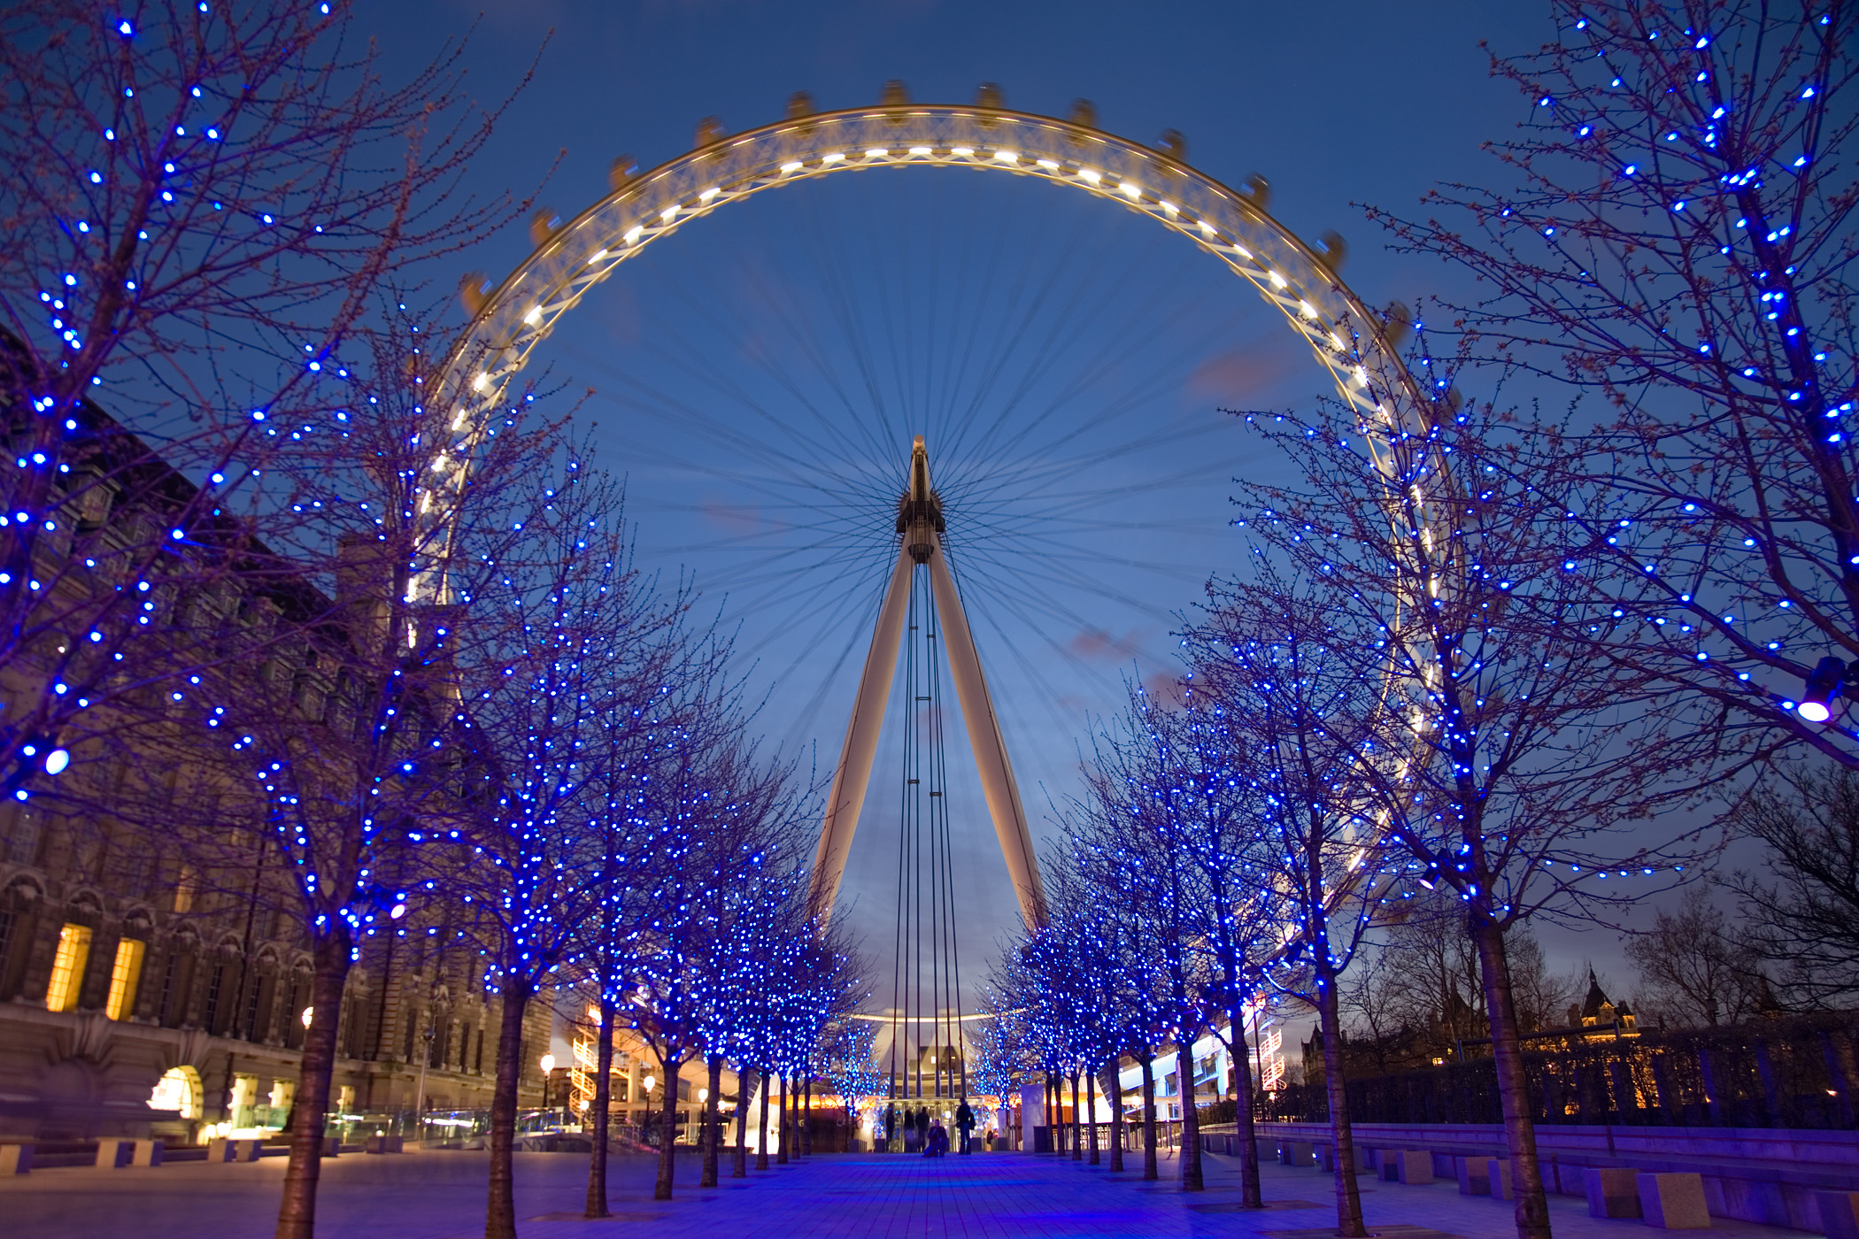
London Eye
The Merlin Entertainments London Eye The only better known as the London Eye ("London Eye"), or even as the Millennium Wheel (Millennium Wheel) is a Ferris wheel built in 1999 and opened to the public in March 2000. With its 135 meters, was the highest in the world until the construction of The Star of Nanchang opened in May 2006 and then the Singapore Flyer, 30 meters higher than the London Eye. The London Eye has become the most popular paid attraction in the United Kingdom, with 3.5 million visitors a year. The London Eye stands for 135 meters at the western end of Jubilee Gardens, on the south bank of the Thames between Westminster Bridge and Hungerford Bridge

Slide 13
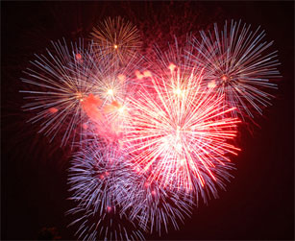
The end

