Slide 1
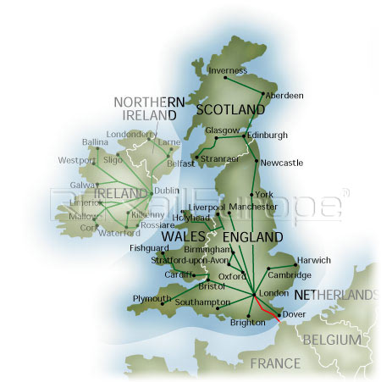
THE UNITED KINGDOM OF GREAT BRITAIN

Slide 2
THE UNITED KINGDOM OF GREAT BRITAIN
It is a monarch state situated in the North-west of Europe .These states are also part of the Commonwealth of which the Quuen is Head of State.
The UK is made up by four countries:ENGLAND
SCOTLAND
WALES
NORTHERN IRELAND
The UK is surronder by the Atlantic Ocean,the North Sea and English Channel which separates the UK from the continent,but it is also linked to France and Europe by the Channel Tunnel.
The Union Flag ,also known as the Union Jack,is the flag of the United Kingdom.
It is composed of the union of three flags:
St. George’s Cross (the national flag of England)
St. Andrew’s Cross (the national flag of Scotland)
St. Patrick’s Cross (the national flag of Northern Ireland)
The red dragon, the national flag of Wales, is noot part of the Union Jack because when the first Union Flag was created Wales was alredy united with England.
Notes:
Fatto da Lorenzo D’amore

Slide 3
THE UNITED KINGDOM OF GREAT BRITAIN
ENGLAND;SCOTLAND;WALES;NORTHERN IRELAND
ATLANTIC OCEAN;NORTH SEA;ENGLISH CHANNEL
ST.GEOGE
ST.ANDREW
ST.PATRICK
RED DRAGON
CHANNEL TUNNEL LINKED TO FRANCE AND EUROPE
UK
COMMONWEALTH OF WHICH THE QUEEN IS HEAD OF STATE
Notes:
Fatto da Lorenzo D’amore

Slide 4
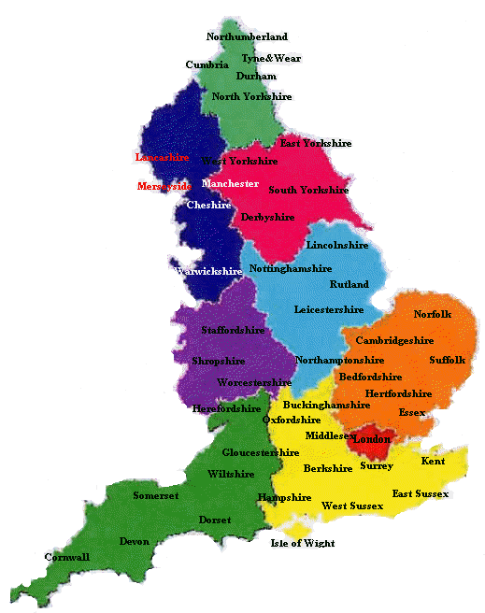
ENGLAND
Notes:
Fatto da Lorenzo D’amore

Slide 5
ENGLAND
England is the largest country of the United Kingdom.It borders with Scotland in the north and Wales in the south-west.The Head of State is Queen Elizabeth II who is also the Head of the Commonwealth.Many important people come from England such as Shakespeare, Tolkien and Newton.It is a protestant country and the monarch is the Head of the Church of England.
The capital city of England is London.
The main river is the Thames.
One of the most famous places in England is Stonehenge, a prehistoric monument, composed of stones.
Notes:
Fatto da Lorenzo D’amore

Slide 6
ENGLAND
BORDERS , CAPITAL AND
RIVER
SCOTLAND/NORTH - WALES/SOUTH-WEST
LONDON
POLITICAL AND RELIGION
QUEEN ELIZABETH II
PROTESTANT
PLACES AND FAMOUS PEOPLE
STONEHENGE
SHAKESPARE;TOLKIEN;NEWTON
THAMES
Notes:
Fatto da Lorenzo D’amore

Slide 7
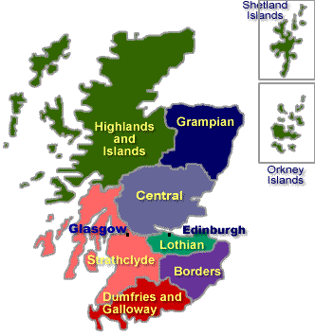
SCOTLAND
Notes:
Fatto da Lorenzo D’amore

Slide 8
SCOTLAND
Scotland is one of the four countries of the United Kingdom. Edinburgh is the capital city, but the largest city is Glasgow.
Scotland has its own Church, the Church of Scotland,which is Presbyterian. Bagpipes and kilts are typical of Scotland.
William Wallace is one of the most famous Scots together with Sean Connery.
Famous musician of Scotland include Annie Lennox, Wet Wet Wet, Travis and Simple Minds.Scotland is famous for medieval castles and Loch Ness Lake
A legend tells about a mysterious monster in the depths of the water.
Notes:
Fatto da Lorenzo D’amore

Slide 9
SCOTLAND
SCOTLAND
CAPITAL IS EDINBURGH
BIG CITY IS GLASGOW
IT IS IN UK
CHURCH OF SCOTLAND
PRESBYTERIAN
MEDIEVAL CASTLE AND LOCH NESS LAKE
(A MYSTERIOUS MONSTER IN WATER)
BAGPIPES AND KILTS
WILLIAM WALLACE, WET WET WET, TRAVIS AND SIMPLE MINDS
Notes:
Fatto da Lorenzo D’amore

Slide 10
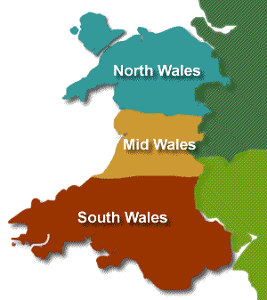
WALES
Notes:
Fatto da Lorenzo D’amore

Slide 11
WALES
Wales is situated in the south-west of the UK and borders only with England. Cardiff is its capital city. Wales’s main languges are Welsh and English.
The largest religion is Christianity. Saint David is the patron saint of Wales.Catherine Zeta Jones and Tom Jones are from Wales.
The national flag of Wales is the red dragon. The dragon is a very old Welsh symbol. In the Millennium Stadium in Cardiff there are rugby matches, football matches and concerts.Conwy Castle is in North Wales.
It’s 800 years old and it’s got eight towers. The smallest house in Britain is in Conwy.There’s one room upstairs and one room downstairs.
Love spoons are the main symbol in Wales: they stand for friendship and good luck.
Notes:
Fatto da Lorenzo D’amore

Slide 12
WALES
WALES
SOUTH-WEST CARDIFF ENGLISH AND WELSH
CHRISTIANITY SAINT DAVID RED DRAGON
CONWY CASTLE SMALL HOUSE CONWY LOVE SPOONS
CATHERINE ZETA JONES AND TOM JONES
MILLENIUM STADIUM
Notes:
Fatto da Lorenzo D’amore

Slide 13
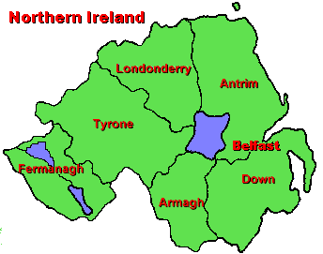
NORTHERN IRELAND
Notes:
Fatto da Lorenzo D’amore

Slide 14
NORTHERN IRELAND
It is part of the UK, but it is not situated on the Island of Great Britain.It borders only with the Republic of Ireland which is an indipendent country and is not part of the UK.
Belfast is Northern Ireland capital and largest city. For many years Northern Ireland has been split in two and there have been many battles, wars and deaths
This violence has been for religious reasons. Saint Patrick is the Patron Saint.
Notes:
Fatto da Lorenzo D’amore

Slide 15
NORTHERN IRELAND
BORDER WITH REPUBLIC OF IRELAND
BELFAST
IRELAND IS INDIPENDENT
NORTHERN IRELAND
SAINT PATRICK
MANY BATTLES;WARS AND DEATHS
Notes:
Fatto da Lorenzo D’amore

Slide 16
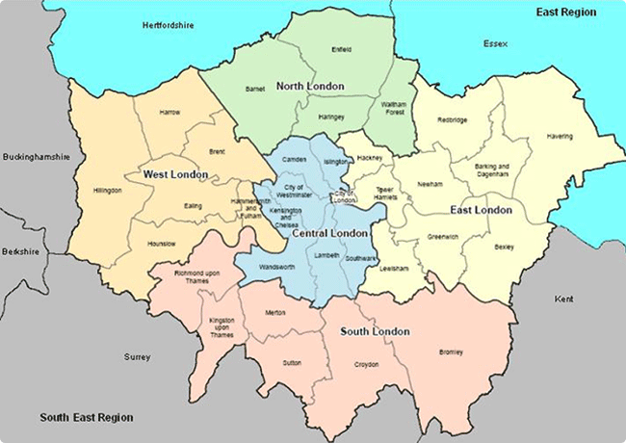
LONDON
Notes:
Fatto da Lorenzo D’amore

Slide 17
LONDON
London is the capital of England and of the United Kingdom. It is the largest metropolis in Europe with a population of 14 milion people. Its population is very cosmopolitan.
London is a major tourist attraction.It has 5 international airports (Heathrow is the biggest. The most famous tourist attractions are Big Ben, the Houses of Parliament and the Queens Palace, Buckingham Palace .
London is a green city with lots of parks. The most famous parks are Hyde Park, where people swimming, fishing and going out in boats on the Serpentine,the river in Hyde Park. St James’s Park with birds and squirrels, great for picnics and Greenwich Park.People often have lunch in the parks, spend their free time and children can enjoy themselvesin many pools and little lakes.
In Madame Tussaud’s waxworks museum there are wax statues of famous people.
The Tower of London is a historic tower in the centre of London. It is 900 years old. William the Conqueror built the White Tower in 1067 by the River Thames. It was a fortress, a royal palace and a prison. Many prisoners were executed in this tower. Now you can see the crown Jewels in the Tower of London.
London has many important museums such as the British Museum and the National Gallery. The British museum contains Egyptian collections of mummified skeletons found in the pyramids, and Greek sculptures from the Parthenon in Athens. The National Gallery is one of the most important art galleries in the world.
Notes:
Fatto da Lorenzo D’amore

Slide 18
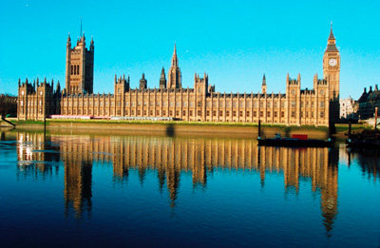
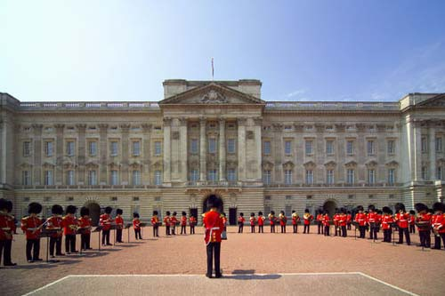
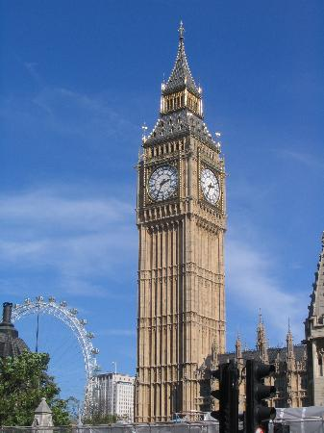
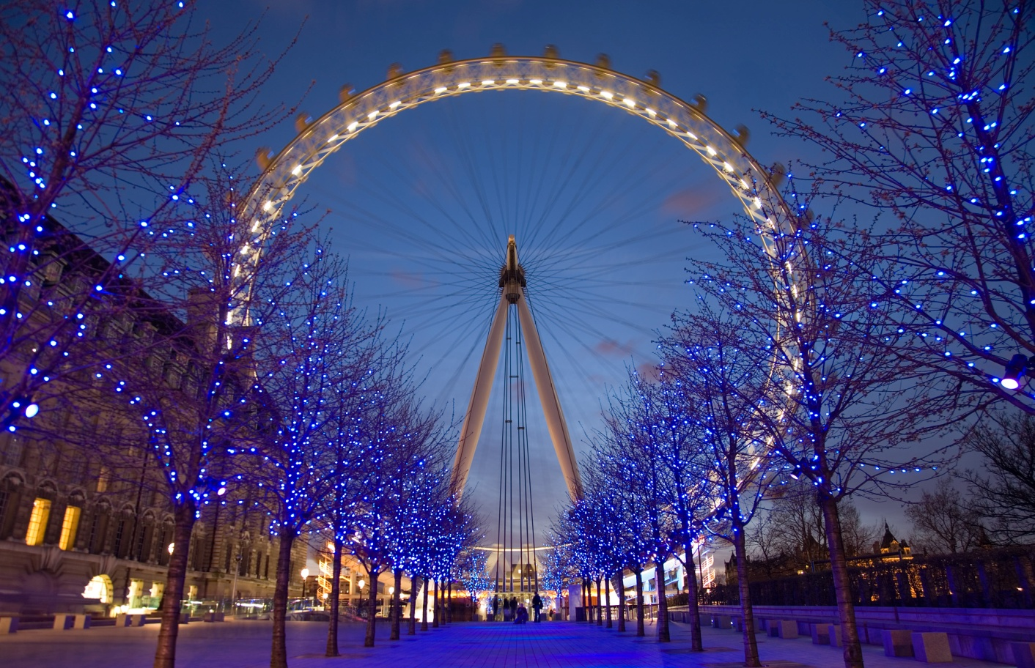
MONUMENT AND ATTRACTION OF LONDON
Notes:
Fatto da Lorenzo D’amore

Slide 19
MONUMENT AND ATTRACTION OF LONDON
The Palace of Westminster, also known as the Houses of Parliament or Westminster Palace, is the meeting place of the two houses of the Parliament of the United Kingdom —the House of Lords and the House of Commons. It lies on the north bank of the River Thames in the heart of the London borough of the City of Westminster, close to the historic Westminster Abbey and the government buildings of Whitehall and Downing Street. The name may refer to either of two structures: the Old Palace, a medieval building complex, most of which was destroyed in 1834, and its replacement New Palace that stands today.
Big Ben is the name of the bell of the Great Clock of Westminster Main, on the Clock Tower (Clock Tower, dedicated to St. Stephen), located at the northeast corner of the Palace of Westminster, also known as the Houses of Parliament in London . It is traditionally called the Big Ben clock tower the whole, 96.3 meters high, built in Gothic style. Officially, the name of the bell (one of five clock), however, is &quot;Great Bell. The first claims that the name comes from Sir Benjamin Hall, a member of the House of Commons and the works supervisor for the reconstruction of the Palace of Westminster. The second holds that the name derives from the name of the heavyweight champion of boxing Benjamin Caunt, who fought his last meeting in 1857.
The Buckingham Palace in London is the official residence of the sovereign of the United Kingdom. The expression Buckingham Palace, or simply The Palace has become common to express all of the Court with regard to the environments and the royal family. Besides being the official residence of Queen Elizabeth II, Buckingham Palace is the place where numerous public ceremonies (receptions from the royal visits to the various heads of state) and is also a major tourist attraction (known around the world is the changing of the Guard).
Notes:
Fatto da Lorenzo D’amore

Slide 20
LONDON
LONDON
METROPOLIS/CAPITAL OF ENGLAND/5 AIRPORT/COSMOPOLITAN/TOURIST ATTRACTION/
HOUSES OF PARLIAMENT
BIG BEN BUCKINGHAM PALACE LONDON EYE MADAME TUSSAUD’S TOWER OF LONDON
PARKS: HYDE PARK(SERPENTINE) ST JAMES PARK GREENWICH PARK
MUSEUMS: BRITISH MUSEUM(EGYPTIAN/GREEK SCULPTURES) NATIONAL GALLERY(ART GALLERY IN THE WORLD)
Notes:
Fatto da Lorenzo D’amore

