Slide 1
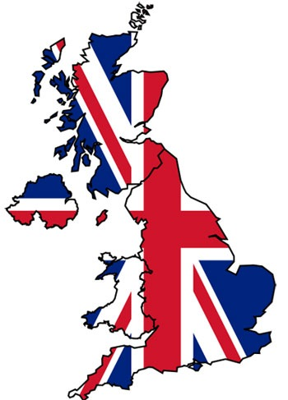
THE UNITED KINGDOM OF GREAT BRITAIN
It is a monarch state situated in the North-West of Europe.
UK is composed of four countries:
1-England
2-Scotland
3-Wales
4-Northern Ireland
The Uk is surrounded by Atlantic Ocean,the North Sea and the English Channel that separates the UK from the continent.
The flag of the UK is the UNION FLAG,also known as the UNION JACK.
It is composed of the union of three flags:
_St.George’s Cross(the national flag of England)
_St.Andrew’s Cross(the national flag of Scotland)
_St.Patrick’s Cross(the national flag of Northern Ireland)
The red dragon, the national flag of Wales, isn’t part of the Uk.

Slide 2
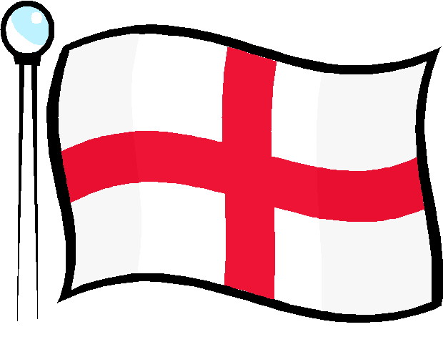
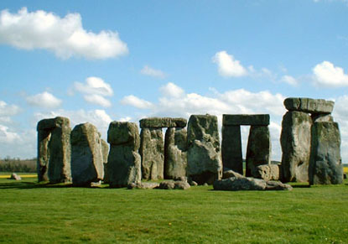
ENGLAND
England borders with Scotland in the North and Wales in the South-West.
The capital city of England is London.
The Head of State is Queen Elizabeth II who is also the Head of the Commonwealth.
It is a protestant country.
The main river is the Thames.
One of the most famous places in England is Stonehenge.

Slide 3
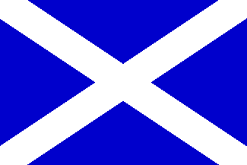
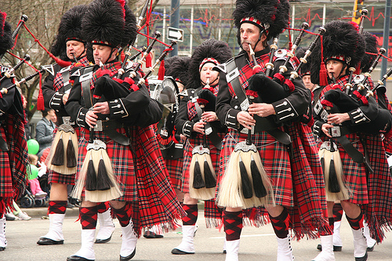
SCOTLAND
Edinburgh is the capital of city,but the largest city is Glasgow.
Bagpipes and kilts are typical of Scotland.
Scotland is famous for medieval castles and Loch Ness lake.

Slide 4
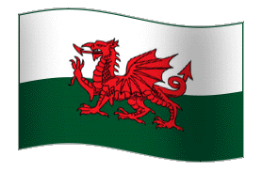
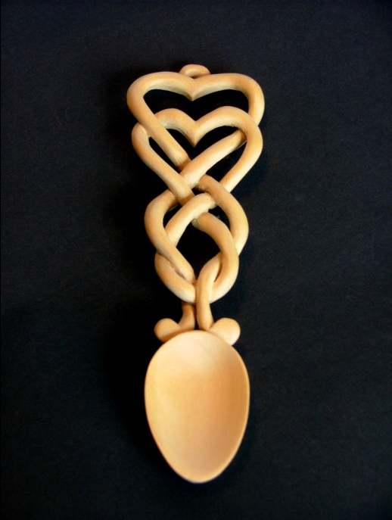
WALES
Wales is situated in the South-West of the UK and bordes only with England.
Cardiff is its capital city.
Wales’s main languages are Welsh and English.
The largest religion is Christianity. Saint David is the patron saint of Wales.
The national flag of Wales is the red dragon. The dragon is a very old Welsh symbol.
In the millennium Stadium in Cardiff there are rugby matches and concerts.
The smallest house in Britain is in Conwy.
Love spoons are the main symbol in Wales.

Slide 5
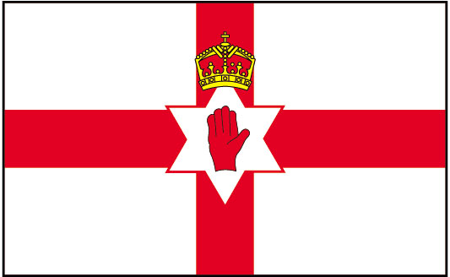
NORTHERN
IRELAND
Belfast is
Northern Ireland
Capital and
Largest city.
It borders only with the Republic of Ireland which is an independent country and isn’t part of the UK.
Saint Patrick is the Patron Saint.
It is part of the UK, but it isn’t situated on the Ireland of Great Britain.

Slide 6
CONCEPTUAL MAPS
North-West
Europe
Monarch
State
_Atlantic Ocean
_North-Sea
_English-Channel
_Channel Tunnel
UNITED KINGDOM
OF
GREAT BRITAIN
Union Flag
Composed of:
-England
-Scotland
-Wales
-Northern Ireland
England
Northern
Ireland
Scotland

Slide 7
Stonehenge
London
ENGLAND
Thames
_Scotland North
_Wels South-West
Protestant Country
Queen
Elizabhet II

Slide 8
-Medieval Castle
-Lockness
Lake
Edinbourgh
SCOTLAND
Bagpipes and Kilts
Glasgow

Slide 9
Love Spoons
South-West
Smallest House is Cnowy
WALES
England
Millennium
Stadium
Cardiff
Welsh and
English
Red Dragon
Christianity
St.David
Symbol is
Dragon

Slide 10
Indipendent Country
Republic of
Ireland
Northen
Ireland
Isn’t
Part of
UK
Belfast
St.Patrik

Slide 11
London is the capital of England and of the United Kindom.
It is the largest metropolis in Europe with a population of 14 million people.
London is a major tourist attraction.It has 5 international airports.Heathrow is the biggest.
The most famous tourist attractions are the Big Ben,the Houses of Parliament and the Queens Palace and Buckingham Palace.
London is a green city with lots of parks.

Slide 12
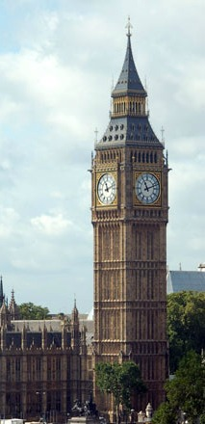
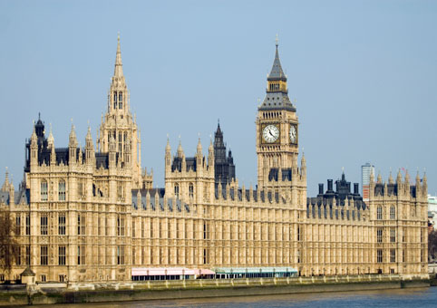
BIG BEN AND THE HOUSES OF PARLIAMENT
Big Ben isn’t the clock
on the tower!
But just the bell
inside it.
The Houses of Parliament is where the two Houses of the
Parliament (Houses of Commons and Lords) meet for political purposes.

Slide 13
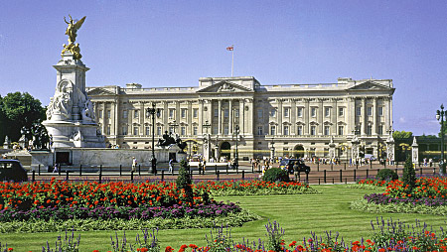
BUCKINGHAM PALACE
Buckingham palace is the official home of the British Monarch in London. It is also a famous tourist attraction
because of the Queen’s Royal guards. Every morning at half past eleven people all over the world come to see the changing of the guards. The guards protect the Queen day and night. They wear red uniforms and black bearskins.

Slide 14
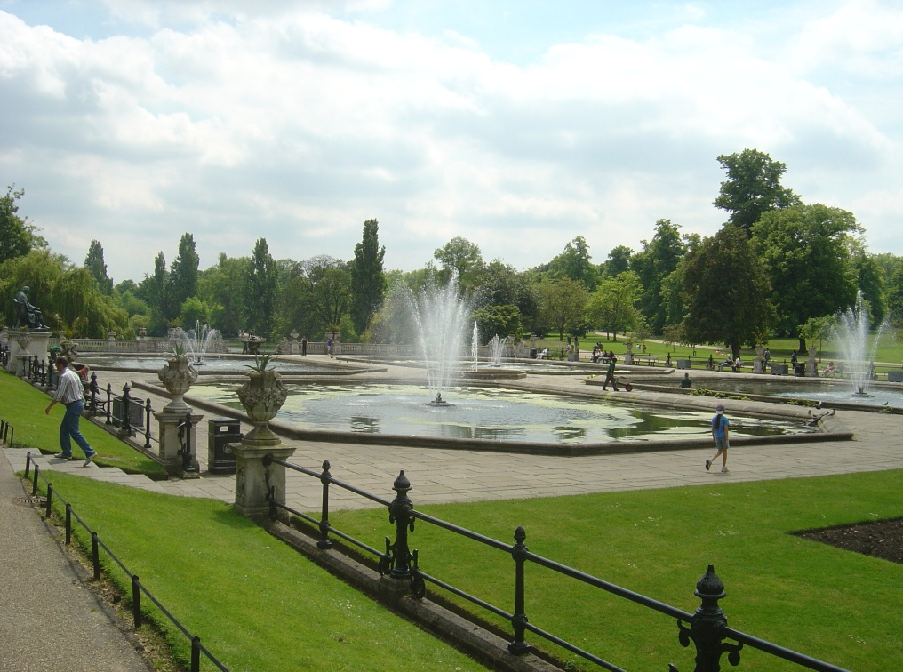
PARKS IN LONDON
The most famous are Hyde Park,where people love swimming, fishing and going out in boats on the Serpentine, the river in Hyde Park ,
St James’s Park,with birds and squirrels, great for picnics,
and Greenwich park.
People often have lunch in the parks.

Slide 15
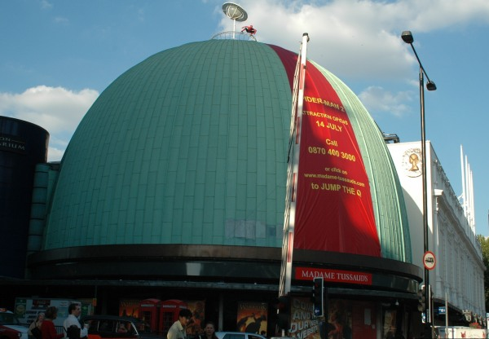
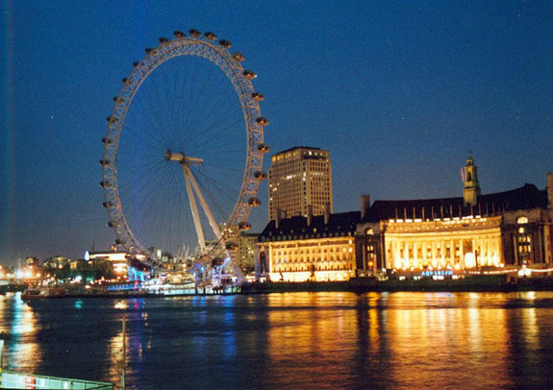
MADAME TUSSAUD
In Madame Tussaud’s waxworks museum there are wax statues of famous people.
LONDON EYE
The London Eye, also known as the Millennium Wheel,was build in 1999 and is a giant wheel. It is 170 m high and you can see the beautiful London skyline from the top.

Slide 16
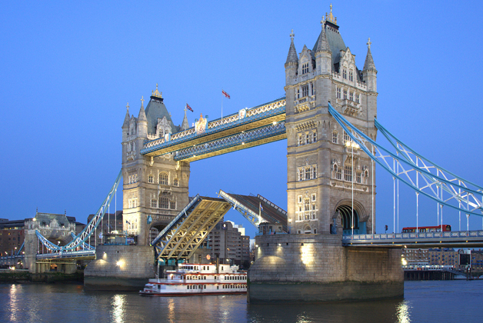
TOWER OF LONDON
The Tower of London is a historic tower in the centre of London. It is 900 years old. William the Conqueror build the White Tower in 1067 by the River Thames. It was a fortress, a royal palace, and a prison. Many prisoners were executed in this tower. Now tou can see the crown jewels in the Tower of London.

Slide 17
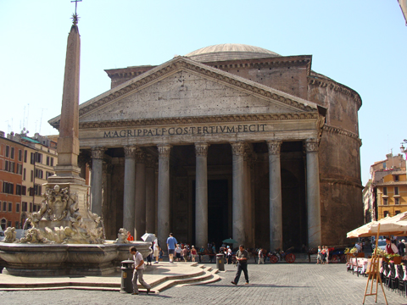
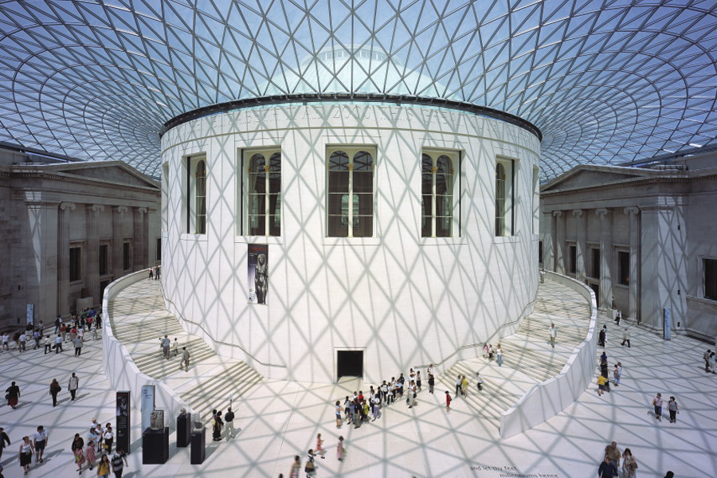
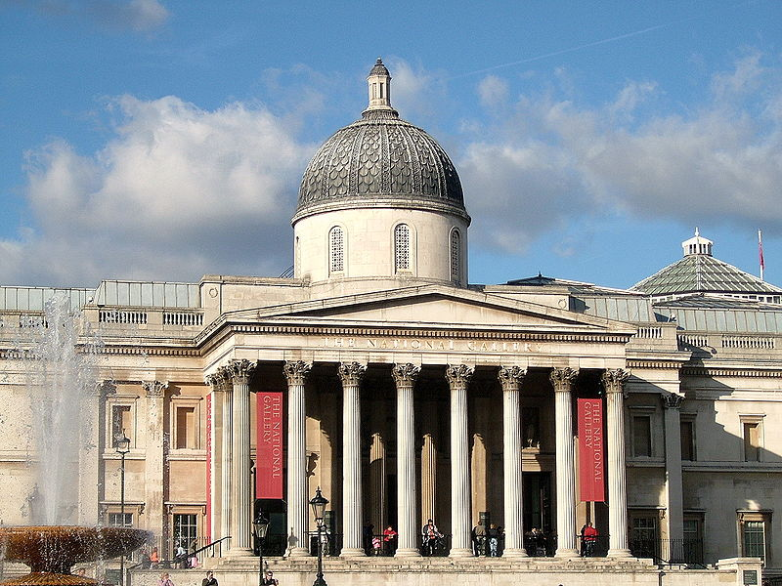
MUSEUMS
London has many important museums such as the British Museums and National Gallery. The British museums contains Egyptian collections of mummified skeletons found in the pyramids, and Greek sculptures from the Parthenon in Athens. The National Gallery is one of the most important art galleries in the world.

Slide 18
CONCEPTUAL MAPS
LONDON
England and
UK
The Largest Metropolis
Many
Parks
5 Airports.
The biggest is Heathrow
Tourist Attractions
Buckingham Palace
Big Ben
Houses of Parliament
Queens Palace

