Slide 1
A TO Z INTERNET

Slide 2
All email addresses have the @ symbol
@ = at in English
.=dot in English

Slide 3
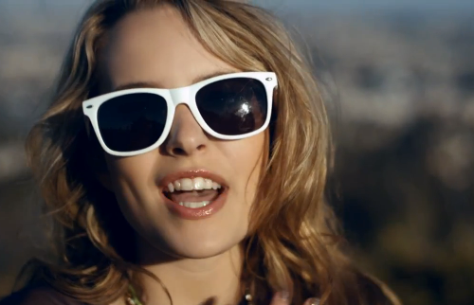
a type of diary that you put on Internet is called BLOG☺♥☻
Blog ready or not? ♥

Slide 4
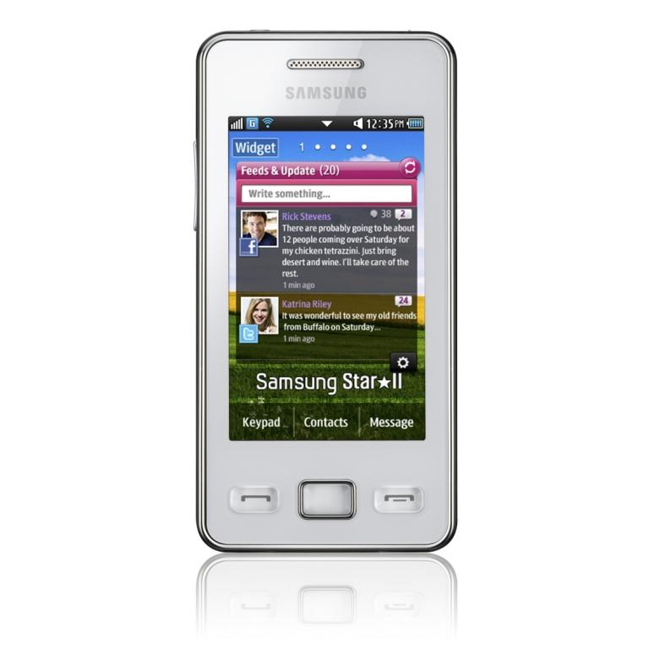
You click with the mouse to make your computer do something ♪

Slide 5
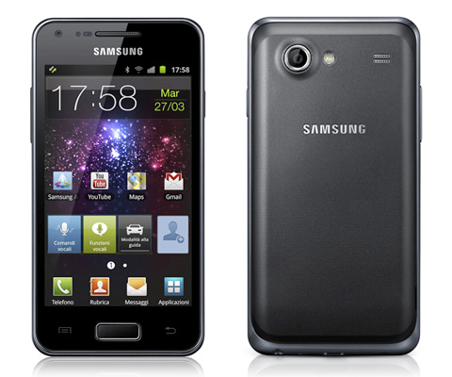
When you take text, music or video from Internet, you download it.
♥↨$

Slide 6
You use email (electronic mail) to send and receive messages on your computer via internet
▲☺

Slide 7
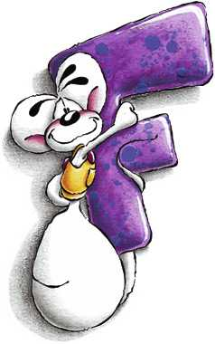
You can keep a list of your favourite websites (called favourites) on your computer. ☺

Slide 8
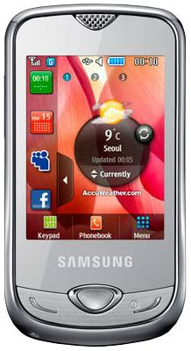
You click Go to start a search on Internet.
☻

Slide 9
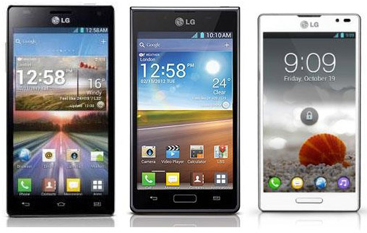
You can use symbols to add humour to your email messages. For example:
☺= amused | ☹= sad | ☺) very happy | != surprised

Slide 10
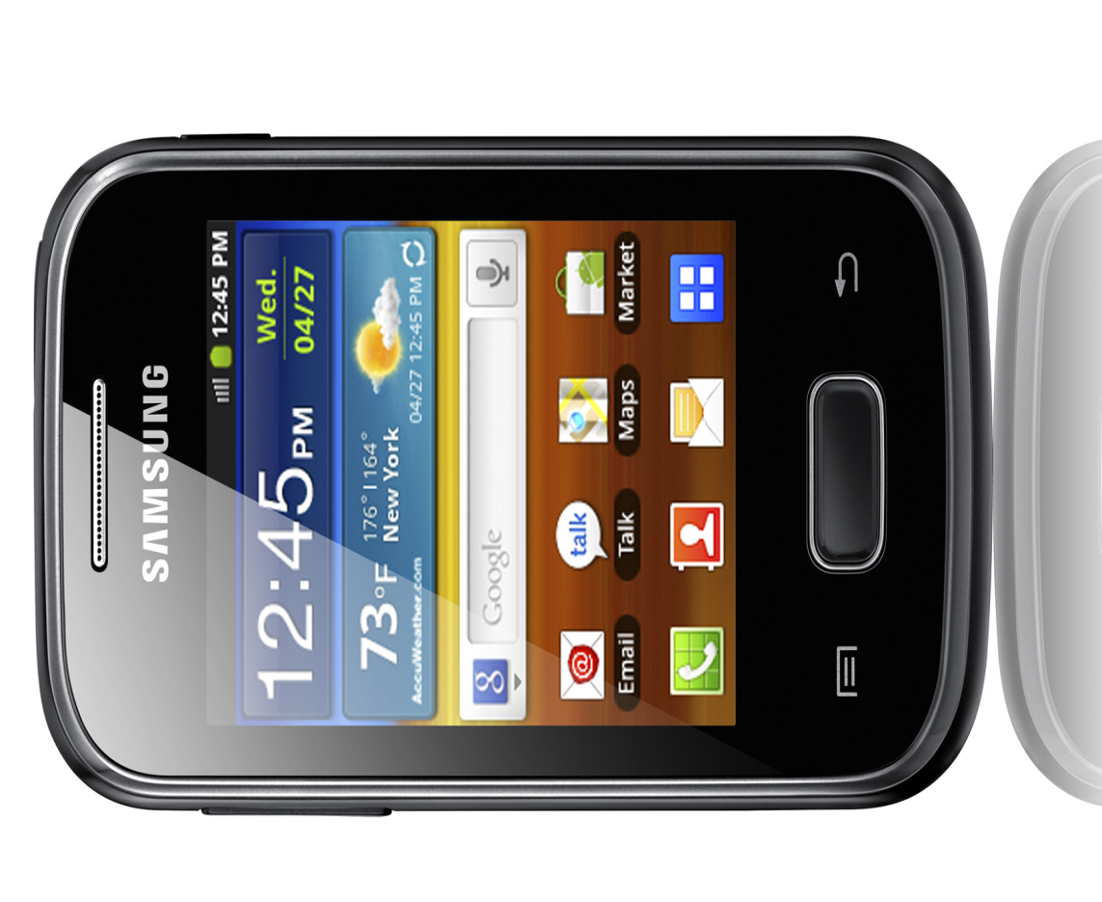
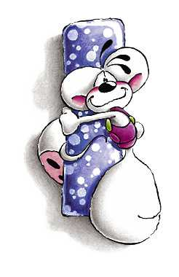
You can use Internet for instant messaging. You send a message and you receive a reply immediately. It’s like a written conversation. ♪♥

Slide 11
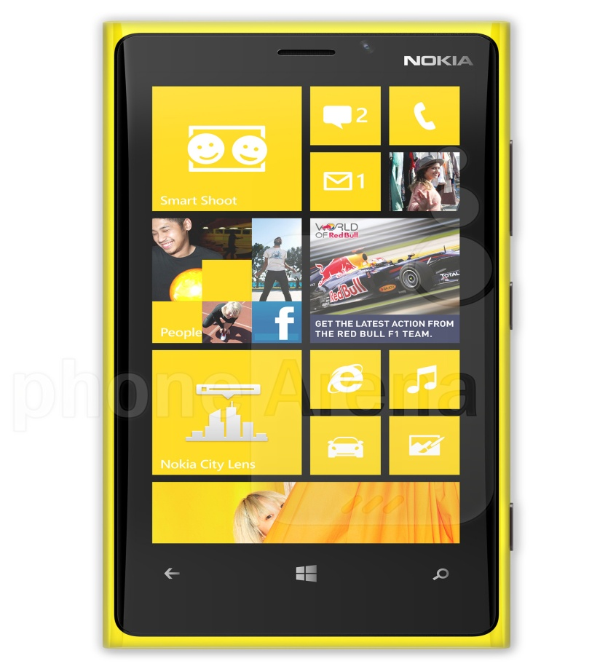
You sometimes receive emails that you didn’t ask for and didn’t want. This is junk mail or spam.
☻

Slide 12
You use the keyboard to type messages.
☻☺♪

Slide 13
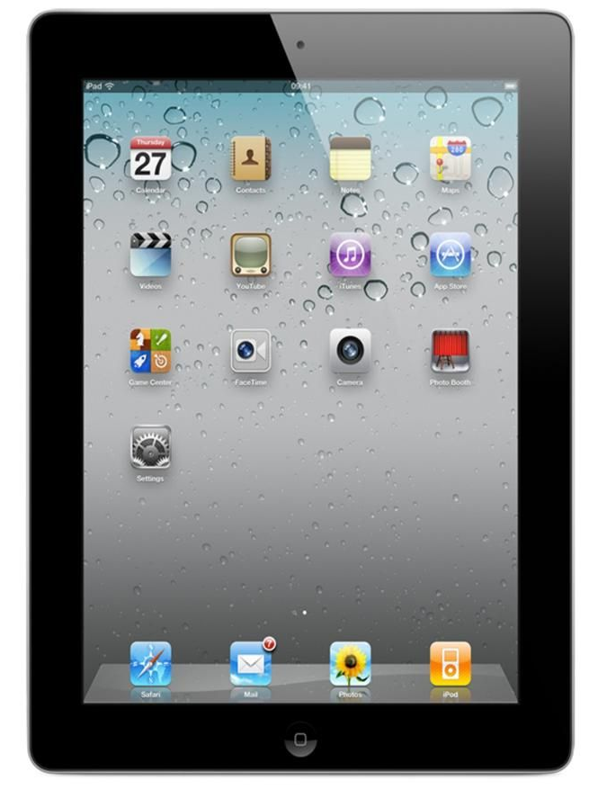
A link connects one web page to another. It’s usually a word or phrase in blue and underlined.
☺♥

Slide 14
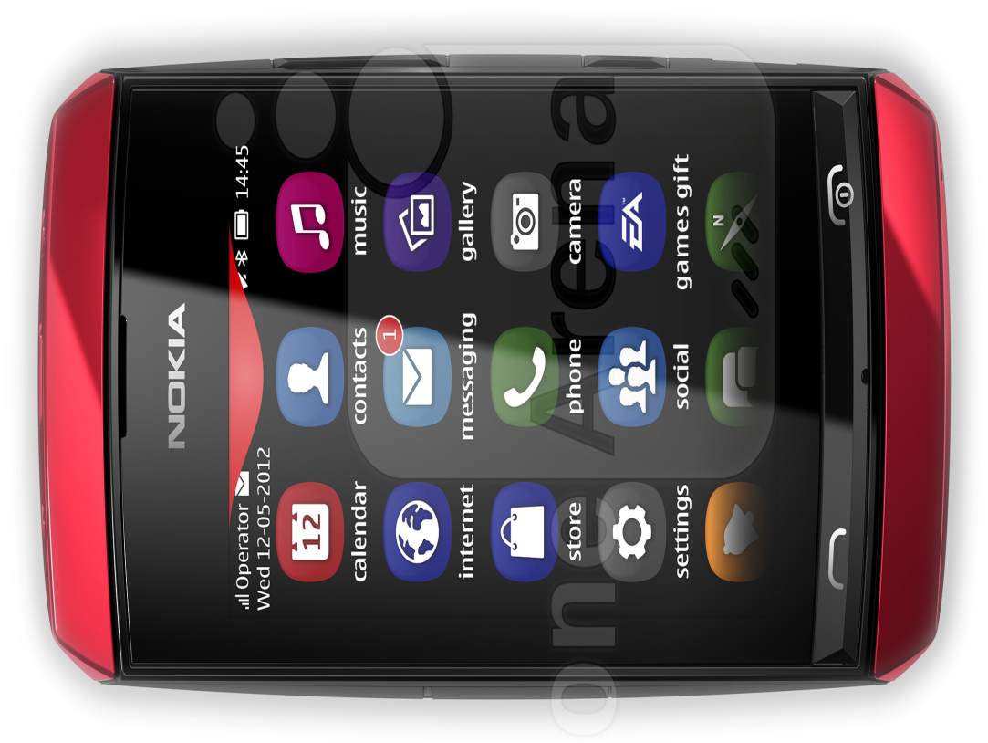
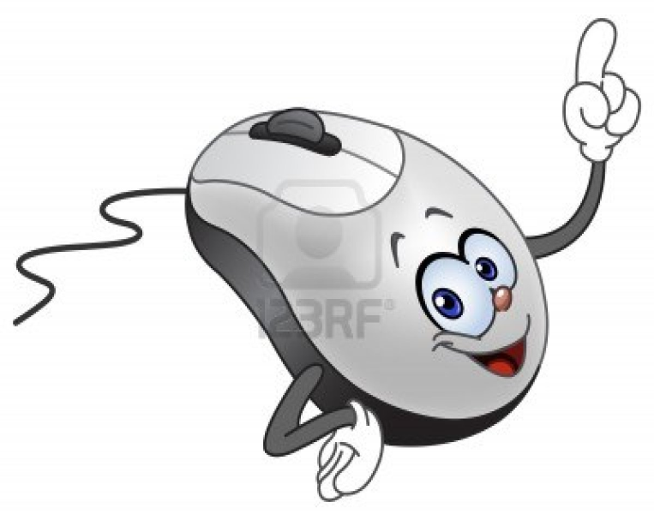
You use the mouse to move around the screen of your computer.
$☺♥§

Slide 15
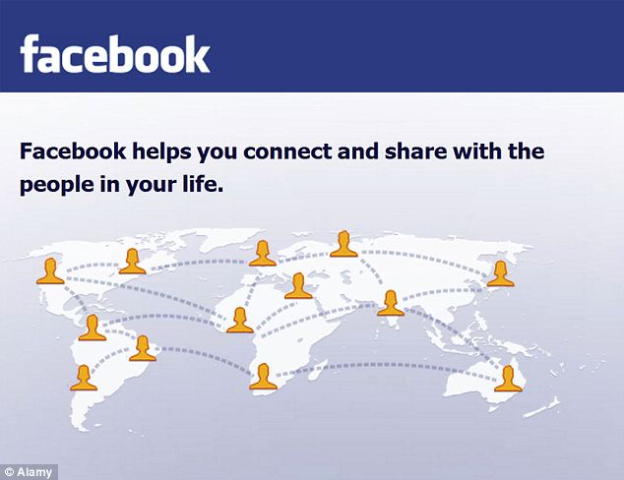
The Net in another word for Internet.
☺♪☻

Slide 16
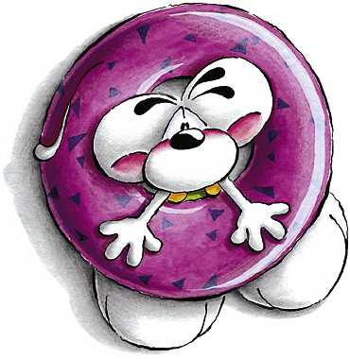
Online means connected to Internet.
♪☻☺

Slide 17
You can download a podcast (a radio programme or a video) from Internet and play it on your iPod (mp3 player).
♣♠♥☻☺

Slide 18
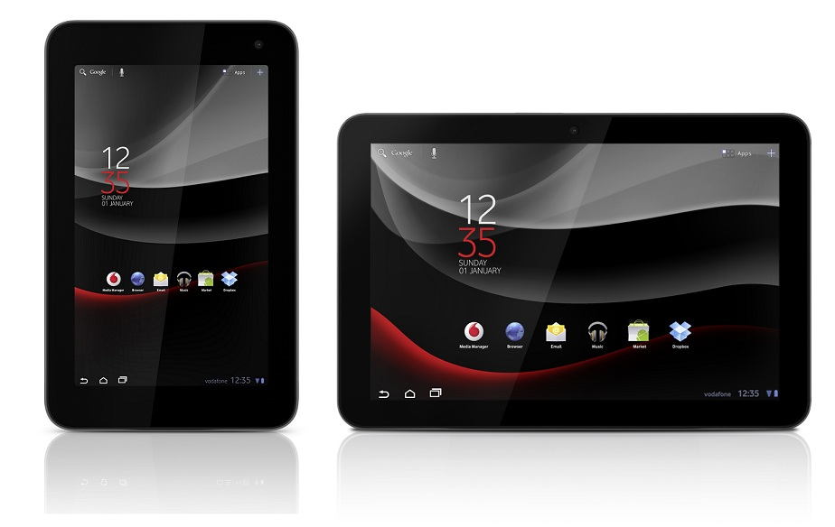
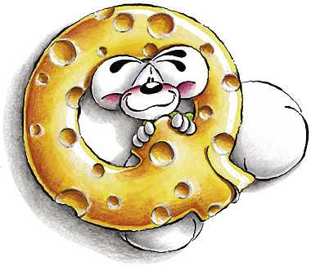
When you quit a computer program, you close it.
☺♥☻

Slide 19
You send a message and you receive a reply.
☺☻

Slide 20
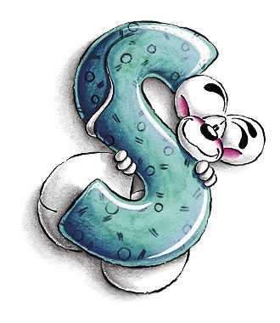
You surf Internet to find information.
♠♣♦♥☻☺

Slide 21
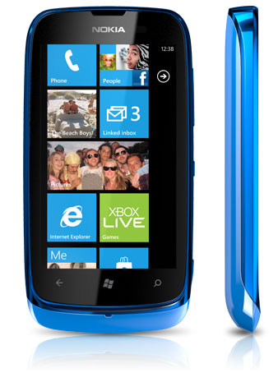
There are tools. They’re on the toolbar.
☻☺

Slide 22
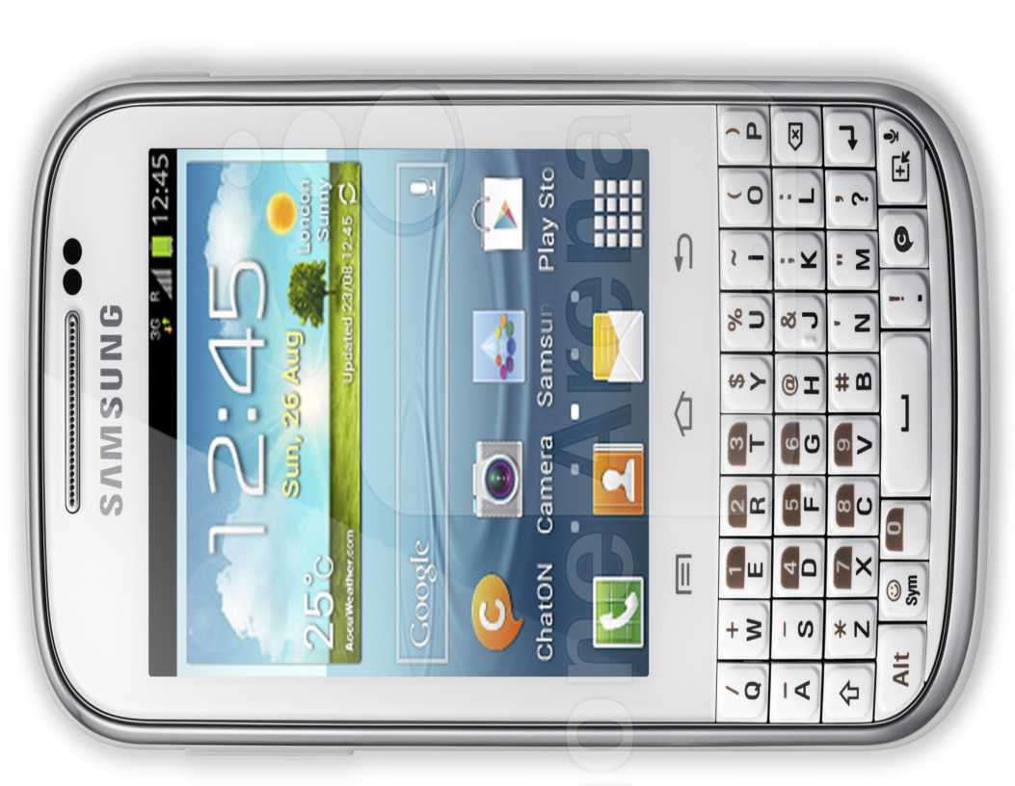
Your username is your email name, e. g. spiderman@italweb.net.
♥♣♠○•

Slide 23
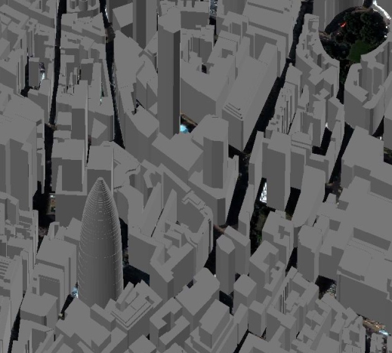
Type ‘virtual tour of London’ into Google and explore the capital of Great Britain!
♥♠♣

Slide 24
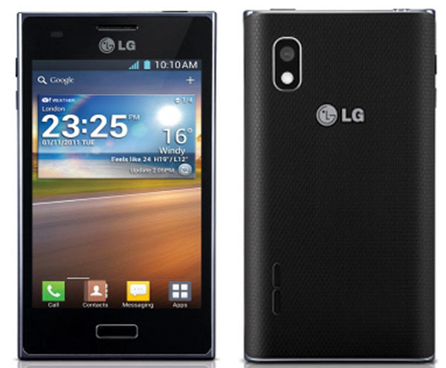
A webcam is a camera connected to a computer.
•○►♥

Slide 25
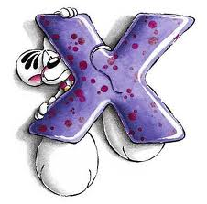
You can write the letter x at the end of your emails to send a kiss.
♣☻♥

Slide 26
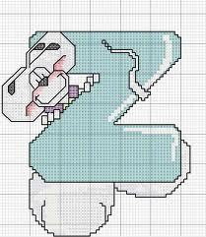
Don’t stay up late surfing Internet. Go to bed!
☻♥

Slide 27
A project by: Tiano Lucia, Spagna Elena and Giglio Paolo

