Slide 1

My personal English alphabet

Slide 2
A
I like Animals

Slide 3
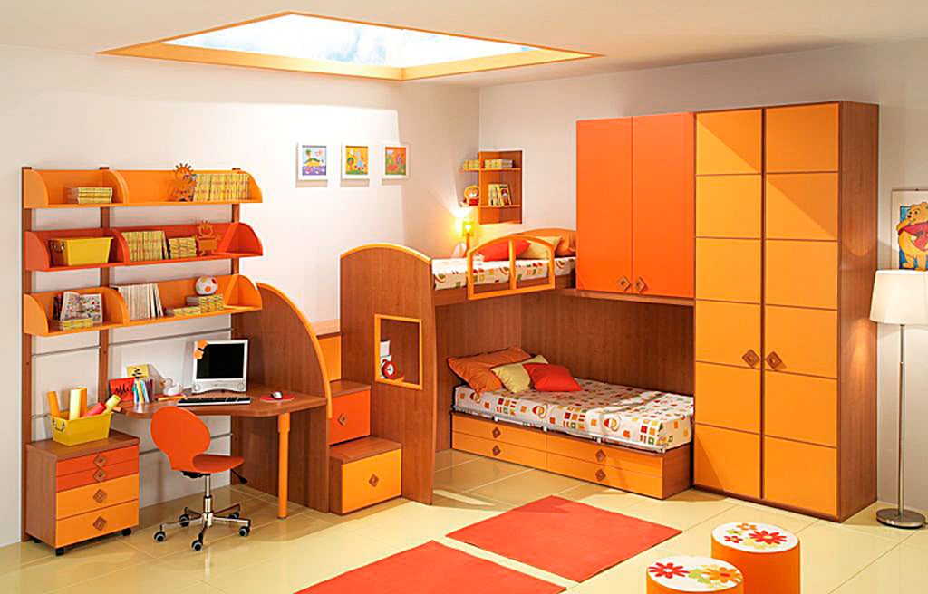
B
My favourite room is Bedroom

Slide 4
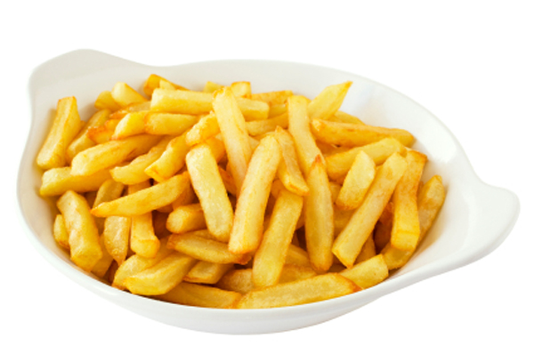
C
My favourite food is Chips

Slide 5
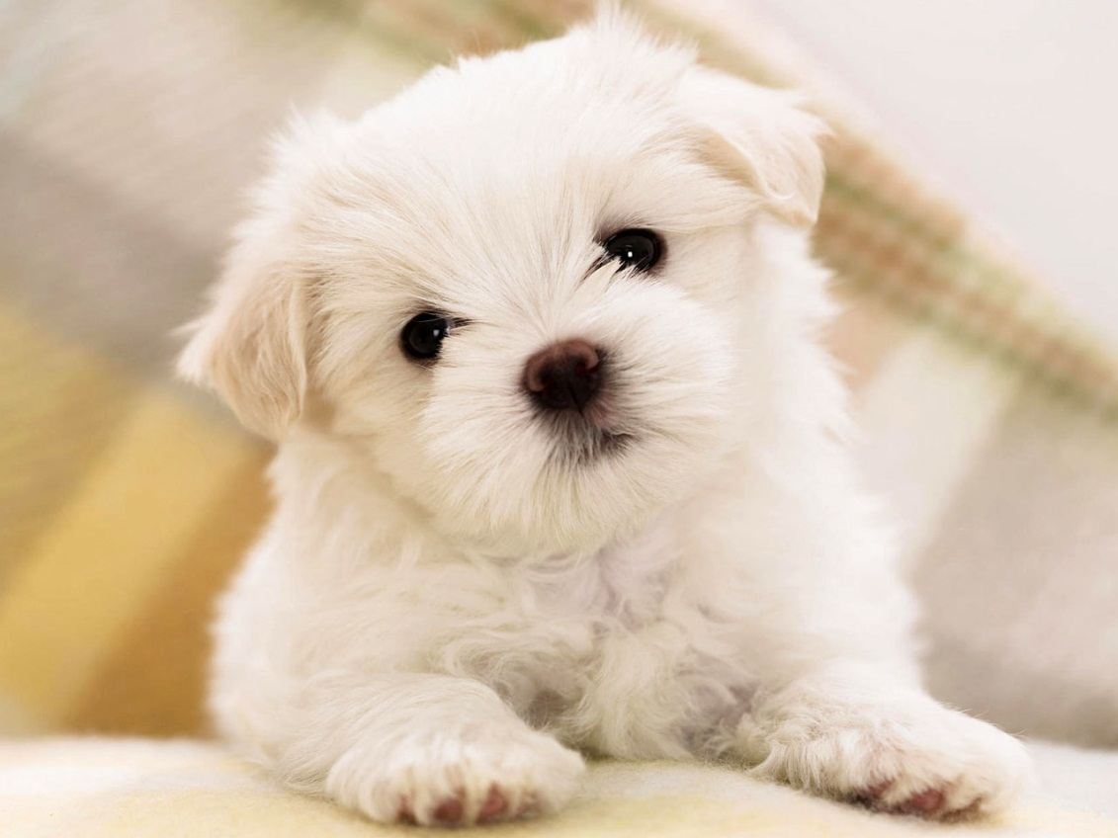
D
My favourite animal is Dog

Slide 6

E
My favourite subject is English

Slide 7
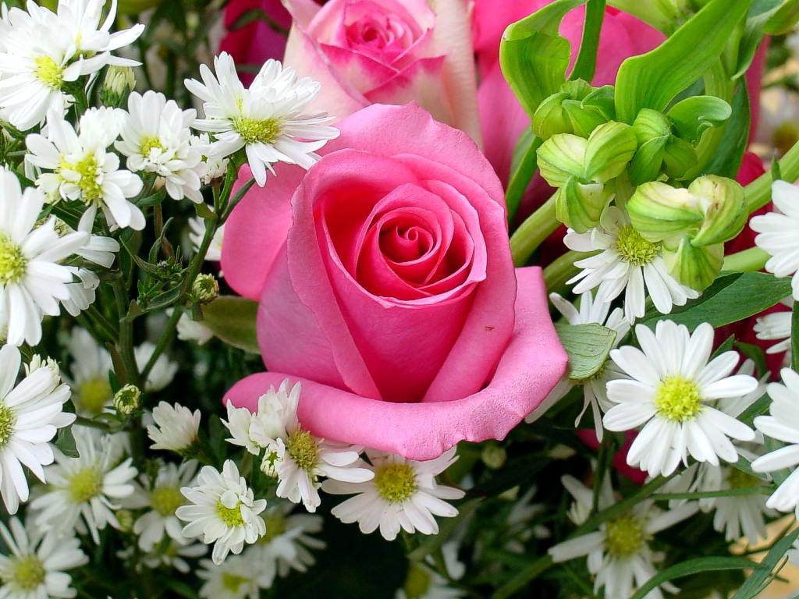
F
I like Flowers

Slide 8
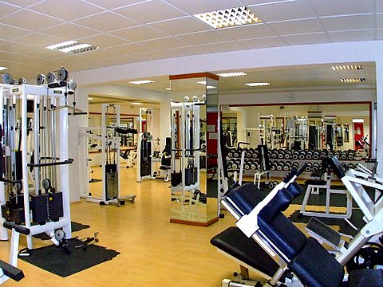
G
I do Gymnastics twice a week

Slide 9
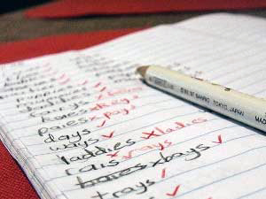
H
I do Homework at 3 o’clock

Slide 10

I
I’m from Italy

Slide 11
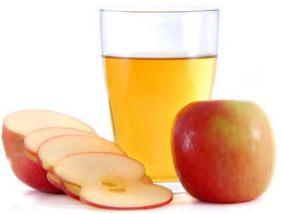
J
I like apple Juice

Slide 12
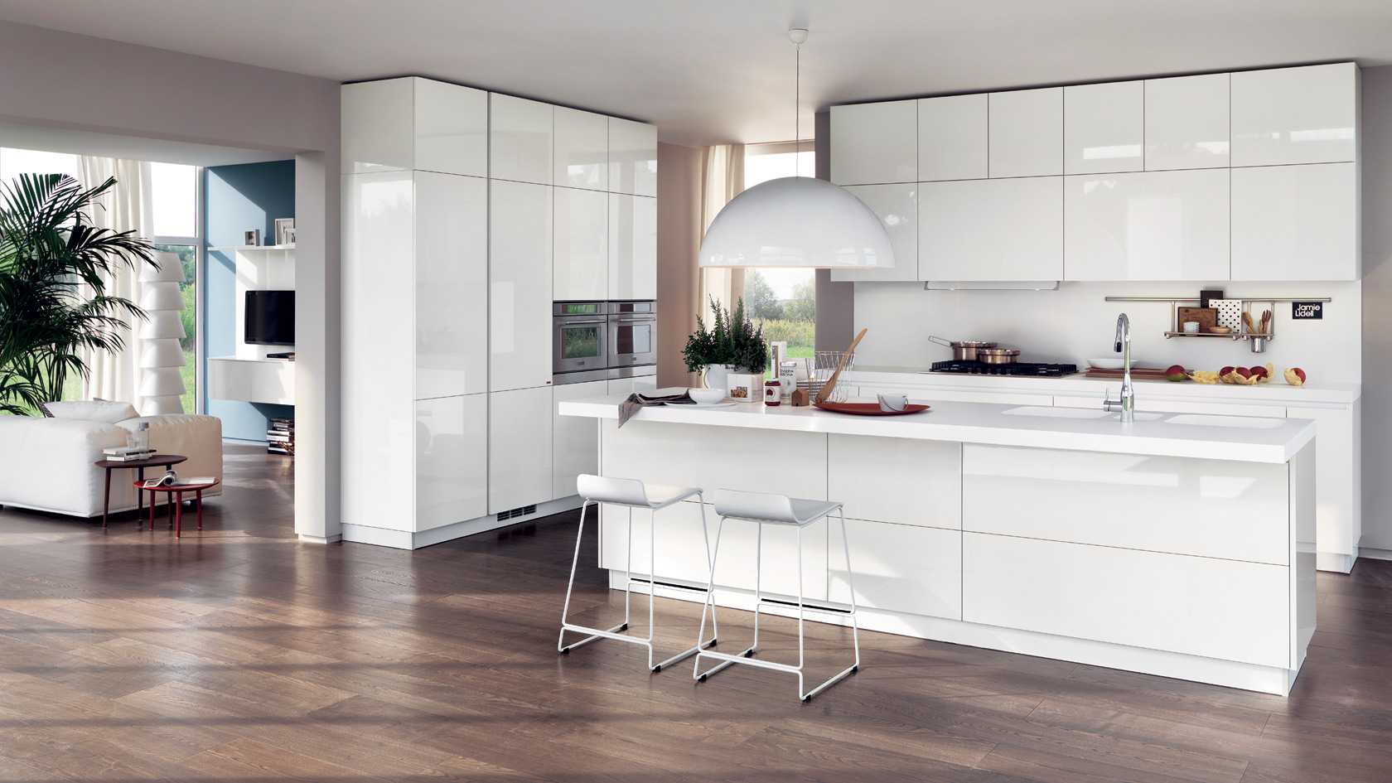
K
My Kitchen is big

Slide 13
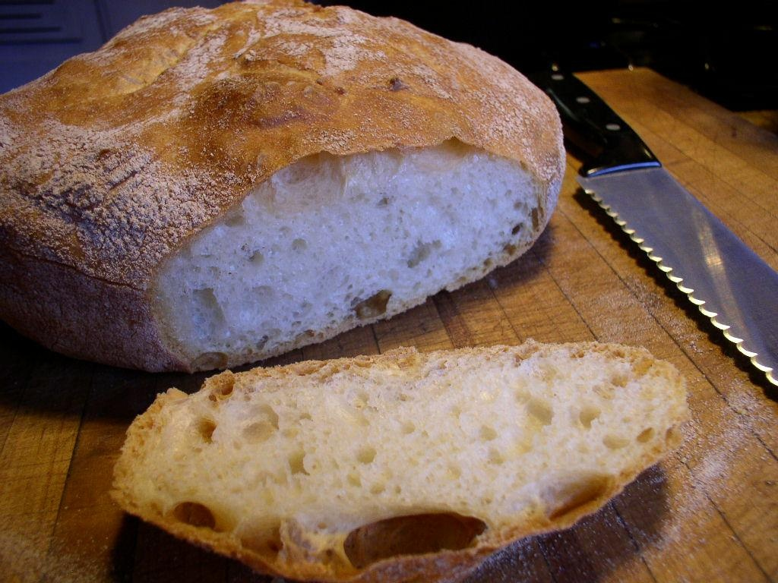
L
I want a Loaf of bread

Slide 14
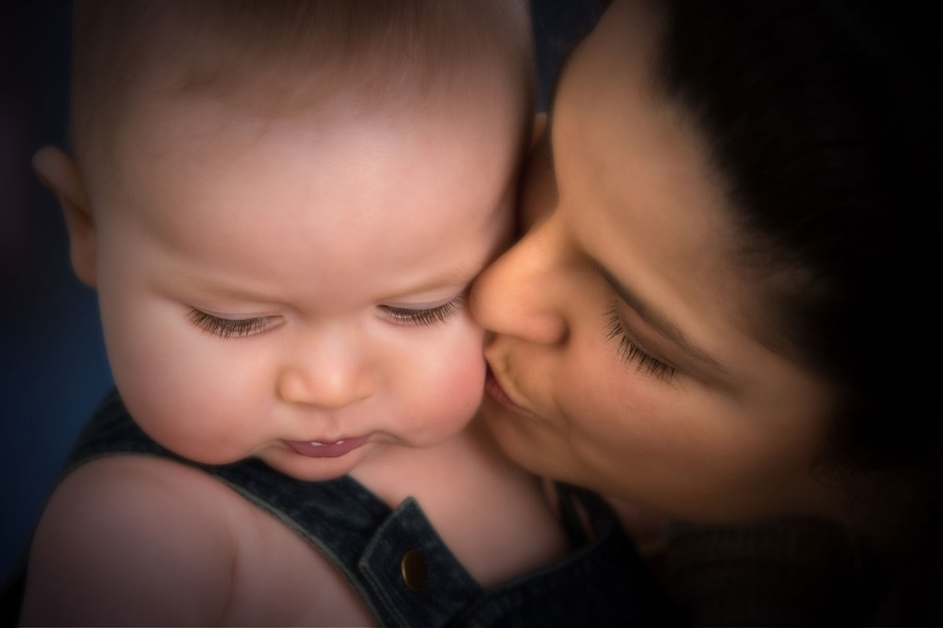
M
My favourite parent is Mum

Slide 15
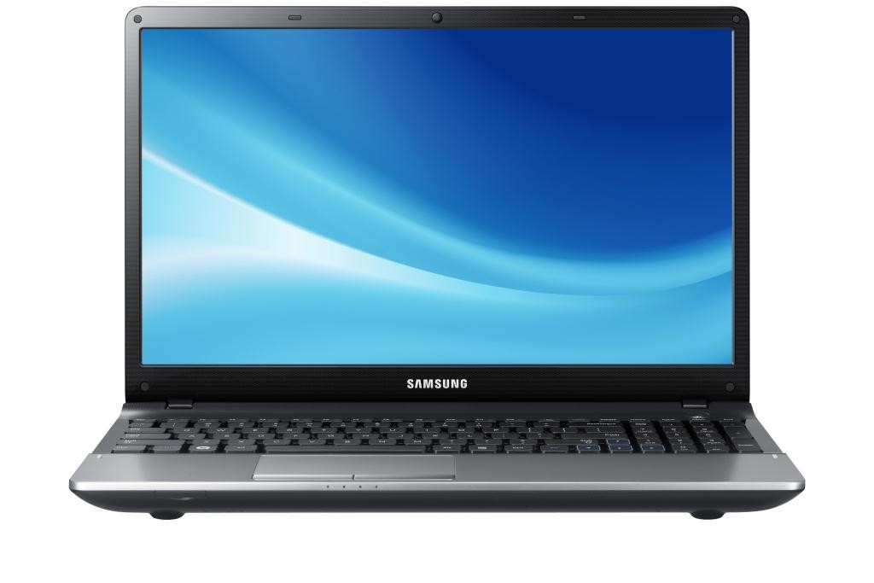
N
I have got a Notebook

Slide 16
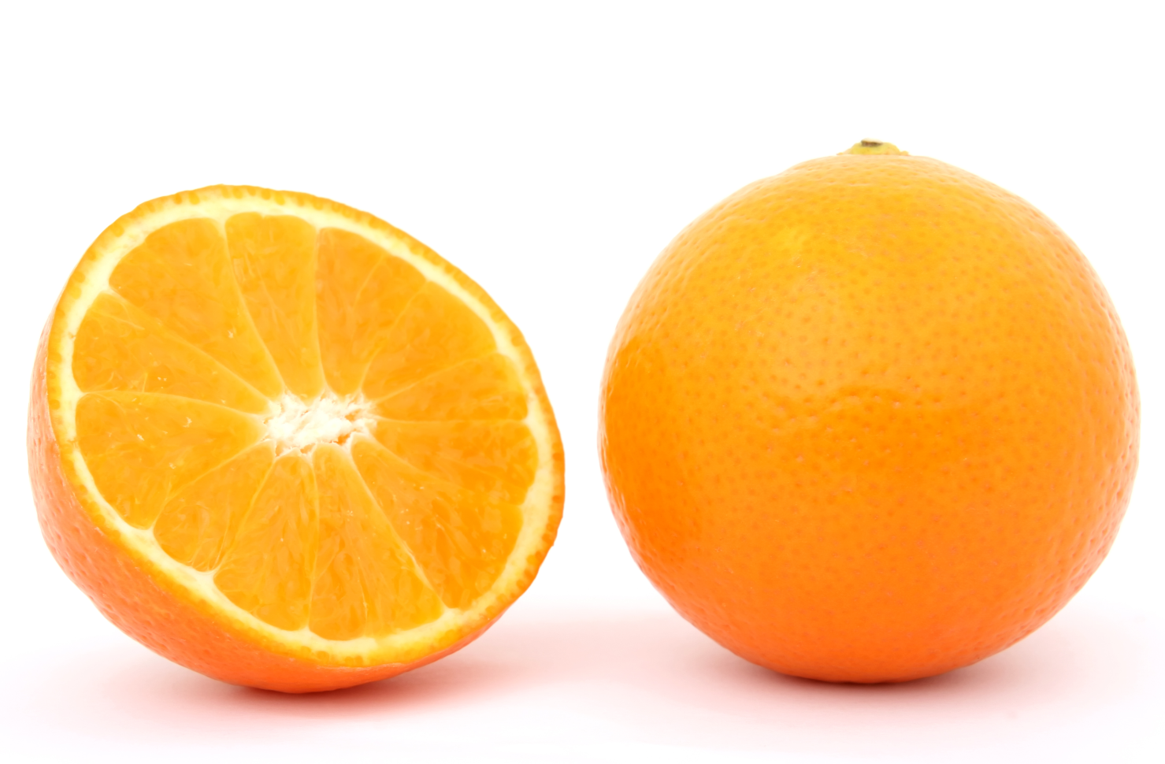
O
My favourite fruit is Orange

Slide 17
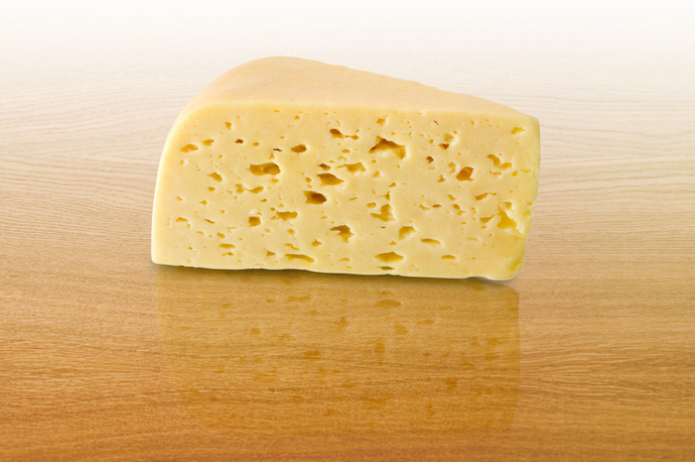
P
I want a
Piece of cheese

Slide 18
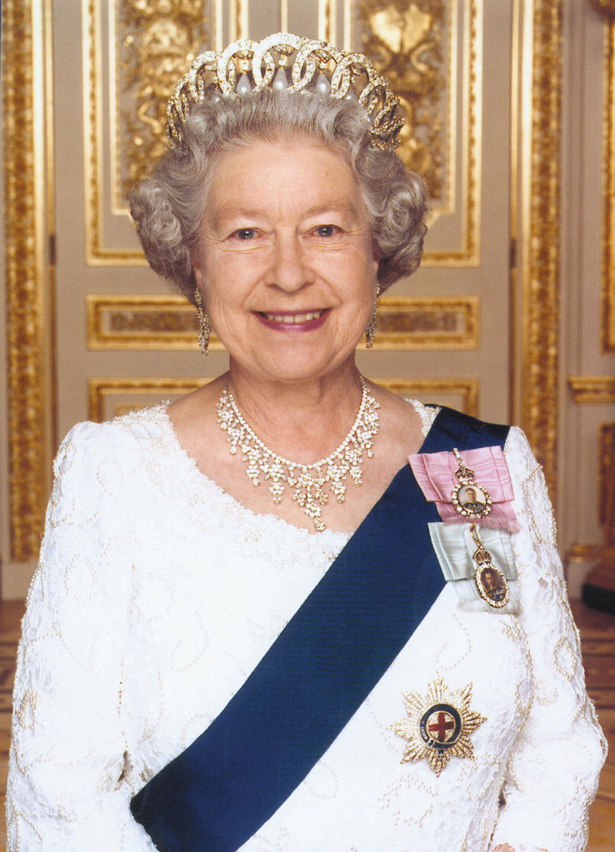
Q
The Queen Elizabeth II lives in London

Slide 19
R
The Rabbit is white

Slide 20
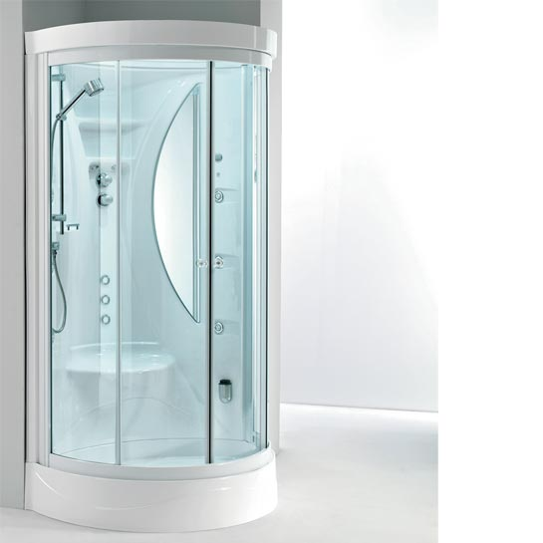
S
I have a Shower three times a week

Slide 21
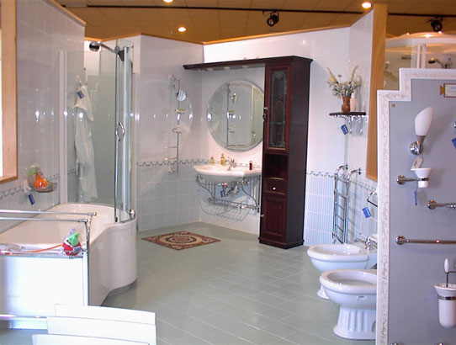
T
I go to the Toilet every day

Slide 22
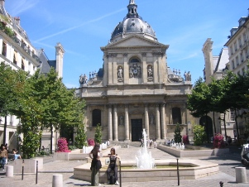
U
My University is important

Slide 23

W
The Wall is blue in the room

Slide 24
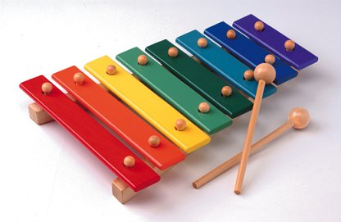
X
I can play the Xylophone

Slide 25
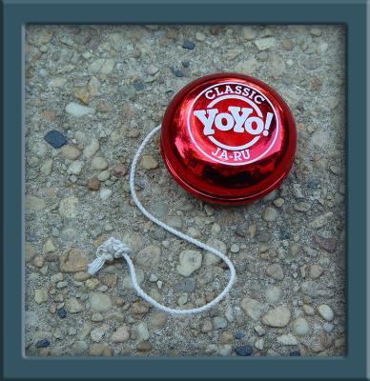
Y
I have got a red Yo-yo

Slide 26
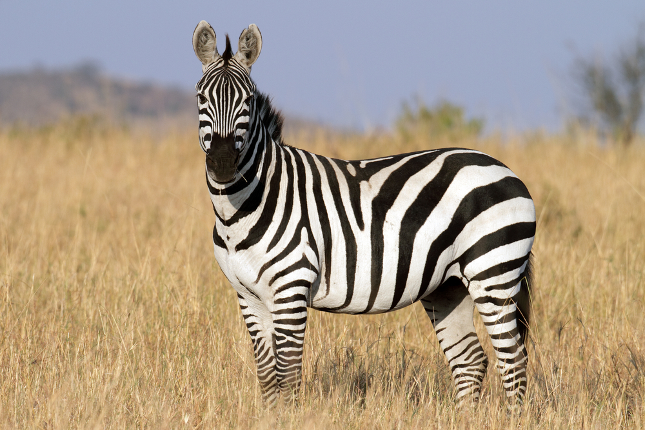
Z
The Zebra has got black stripes

Slide 27
A project by: PAOLO GIGLIO and LUCIA TIANO

