Slide 1
HELLO, WE ARE…

Slide 2

We are…
Hello! I’m Paolo Giglio
Hello! I’m Lucia Tiano

Slide 3
PAOLO AND LUCIA
My nickname is Paolino.
I’m Italian and I speak Italian, English and French.
My mobile number is xxxxxxxxxxxxxxxxx
My nickname is Lulù.
I’m from Italy and I speak Italian, English and French.
My mobile number is xxxxxxxxxxxxxxxxx

Slide 4
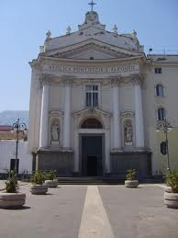
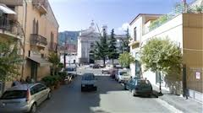
My birthday is in December.
I live in Pagani in square S.Alfonso
My birthday is in August.
I live in Pagani in street A.Cesarano

Slide 5
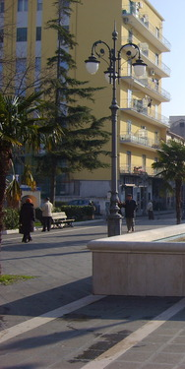
I live in a flat on the second floor.
My flat is 110 square meters.
There are seven rooms:2 bathrooms, kitchen, 2 bedrooms, 1 living room, 1 porch
I live in a flat on the third floor.
My flat is 120 square meters.
There are six rooms: 2 bedrooms, 1 kitchen,
1 dining room, 1 bathroom, 1 closet

Slide 6
In my family there are four people:dad Pino, mum Amalia, brother Marco and me Paolo.
I haven’t got any pets
In my family there are three people:dad Mimmo, mum Maddalena and me Lucia.
I haven’t got any pets

Slide 7
I wake up at 6.30, I get upn at 6.50 and have breakfast at 7.20.I go to school at 8.00 and have lessons at 8.15.I go home at 1.20 PMI have lunch at 1.25 PMI do my homework at 3.00 PM I go to bed at 9.10 .
I wake up at 7.00, I get up at 7.10 and have breakfast at 7.20.I go to school at 7.50 and have lessons at 8.15.I go home at 1.20 PMI have lunch at 1.25 PMI do my homework at 3.00 PM I go to bed at 10.00 .

Slide 8
I have milk for breakfast .
I have pasta, fish, potatoes, apple for lunch.
I have meat and salad for dinner
I have milk and cereal for breakfast .
I have pasta,meat, salad, orange for lunch.
I have fish and potatoes for dinner

Slide 9
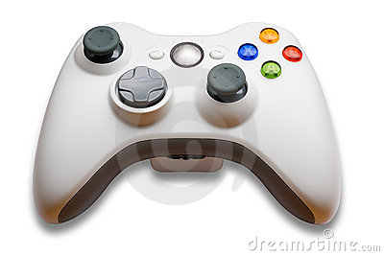
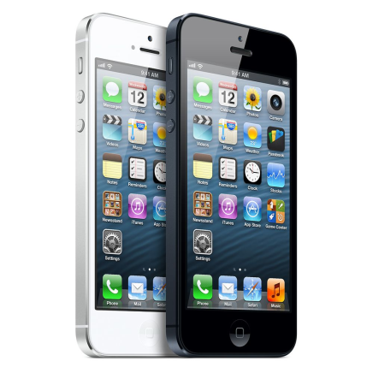
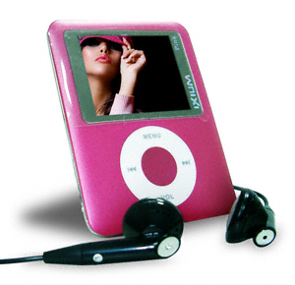
I play videogames and write emails in my free time
I listen to music, go out with my friends, send and receive text messages and read a magazine in my free time

Slide 10
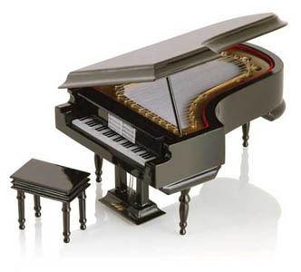
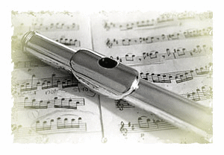
I like playing the recorder.
My favourite colour is purple and my favourite actor is Martina Stoessel.
I like playing the piano.
My favourite colour is yellow and my favourite singer is Emma Marrone.

Slide 11

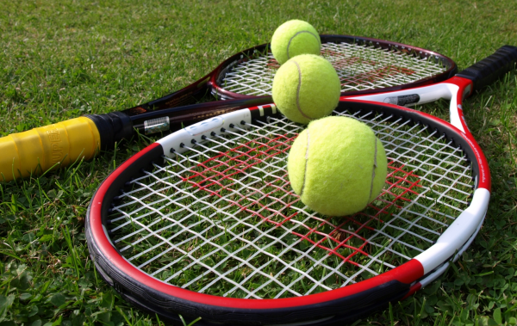

I can play football, I can play volleyball and I can speak English.
I can swim, I can play table tennis and I can speak English and French.

Slide 12
I’m short, slim, good-looking and young.
My hair is short, wavy, blonde-brown; my eyes are small and brown; my face is oval.
I’m of medium height, pretty and young.
My hair is long, curly, brown; my eyes are big and brown; my face is round

Slide 13
NEVER SAY NEVER!!!

Slide 14
A project by: tiano lucia AND PAOLO GIGLIO

