Slide 1


WE ARE…♥♦♣◘•○☺☻

Slide 2
MY NAME IS IMMA AND MY SURNAME IS VOLANTE
MY NICKNAME IS IMMUCCHIA
MY EMAIL IS xxxxxxxx@xxxx.xx
I’M 11
MY BIRTHDAY IS IN JANUARY

Slide 3



I AM ITALIAN
I SPEAK ITALIAN, ENGLISH AND FRENCH

Slide 4
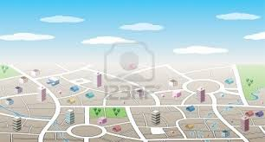
I LIVE IN PAGANI
IN MY FAMILY THERE ARE 4 PEOPLE:MY MUM,MY DAD,MY BROTHER AND ME

Slide 5
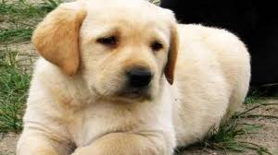
I HAVEN’T GOT ANY PETS =(
MY FAVOURITE ANIMAL IS DOG♥

Slide 6

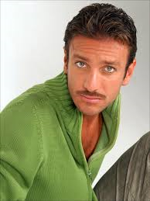
I LIKE VIOLETTA
THE “POU” GAME, ONE DIRECTION BAND AND SERGIO ASSISI

Slide 7
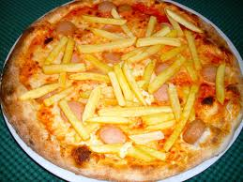
MY FAVOURITE FOOD IS PIZZA AND CHOCOLATE CAKE

Slide 8
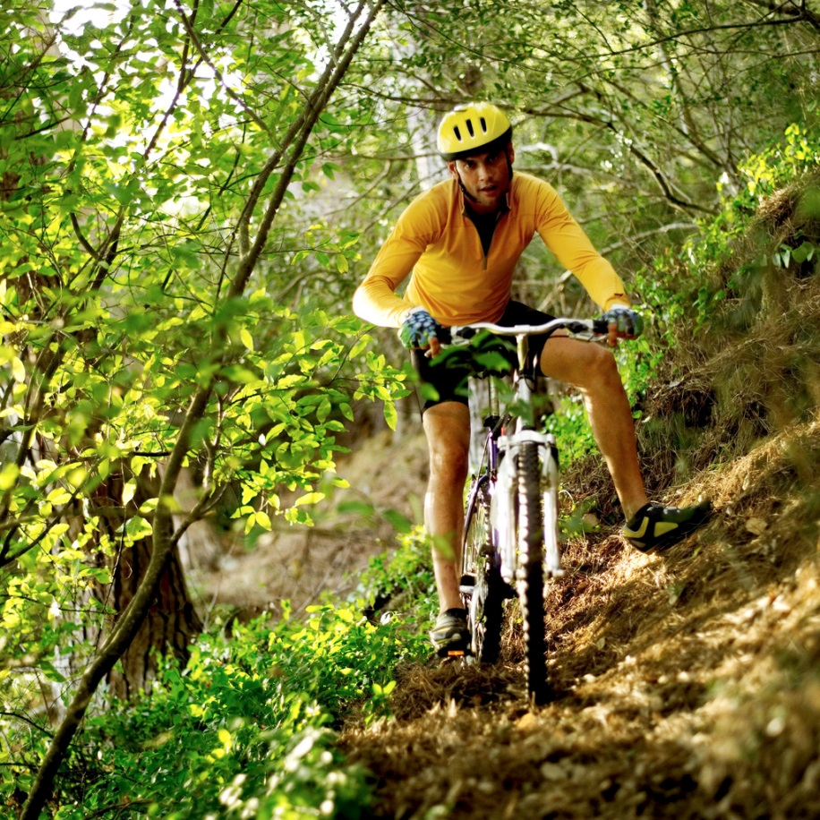
I CAN SING AND RIDE A BIKE

Slide 9

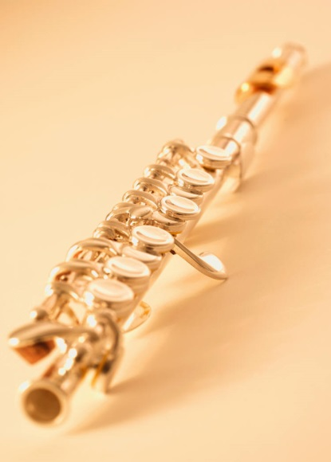
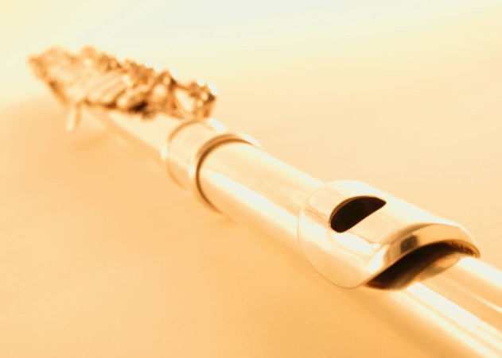
IN MY FREE TIME I PLAY THE FLUTE AND I READ BOOKS

Slide 10
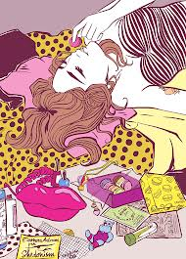
I GET UP AT 7.00 AM
I GO TO SCHOOL AT 7.55 AM
I HAVE LUNCH AT 2.00 PM
I DO HOMEWORK AT 3.30 PM
I HAVE DINNER AT 8.00 PM
I GO TO BED AT 11.00 PM

Slide 11
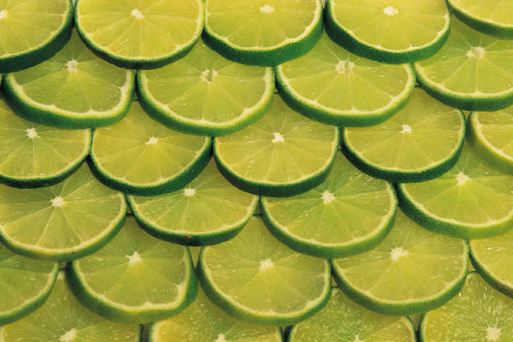
I HAVE MILK AND CEREAL FOR BREAKFAST
I HAVE PASTA AND HAM FOR LUNCH
I HAVE PIZZA FOR DINNER

Slide 12
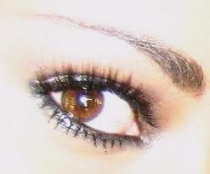
I AM TALL, I’M OF MEDIUM WEIGHT, I’M YOUNG AND I’M BEAUTIFUL. MY HAIR IS LONG ,BROWN AND STRAIGHT, MY EYES ARE BROWN AND SMALL, MY FACE IS OVAL.

Slide 13
IN MY HOUSE THERE ARE 8 ROOMS:MY FAVOURITE ROOM IS MY BEDROOM BECAUSE THERE IS A COMPUTER, TV,
POSTERS, RADIO…

Slide 14

APPEARANCES ARE DECEPTIVE!! ;)

Slide 15
MY NAME IS AURORA
MY SURNAME IS DI LIETO
I’M ELEVEN YEARS OLD
MY NICKNAME IS AURY
MY EMAIL IS XXXXX@XXX.COM
MY BIRTHDAY IS IN DECEMBER
I LIVE IN TORINO

Slide 16

MY TELEPHONE NUMBER IS XXXXXXXXXXXX
I COME FROM ITALY
MY LANGUAGE IS ITALIAN

Slide 17
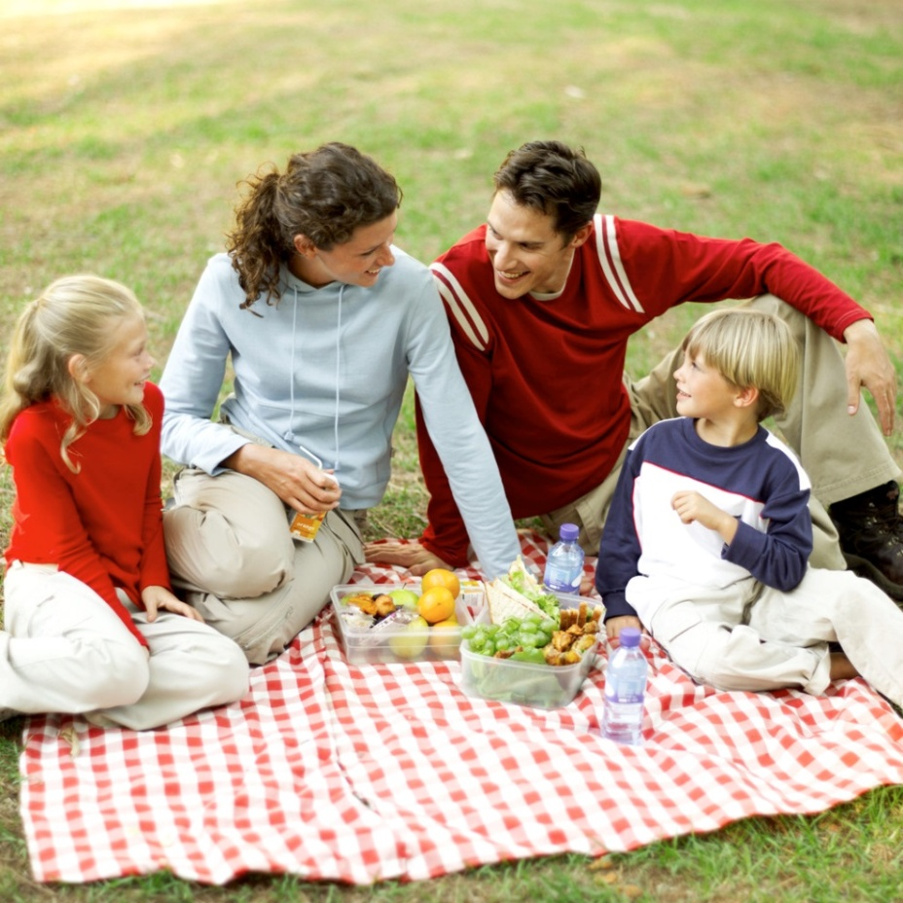
IN MY FAMILY THERE ARE FIVE PEOPLE: MY MOTHER, MY FATHER, MY SISTER, MY GRANDMOTHER AND ME.

Slide 18
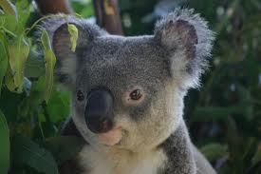
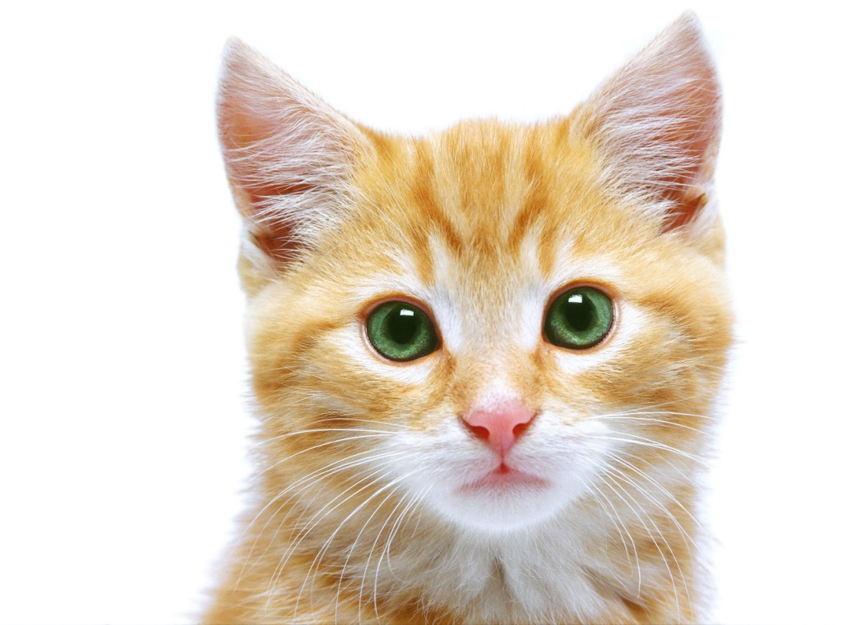
I DON’T LIKE DOG; MY FAVOURITE ANIMALS ARE KOALA AND CAT

Slide 19

MY FAVOURITE SPORT IS VOLLEYBALL,WHILE IN MY FREE TIME I LISTEN TO MUSIC

Slide 20
I GET UP AT 7.30 AM
I GO TO SCHOOL AT 7.40 AM
I GO HOME AT 14.00AM
I HAVE LUNCH AT 2.20 PM
I DO HOMEWORK AT 3.00PM
I HAVE DINNER AT 8.00 PM
I GO TO BED AT 9.00 PM

Slide 21

IN MY HOUSE THERE ARE EIGHT ROOMS: MY FAVOURITE ROOM IS BEDROOM BECAUSE THERE IS A PINK CEILING AND A COMPUTER

Slide 22
I HAVE PASTA FOR LUNCH

Slide 23
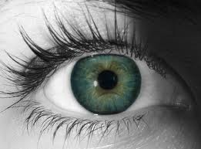
I AM TALL,I HAVE LONG HAIR AND I HAVE BROWN EYES ; I HAVE A SMALL NOSE AND I HAVE A BIG MOUTH

Slide 24
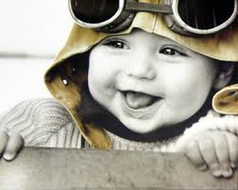
HAPPINESS IS THE SPICE OF LIFE

Slide 25
HELLO!!!!!
WHO AM I????
I AM ELENA!!!!
MY SURNAME IS SPAGNA
MY NICKNAME IS ELY101
MY EMAIL IS XXXXXXX@XXX.XX
MY TELEPHONE NUMBER IS XXXXXX
I’M 11 YEARS OLD ;)

Slide 26
MY BIRTHDAY IS IN DECEMBER
I’M FROM ITALY .
MY LANGUAGE IS ITALIAN, I’M ITALIAN!!
I LIVE IN MILANO. I LIKE NEW YORK,LONDON AND HAWAI☻☺♦

Slide 27
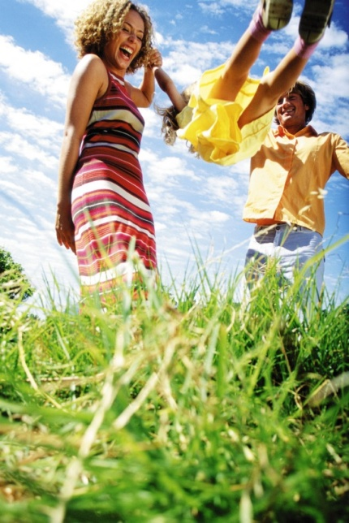
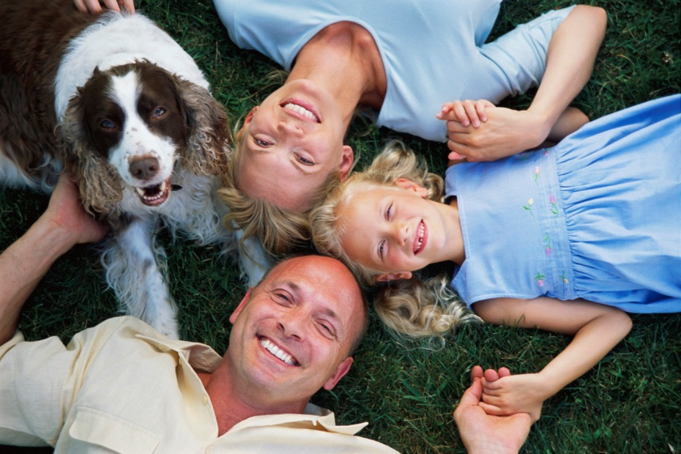
IN MY FAMILY THERE ARE 3 PEOPLE
I HAVEN’T GOT A PET =(
I LIKE DOGS

Slide 28
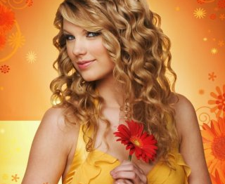


I LIKE VIOLETTA ♥ I LOVE ITALY
I GO TO THE SWIMMING POOL TWO DAYS A WEEK.
I LISTEN TO MUSIC EVERY DAY!
I LIKE THE SONG “22” OF TAYLOR , IT’S FANTASTIC!!!!!

Slide 29

I GET UP AT 7.00 AM
I GO TO SCHOOL AT 7.45 AM
I HAVE LUNCH AT 2.00 PM
I DO MY HOMEWORK AT 3.00 PM
I HAVE DINNER AT 8.00 PM
I GO TO BED AT 11.15 PM
I HAVE SPAGHETTI AND CAKE FOR LUNCH,
PIZZA FOR DINNER …I LOVE CAKES ♥♥!!!
elenaelenaelenaelenaeelenaelenaelenaelenaelenaelenaelenaelenaelenaelenaelenaelenaelenaelenaelenaelenaelenaelenaelenaelenaelenaelenaelena

Slide 30
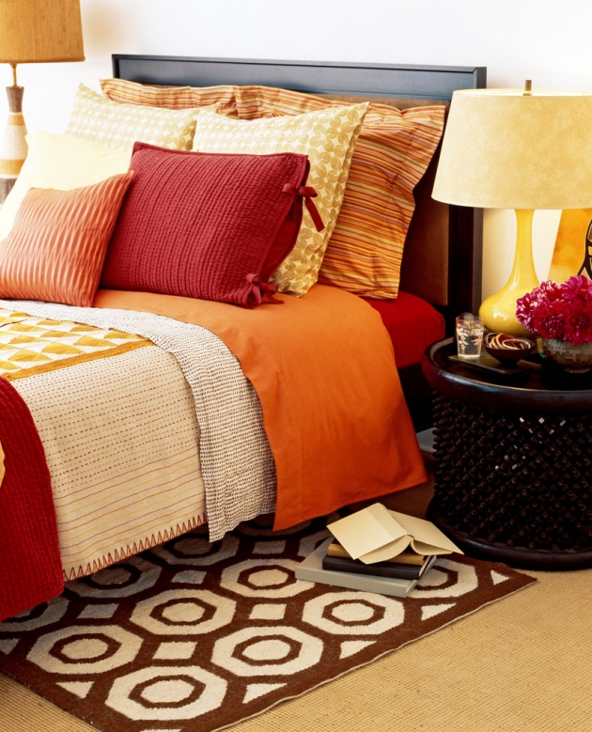

IN MY HOUSE THERE ARE 7 ROOMS … MY FAVOURITE ROOM IS BEDROOM BECAUSE I LISTEN TO THE RADIO , I PLAY COMPUTER.

Slide 31

NOBODY CAN DO EVERYTHING BUT EVERYONE CAN DO SOMETHING!!

Slide 32
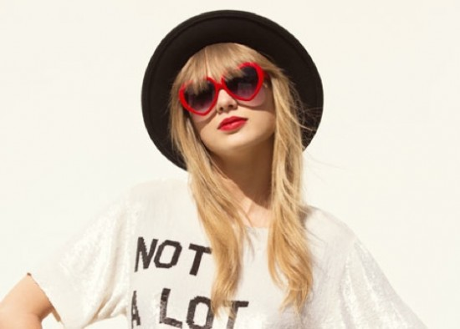
THE PROJECT IS BY:
IMMA
ELENA
AURORA

Slide 33
Thanks!!!!!!!

