Slide 1
This is me

Slide 2
My name is………………….

Slide 3
I am 11 years old

Slide 4
My family is…………..

Slide 5
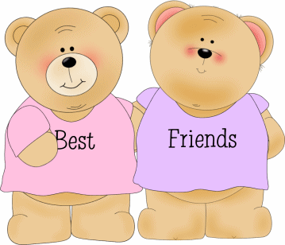
My best friend is……………..

Slide 6
My favourite food is………

Slide 7
My favourite colour is…………..

Slide 8
My nickname is…………..

Slide 9
My favourite sport is……

Slide 10
My favourite subject is….

Slide 11
My eyes are brown

Slide 12
My hair is curly and long

Slide 13
I’m tall and of medium weight

Slide 14
I like studying

Slide 15
I like t-shirt and jeans

Slide 16
I like spaghetti

Slide 17
I live with my family

Slide 18
My house is big and beautiful

Slide 19
I like dogs

Slide 20
A project by Luisella Tortora 1E

