Slide 1

Christmas

Slide 2

Christmas Greetings
Christmas wish is the ideal way to pray for love and peace for all. Wishes can be given to anyone, whether you know a person or not. It is the way to share your feelings and happiness with all those whom you come across on this sacred occasion. You never know; you might make a lonely person smile because of your Christmas wish. The idea of Christmas wishes can go a long way in maintaining relationships and creating a bond that can only become stronger with time.

Slide 3
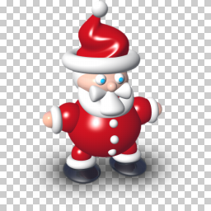
English Christmas traditions
. The celebrations are always expected from large and small. Santa Claus (Father Christmas) is represented according to tradition, that is, as a sweet old man with long white beard wearing shoes of a vivid red, fur-trimmed white. Christmas traditions do not come off much from those of other countries. For children birth begins as early as November when they start to write the list of gifts they want to receive and shops decorate the windows with Christmas themes. From December you start to open the advent calendar and two weeks before Christmas you start to decorate the house and the tree, which is adorned with lights and bows. On Christmas Eve, children hang stockings for Father Christmas and to thank him for the gifts they leave a glass of milk and a sweet (mince pie)

Slide 4

Famous sentences
Christmas is the season for kindling the fire of hospitality in the hall, the genial flame of charity in the heart. ~Washington Irving
It is Christmas in the heart that puts Christmas in the air. ~W.T. Ellis

Slide 5
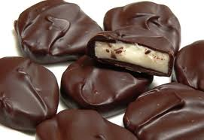

English Christmas sweets

Slide 6
Hugh Grant wants a Terry's Chocolate Orange for Christmas and Claudia Schiffer would like a male tortoise and trainers.
Schiffer and Grant revealed their Christmas gift wish lists for the annual Christmas Stocking Auction held Dec. 3 and organized by Macmillan Cancer Relief. "Dream stockings" full of gifts based on the celebrity gift wish lists were offered for auction.
Schiffer also wants a book about yoga, a box of After Eight chocolates, a bottle of red wine and Agent Provocateur underwear, reports the Daily Mail.
Grant would also like a Richard James shirt, Gucci sunglasses, three pairs of black Pantherella socks, and Adidas trainers
Hugh Laurie wants a Steinway concert grand piano, a Triumph 955i motorcycle, and a 30-foot yacht, reports the Daily Mail.
Scarlett Johansson says her Christmas gift wish list includes four more years for President Obama. “I hope 2012 brings a re-election for President Obama,” Johansson told Hollywood Life.
Celebrities reveal Christmas gift wish lists

Slide 7

Christmas Wishes:
Wishes for Christmas
Wish you a Merry Christmas and may this festival bring abundant joy and happiness in your life!
May this Christmas be so special that you never ever feel lonely again and be surrounded by loved ones throughout!
You are special, you are unique; may your Christmas be also as special and unique as you are! Merry Christmas!
Here's wishing you all the joys of the season. Wish you and your family a Merry Christmas!
May joy and happiness snow on you, may the bells jingle for you and may Santa be extra good to you! Merry Christmas!

Slide 8

Christmas tree
The Christmas tree became popular with the husband of Queen Victoria, Albert, who put a tree as a decoration for celebrations in Windsor Castle in 1840. Since 1947 every year Norway gives Great Britain a large Christmas tree that is placed in Trafalgar Square in memory of the Anglo-Norwegian cooperation during the Second World War.

Slide 9

The famous song are:
We wish you a Merry Christmas;
Merry Christmas;
White Christmas;
One wish;
Jingle Bells.

Slide 10
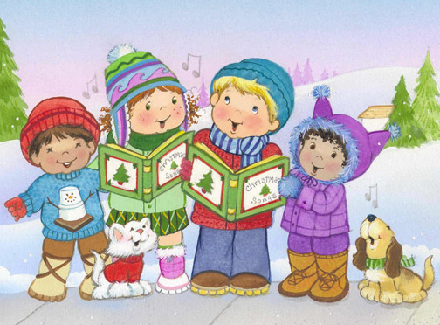
Christmas carol
A Christmas carol is a carol whose lyrics center on the theme of Christmas or that has become associated with the Christmas season even though its lyrics may not specifically refer to Christmas. Both types of Christmas carols are included in this list.
Traditional Christmas carols mainly focus on the Christian celebration of the birth of Jesus. Other Christmas songs focus on more secular Christmas themes, such as winter scenes, family gatherings, and Santa Claus.

Slide 11
Luigi’s personal wishlist:
I wish a new computer for Christmas

Slide 12
Giuseppe’s personal wishlist:
I wish a new ball for playing basket and a new computer for Christmas.

Slide 13
Mario’s personal wishlist:
I wish a new computer

Slide 14

MERRY CHRISTMAS AND A HAPPY NEW YEAR

Slide 15
Realizzato da Mario Petagna Giuseppe Pepe Luigi Santangelo

