Slide 1
MERRY CHRISTMAS

Slide 2
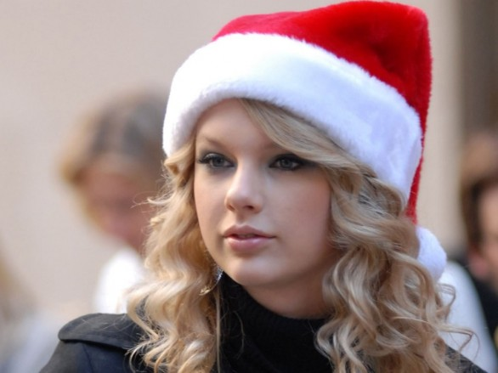
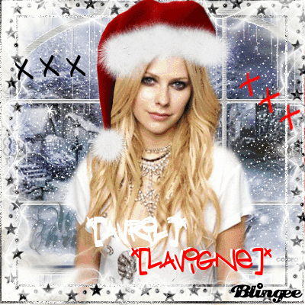
Celebrities reveal Christmas gift wish lists
Avril Lavigne wants chef's knives for Christmas. Lavigne also told Popcrush she’s received some strange Christmas gifts from her fans over the years, including a a wedding dress from a Korean fan.
A pasta maker is on Taylor Swift's holiday wish list. Swift says she also hopes to receive antique picture frames and “anything from Free People or Anthropologie,” according to People.

Slide 3

Happy, happy Christmas, that can win us back to the delusions of our childish days; that can recall to the old man the pleasures of his youth; that can transport the sailor and the traveler, thousands of miles away, back to his own fire-side and his quiet home! ~Charles Dickens, The Pickwick Papers, 1836
I have always thought of Christmas time, when it has come round, as a good time; a kind, forgiving, charitable time; the only time I know of, in the long calendar of the year, when men and women seem by one consent to open their shut-up hearts freely, and to think of people below them as if they really were fellow passengers to the grave, and not another race of creatures bound on other journeys. ~Charles Dickens

Slide 4

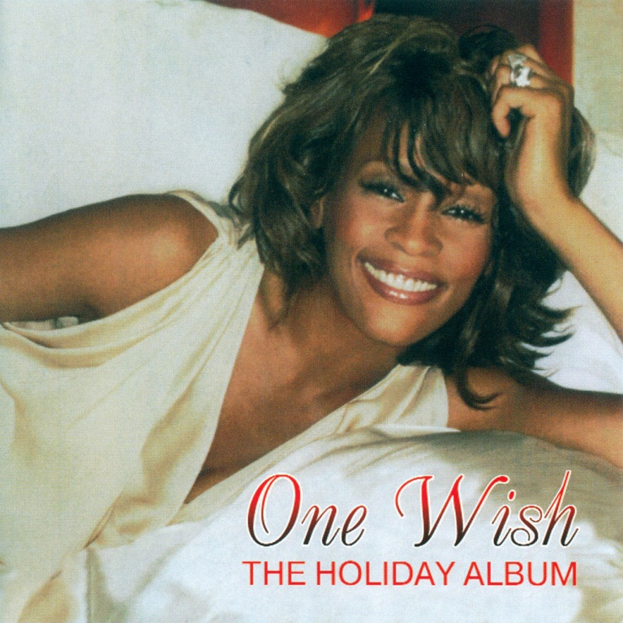
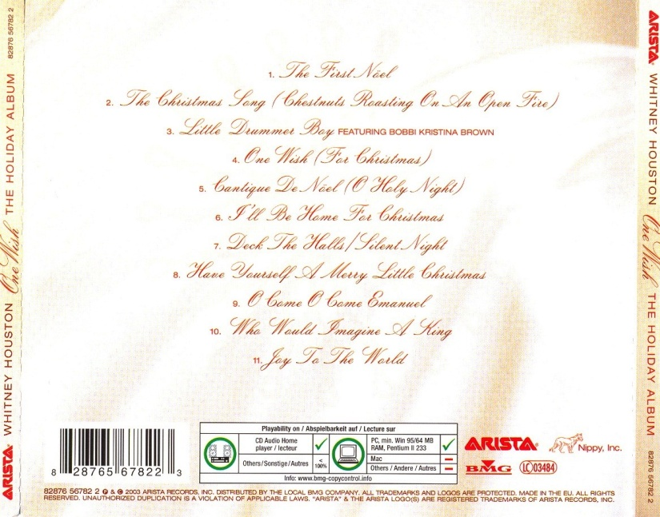
One Wish (For Christmas) - Whitney Houston
(Oooh oooh oooh oooh)
If there were no presents
Waiting on Santa's sleigh
What would I wish for Christmas
And if Frosty the Snowman
Were melting away
I would pray for hope and unity
On Christmas day
If I had one wish for Christmas
There would be joy
And peace here on earth
If I had one wish for Christmas this year
We would all come together as one
If Rudolph and his reindeer
Ran into delays
I'd still hope for joy this season
And if somehow Santa got lost on his way
I would try to find a way to smile
Smile on Christmas day
Chorus
You know it ain't about
All those material things (no no)
What you've gotta think about
Is the love Christmas brings (yeah)

Slide 5


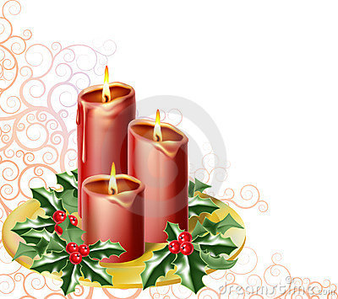
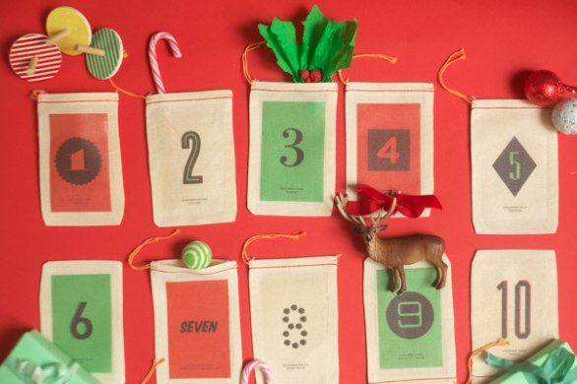
Advent - (Four Sundays Before Christmas)
Advent is not widely celebrated in England, its celebration actually originated in Germany, although in the church calendar Advent is the official start of the run up to Christmas.
Two traditions that have caught on in England are the Advent calendar and the Advent candle.

Slide 6
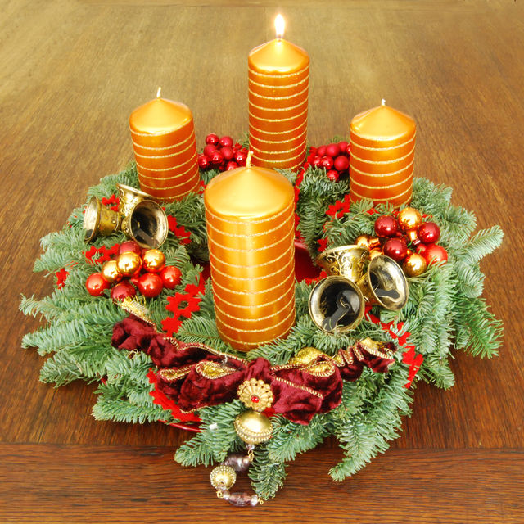

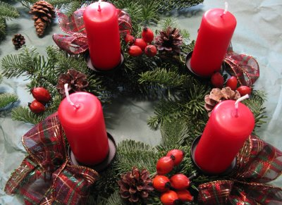
An Advent candle often has 25 marks on it, a bit of the candle is burned down by one mark each day. In some homes, 24 candles are kept, one for each night from December 1 through Christmas eve. One candle is lit for a while on December 1, then a new candle is added each day for the 24 day period.
. Advent candles are lit in many homes, schools and churches, in England, with a final central candle lit on Christmas Day; these are often on a hanging decoration known as an "Advent Crown."

Slide 7
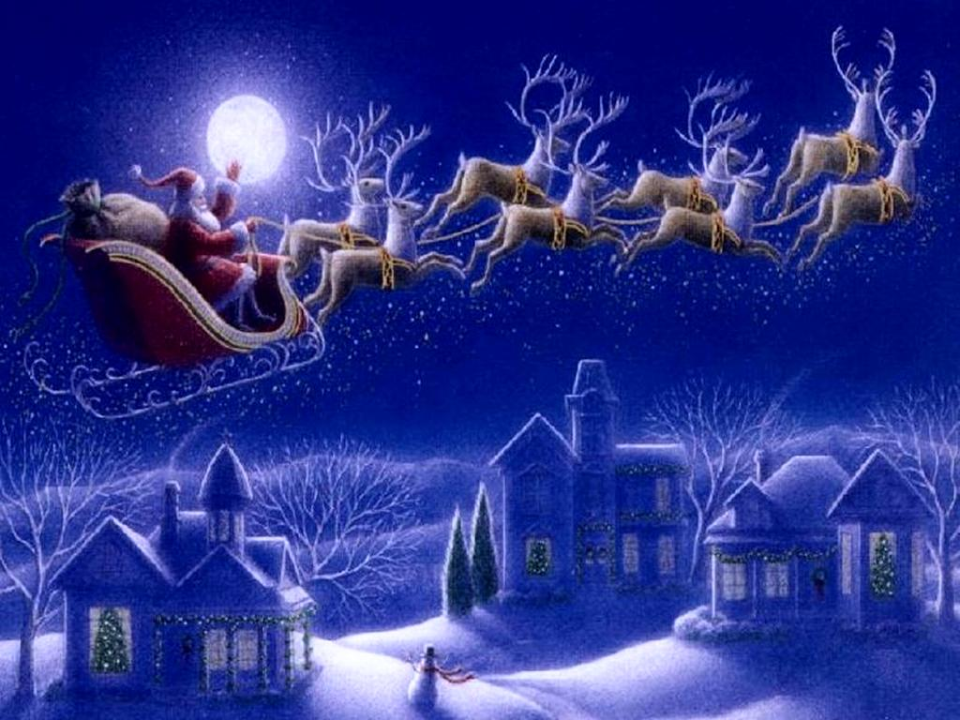

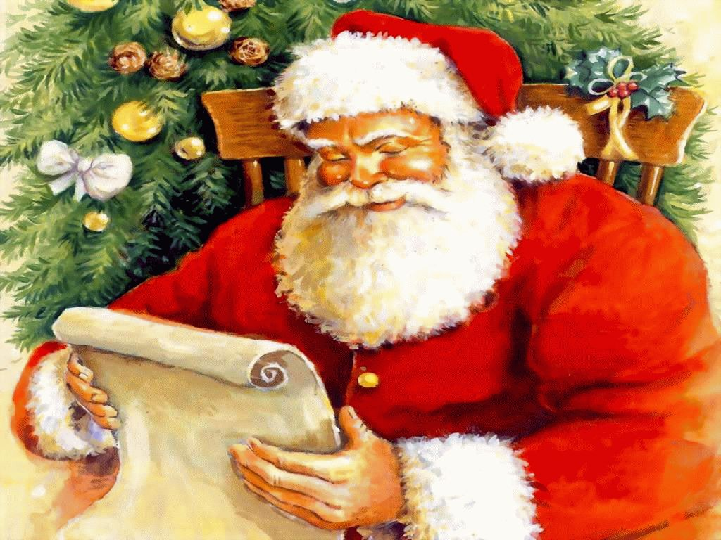

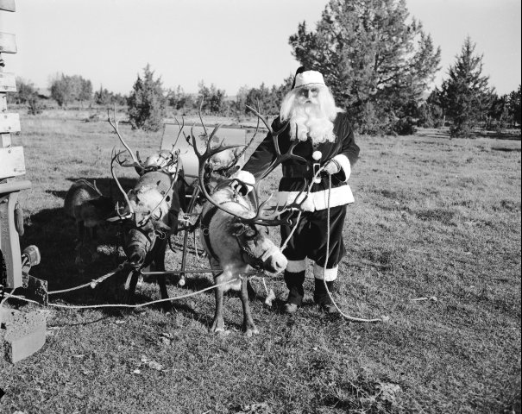
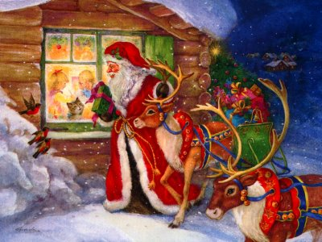
Night time on Christmas Eve though is a very exciting time for young children. It is the time when Santa or Father Christmas comes. They hang up their stockings and go to sleep. Santa and his elves make all the toys for Christmas in his home in Greenland. On Christmas Eve he piles all of the toys onto his sleigh and rides across the sky with his 9 reindeer (Dasher, Dancer, Prancer, Vixen, Comet, Cupid, Donner (or it may be Donder), Blitzen and of course ... Rudolf!). The most famous one is Rudolf the who is always the one at the front, to lead the way with his red nose. In the morning when the children wake up they open their stocking presents. Traditionally on Christmas Eve mince pies and sherry (or milk) are left out for Santa and nowadays carrots are left for his reindeer. Most children are in bed way before midnight waiting for Santa to visit.

Slide 8
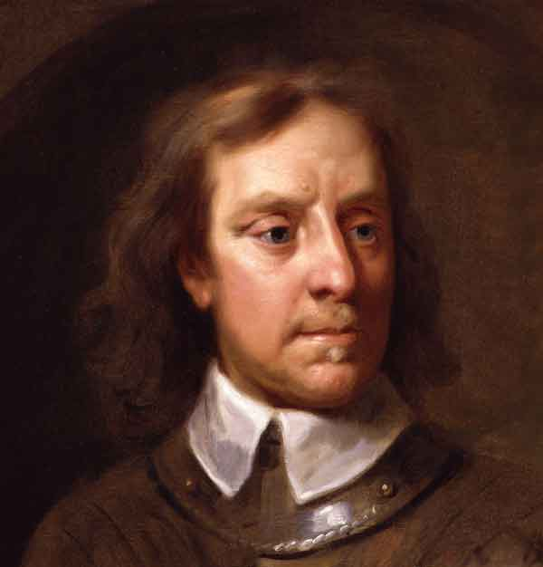
However in 1647, the English parliament passed a law that made Christmas illegal, all festivities were banned by the Puritan leader Oliver Cromwell, who considered feasting and revelry on what was supposed to be a holy day to be immoral. The ban was lifted only when Cromwell lost power in 1660.

Slide 9
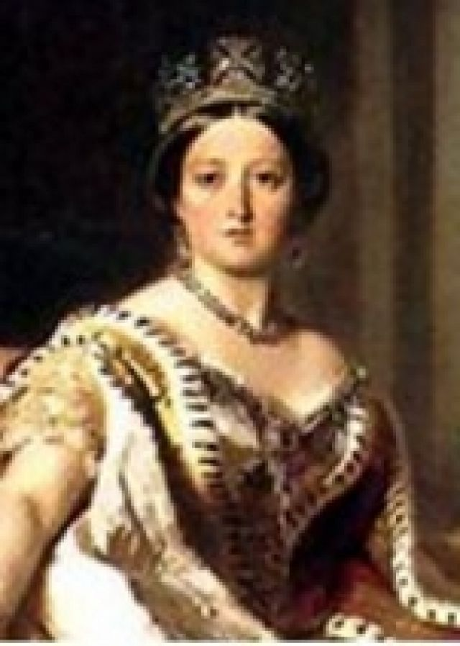
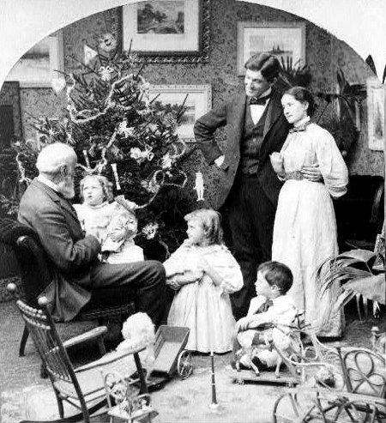

In Britain, the Holy Days and Fasting Days Act of 1551 (which has not yet been repealed) states that every citizen must attend a Christian church service on Christmas Day, and must not use any kind of vehicle to get to the service There are a large number of Britons who break this law every year. The law may have been intended to encourage humility by forcing even the wealthy to attend the church on foot, or perhaps it was simply to avoid the traffic and parking crush that universal attendance would otherwise have brought about.
Later, during Queen Victoria's reign, Christmas became a time for gift giving, and a special season for children.

Slide 10
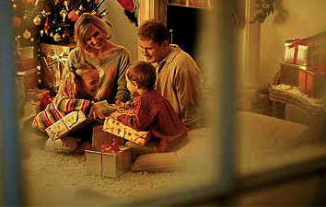



Nowadays, according to research by, of all things, Jarlsberg cheese, the average family gets out of bed just before 8am and is ready to start opening presents by 8.19am. Once the wrapping paper has been torn off all the presents, the family sits down to breakfast at 9.02am, but not before they have tucked into a bit of chocolate at 8.39am.

Slide 11
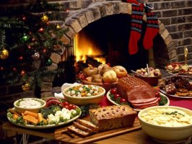
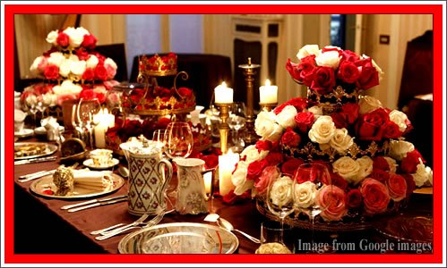
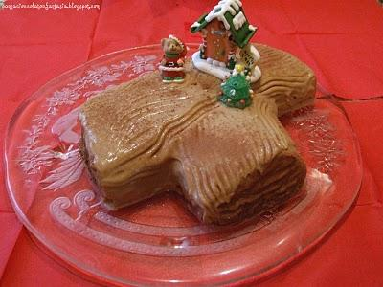
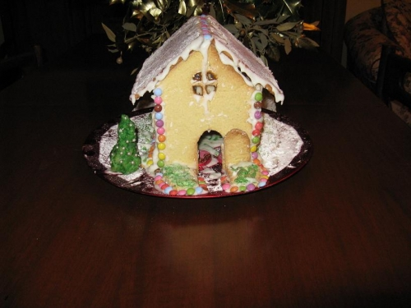
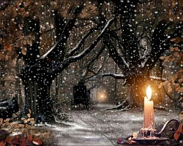
13 per cent of families always attend church on Christmas Day.
Unfortunately all the excitement and stress means that at precisely 9.58 on Christmas morning the first rows begin, and the average parent ends up losing it, and they start to tell off their children for the first time around 11.07am.
The strain of cooking the big Christmas dinner sees the average Brit start to sip their first alcoholic drink at 11.48am.
27 per cent of families sit down to watch the Queen’s Speech.
Dinner is finally served at 3.24pm, with 85 per cent of people enjoying the traditional turkey with all the trimmings.
All that food and drink means the first person falls asleep at around 4.58pm, with dad being the leader in losing the "staying awake" battle. Almost half of those who do nod off end up annoying the others with their loud snoring. For those who manage to stay awake, family board games are brought out at 5.46pm.
38 per cent of families think that spending time with the family is the best thing about Christmas Day.
And lights out? 11.39pm.

Slide 12
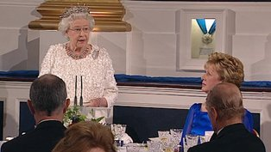

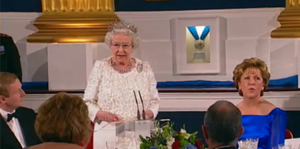
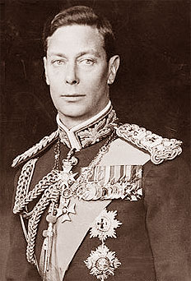
One Christmas ritual not drawn from an ancient tradition is the British monarch's broadcast on Christmas day. The tradition began in 1932 when King George V read a special speech written by Rudyard Kipling. The broadcast was an enormous success . It began, "I speak now from my home and from my heart, to you all...".
Queen Elizabeth II continues the tradition to this day. Every year she broadcasts her message on Christmas Day, and it is heard by millions of people all over the world. In England most people watch or listen to it whilst digesting their Christmas Dinner!

Slide 13
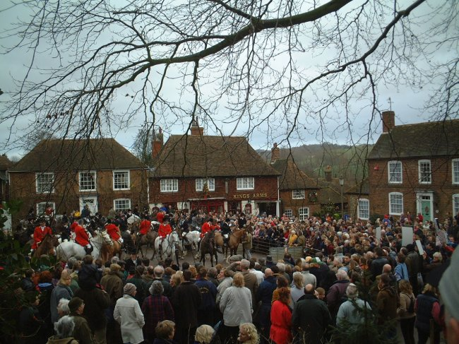
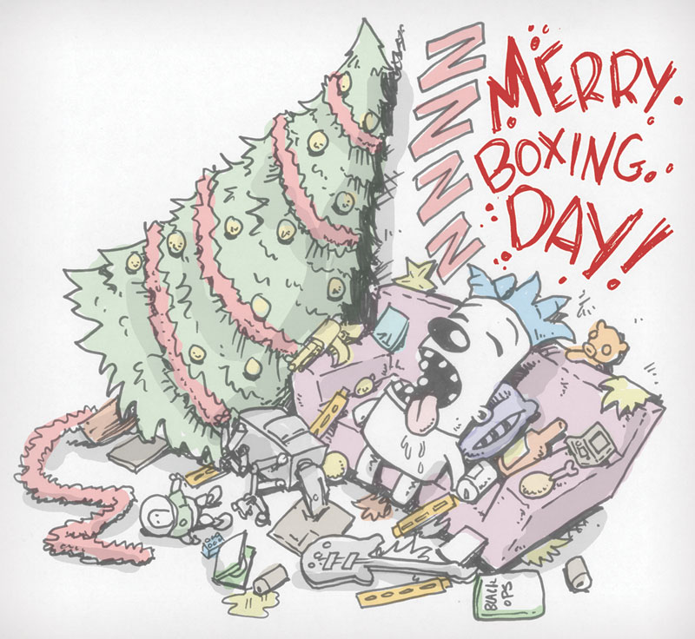

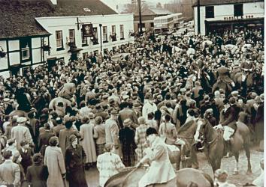
In England Boxing Day celebrated on December 26th, is traditionally a time to give gifts to tradesmen, servants, and friends.
It originated in medieval times, when every priest was supposed to empty the alms box of his church and distribute gifts to the poor. Wealthy people indulged in huge Christmas feasts, and when they were finished, packed up the remains of feasts in boxes and gave them out to their servants. It didn't become widely celebrated though until Victorian England.
In Ireland there is an Irish custom called "feeding the wren". The custom is based on a legend of St. Stephen. Once he was forced to hide in a bush, but a chattering wren gave him away. In the past Children caged the wren to help it do penance for this misdeed. Nowadays children carry a long pole with a holly bush at the top - which is supposed to hide a captured wren.
In the UK Boxing Day is still a public holiday, some shops and supermarkets open nowadays, but banks and most offices remain closed.

Slide 14
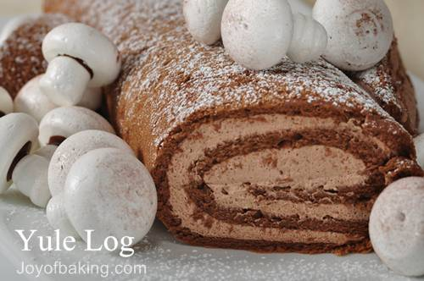

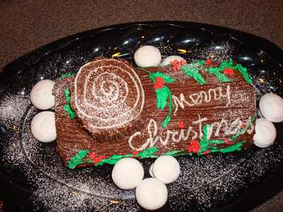
During the ancient 12-day Christmas celebration, it was considered unlucky to let the log in the fireplace stop burning. This log was called the Yule log and would be used to light the fire in New Year, to ensure that good luck carried on from year to year. The Yule Log custom was handed down from the Druids, but with the advent of gas and electric fires it is rarely observed nowadays

Slide 15
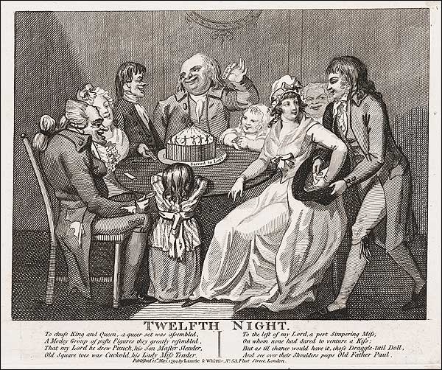
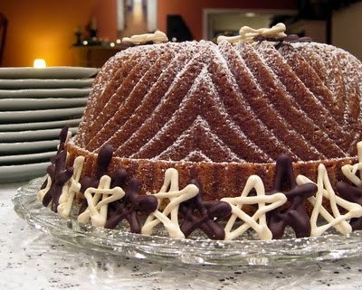

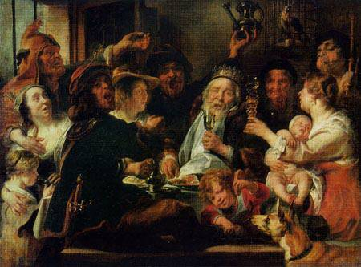
Another custom in medieval times, was to hide a dried bean in a cake, the cake was then eaten on Twelfth Night (January 6), during the most boisterous party of the year. The finder of the bean became "King of the Bean" and ruled the party for the night.

Slide 16

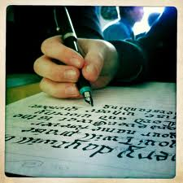
However, according to A Celebration and History(ISBN 0-679-74038-4), by Leigh Grant, the written lyrics to "The Twelve Days of Christmas" first appeared in Mirth without Mischief in the early 1780s in England. Grant states that the tune to which these words are sung apparently dates back much further and came from France. Mirth without Mischief describes "The Twelve Days of Christmas" as a type of memory game played by children at that time. A leader recited the first verse, the next child recited the second verse, and so on until someone missed a verse and had to pay some kind of penalty in the game. There was no religious significance. At anyrate the popular urban myth makes a good story... at least as good as the song itself, so here is a slice of urban myth culture for you: A very famous song about this time of year is "The Twelve Days of Christmas", which has a very interesting history. During the period 1558 to 1829 Catholics in England were prohibited from any practice of their faith by law - private or public. It was a crime to be a Catholic. Some people say that the song was written to help young Catholics learn the tenets of their faith during that period when to be caught with anything in 'writing' indicating adherence to the Catholic faith could not only get you imprisoned, but could also get you hanged, drawn and quartered! The song's gifts are allegedly hidden meanings to the teachings of the faith. "True Love" mentioned refers to God. "Me" refers to every baptized person, here are the other lyrics and their other hidden meanings. However, some people say this is an Urban Myth, but you can make your own mind up.

Slide 17
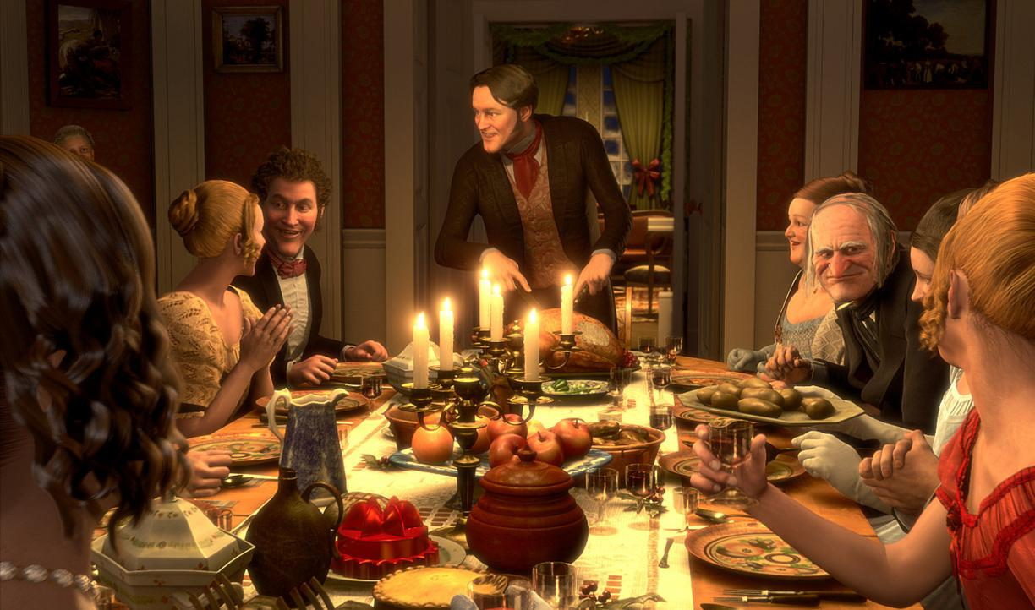
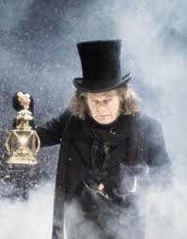
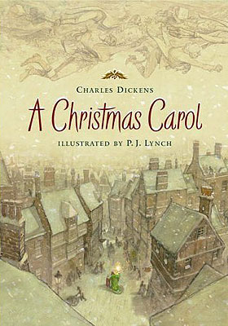
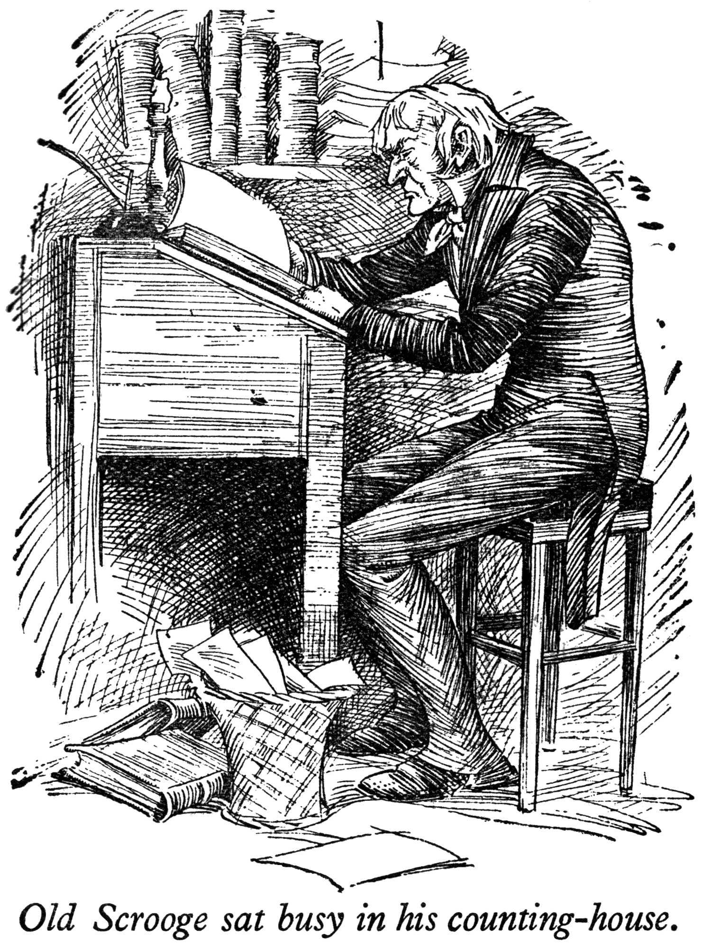
Around Victorian times another traditional Christmas feast was roasted goose or roasted turkey. In Victorian times, most Londoners would have been familiar with the "goose club", which was a method of saving to buy a goose for Christmas.
The traditional Christmas goose was featured in Charles Dickens' 'A Christmas Carol'.

Slide 18

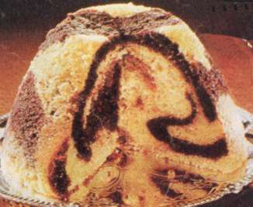
The forerunner of the Christmas pudding (aka. plum/figgy pudding), a rich fruit pudding, was called Frumenty, it was served in Medieval times. Frumenty was a
spiced porridge, enjoyed by both rich and poor. It has its origins in a Celtic legend of harvest god, Dagda, who stirred a porridge made up of all the good things of the earth.
The pudding became specifically associated with Christmas, rather than merely any festive occasion, when it was introduced to the Royal Christmas dinner table by Prince Albert.
Plum puddings are a very rich, dark pudding made with all sorts of dried fruits, nuts, spices, black treacle and lots sherry or brandy. They are made well before Christmas as it takes time for the alcohol to soak into the dried fruit, however nowadays most people buy them from a supermarket. They are steamed when first made, and re-steamed on Christmas Day before being served with a sweet white sauce or brandy butter. If the pudding is made at home, everyone in the household must take it in turns to stir the pudding and make a wish, the mixture should be stirred from east to west, in honour of the three wise men.
Some people like to hide a coin or trinket in the Christmas pudding. This may have originated in the ancient custom, in Rome and elsewhere, of concealing a particular object in food.

Slide 19
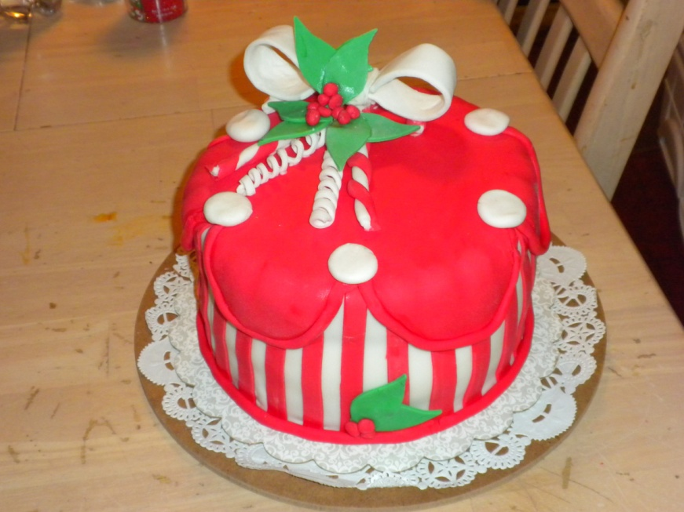
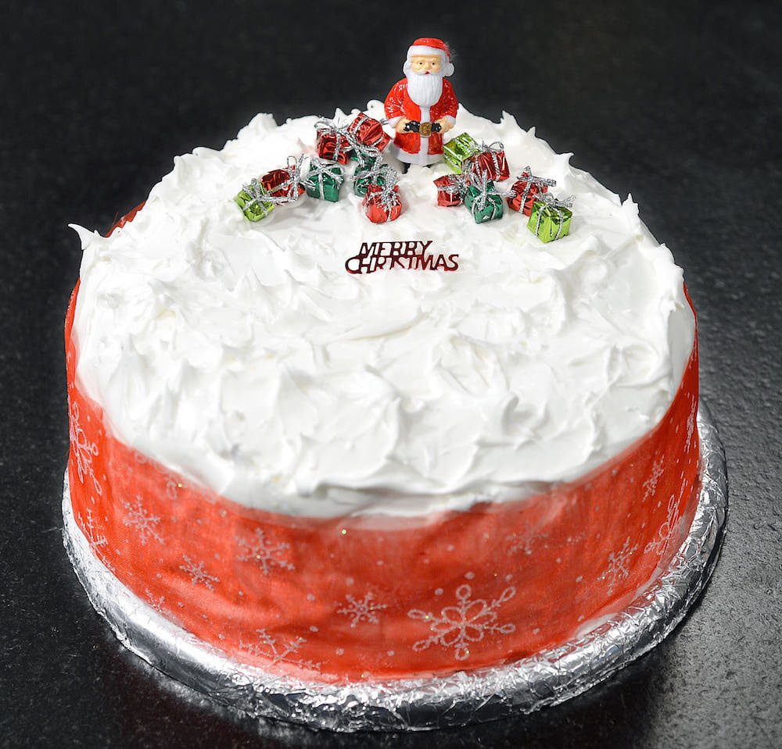


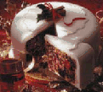
Christmas cakes are also very rich and dark and contain just about every dried fruit you can think of, nuts (usually blanched almonds) glace cherries, candied peel and once again, sweetened with black treacle. They are covered with a layer of marzipan or almond paste and then thick white "Royal" icing made with icing sugar and egg whites.
It was introduced as a custom by the Victorians. Prior to that period, cake was eaten during Christmas, but without the toppings. The idea of using marzipan is thought to be linked to the Tudor Marchpane an iced and decorated cake of marzipan that acted as the table centrepiece during banquets and festive occasions. They should be made about six weeks before Christmas and are usually decorated with ribbons and images of Santa Claus or robins with holly.

Slide 20
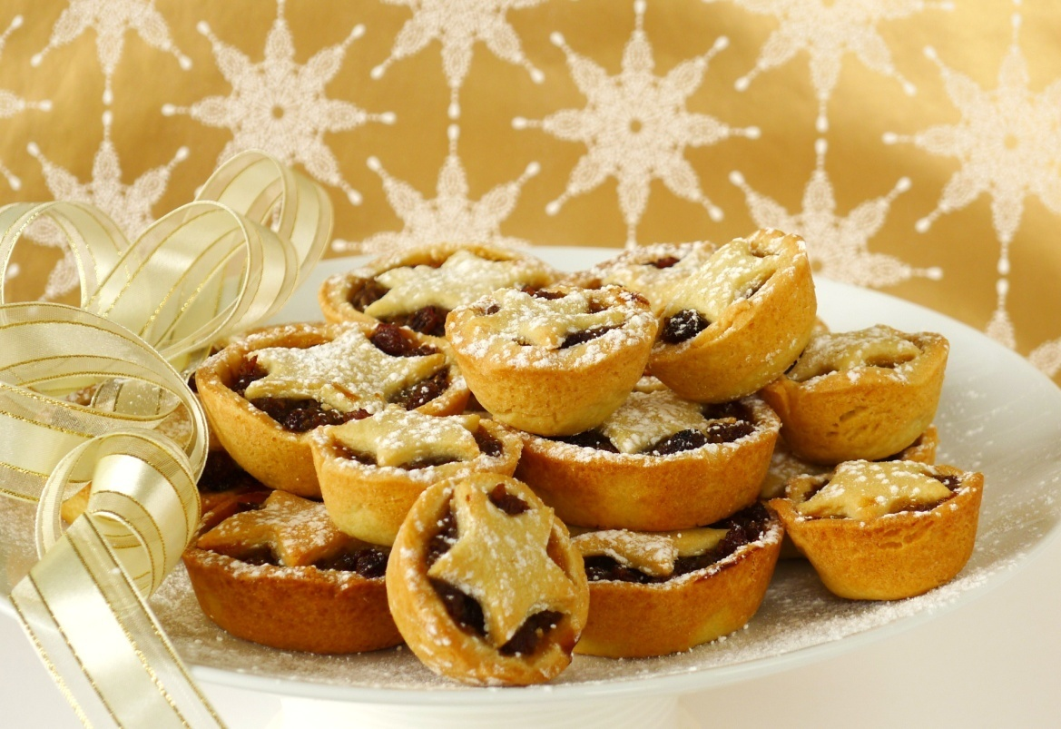
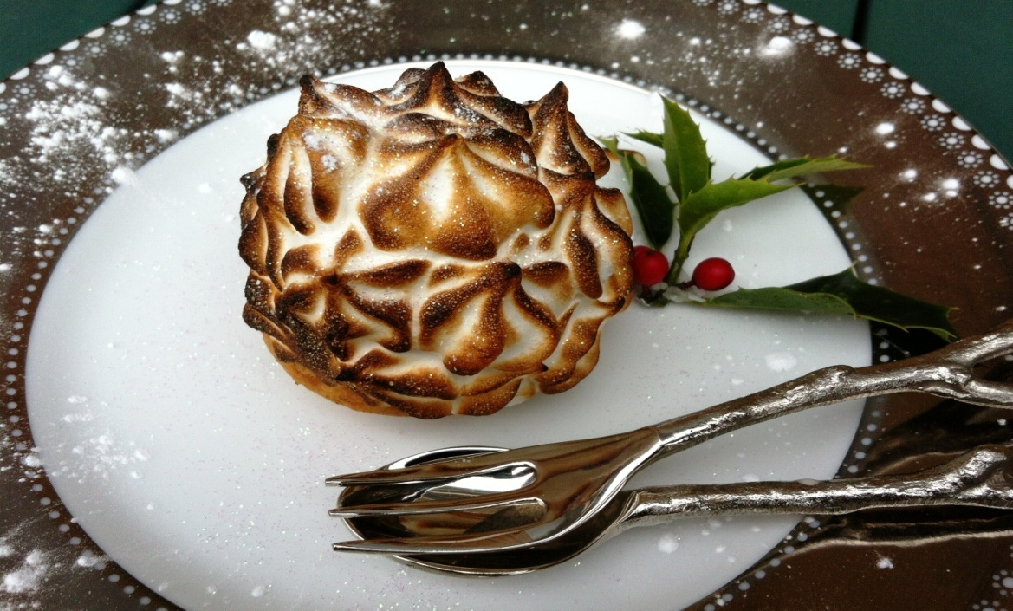
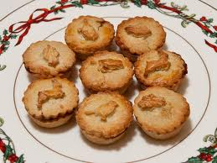
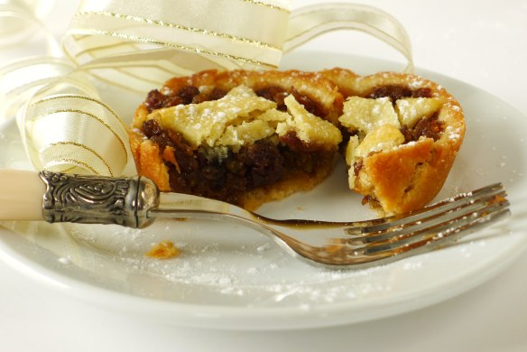
Mince pies were often known as Christmas pies, they were banned in the seventeenth century by that killjoy Cromwell but eventually came back into existence after the Restoration. They are made with mincemeat – which doesn’t contain meat at all. The sweet, rich and fruity pies that we are now accustomed to developed early in the twentieth century when the meat content was removed for good and now the "mincemeat" is a mixture of dried fruit (raisins, sultanas, candied peel, etc.,) apples, spices, sugar and suet, often moistened with brandy or sherry, and baked in small pastry cases.
If the mincemeat is home made everyone in the household should stir it as it is considered to be lucky. The cases should be oval in shape, to represent the manger, with a tiny pastry baby Jesus on top, but as very few people have tins that shape they are nearly always round now.

Slide 21
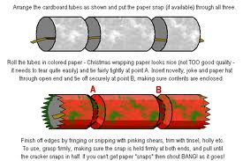

Christmas Crackers have been a part of the traditional British Christmas since1847, when almost by accident, Tom Smith invented the cracker. They are used to decorate the table at dinner.
In it's simple form a cracker is a small cardboard tube covered in a brightly coloured twist of paper. When the cracker is 'pulled' by two people, each holding one end of the twisted paper, the friction creates a small explosive 'pop' produced by a narrow strip of chemically impregnated paper. Inside the cracker there is usually a tissue paper hat, a balloon, a slip of paper with a very corny joke on it (for example: "What does Santa call his blind reindeer?" "No-eye-deer!" / "Where do fish wash?" "In the river basin!" / "What do you get if you cross a sheep with a kangaroo?" "A wooly jumper!" /" What lies in a pram and wobbles?" "A jelly baby!" ) and a small gift (usually a little cheap plastic thing e.g. a plastic ring or nail clippers).
The family will pull each other's crackers before the meal starts, this often involves crossing arms and pulling two crackers at once. The person who gets the "big end" keeps the plastic trinket. The paper hats are donned, and the jokes read out, accompanied by moans and groans at how awful they are. Then, and only then, can the meal begin.

Slide 22

Christmas trees are an integral part of the Christmas decorations in most British households. Although it was always traditional to bring evergreens into the house the Christmas tree is another tradition borrowed from Germany, where it is said that German Martin Luther was the first person to decorate a tree with candles and bring it indoors to show his children what stars looked like at night in the forest. It didn't become popular in Britain until the nineteenth century, when Queen Victoria’s husband Prince Albert introduced the custom from Germany.
Nowadays in the UK you will find a variety of trees, from real trees with roots that can be replanted after the festivities, to felled trees that get recycled, to plastic imitations that get unpacked every year. No one seems to be able to agree which is the most environmentally friendly option. The tree will be decorated with lights (candles are a rarity due to the risk of fire), tinsel, baubles, chocolate figures and coins, and the obligatory angel / fairy on the top.

Slide 23
The Story of St Nicholas (the original Santa Claus)
The real St. Nicholas lived in Turkey, he was bishop of the Turkish town of Myra in the early 4th century. It was the Dutch who first made him into a Christmas gift-giver, and Dutch settlers brought him to America where his name eventually became the familiar Santa Claus.
However, he is a very popular saint in England where there are almost 400 churches of St. Nicholas, more even than churches of St. George, England's patron saint. Many different stories are told to British children about Saint Nicholas, here is just one:-
Long long ago, in the days when Saint Nicholas was alive, there lived a kindly nobleman. He had a beautiful wife and three pretty young daughters, and all the money his family would ever need. But one day, the mother of the family, who was a sweet gentle woman, became very ill. The nobleman was frantic! He summoned the town's only doctor, a very old, very wise woman, who knew all there was to know about herbs and magic.
The old woman tried all the cures she knew, but she could do nothing to save the poor woman. Finally he called for the priest to come, but by that time his poor wife had passed away. The nobleman was in despair! He missed his wife so much that he lost his head. He wasted all his money away on silly projects and useless inventions. He became so poor that he had to move his family out of their castle and into a little peasant's cottage. Meanwhile his daughters were growing up. Poverty was difficult for them, but they remained cheerful and strong. They soon learned to do their own cooking, cleaning and sewing, and they took care of each other.
All three girls were very pretty. In time each of them fell in love and wanted to get married. But they couldn't because their father was so poor. He had no dowry (a sum of money or some valuable property) to give to the prospective husband's family. He felt he had failed his own children, and he became even more sad and gloomy.
Now, Saint Nicholas happened to live in the same area. The kindly saint had dedicated his whole life to doing good deeds, and was always on the lookout for someone in need. One night the saint came riding through the town on his white horse looking for the house of the nobleman and his three daughters. He rode up to the cottage and peeked in through a chink in the wall. That same night, the daughters had washed out their clothes by hand, and hung them up in front of the fireplace to dry. There were the stockings, three pairs, hanging right on the chimney. Inspiration struck Saint Nicholas. From his pouch he took out three little bags filled with gold coins. One by one he threw the bags down the chimney, so they landed in the stockings of the three daughters. The nobleman, worried about his daughters' futures, had terrible trouble falling asleep a night and was still awake. He heard the clip clop of the white horse as the saint was leaving, and peeked out of the door. He called out to Nicholas, but he had already disappeared into the dark night.
When the daughters woke in the morning, they found their stockings filled with plenty of money for their dowries. When they went to tell their father, they found him sleeping peacefully with a smile on his face. Saint Nicholas had taken care of all his worries. And so, through the goodness of Saint Nicholas the three daughters were able to marry the men they loved, and the nobleman lived on to be a happy grandfather.
St. Nicholas is a very hard-working saint, being the patron saint of children, merchants, apothecaries, pawnbrokers, scholars and mariners. He is reputed to be able to calm storms and rescue sailors. Even pirates have been known to claim his protection. Over the years he has become known as Santa Claus and even his now traditional red costume can be traced to Coca Cola advertising in America!
The tradition of hanging up the stocking is still followed in the British Isles. It is left out on Christmas Eve, along with mince pies, sherry and carrots for Santa and his reindeer, and even today most children are in bed way before midnight waiting for Santa to visit.
The stocking is opened by excited children on Christmas morning. Nowadays the gifts Santa Claus brings can be quite elaborate, in Victorian times it was traditionally fruit, nuts, sweets and coins

Slide 24











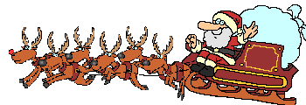







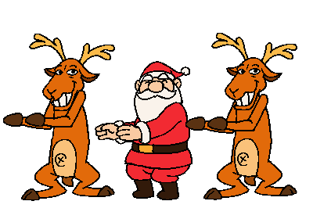




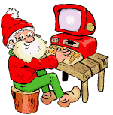
Santa Claus

Slide 25



Erica
Christmas Is...My Personal Wish List for Christmas
Mmmmm, I love Christmas
Christmas is definitely around the corner
this is my personal wish-list for this wonderful season.
Some of these are material things, others are not. Some are realistic,
Hope you like reading them as much as I loved writing my wish list:
I WANT THE OLD FRIENDSHIPS pacify, BACK TO THE PAST correcting mistakes…
THERE ARE ALSO THINGS SUCH AS A NEW PHONE ..... THIS is MY WISH LIST

Slide 26
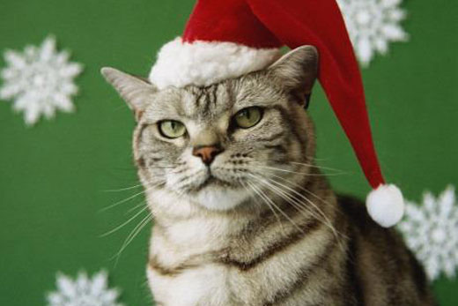

Aurora
Christmas. It’s my favorite holiday of the year
Christmas songs are already being played over the radio;
Christmas decorations are already seen on TV and the stores are already being made for Christmas parties
MY WHISH LIST:
FOR CHRISTMAS I WANT A PENDRIVE FOR THE COMPUTER, AND A BELT

Slide 27


Simona
FOR ME CHRISTMAS IS TO BE TOGETHER WITH MY FAMILY AND THE BIRTH OF THE CHILD JESUS ​​.. I wish there was PEACE IN THE WORLD AND ALL THE POOR CHILDREN OF THE WORLD HAD A CHRISTMAS AS SPECIAL AS MINE.
I WANT FOR CHRISTMAS A
DIGITAL CAMERA
A SET FOR DIVING

Slide 28


Valentina
I love Christmas: it is my favorite holiday
I love that my parents are at home and especially that I'm at home
you know they asked me what I want for Christmas and this is my list:
I want this presentation to be fantastic, then I want to get a good grade in Italian, in Maths, and I hope to finish all English homework (believe me!!!).
MERRY CHRISTMAS

Slide 29






Direction and
production By :
Valentina,SimonaErica and Aurora

Slide 30


