Slide 1
THE HAPPY PRINCE
BY oscar wilde

Slide 2
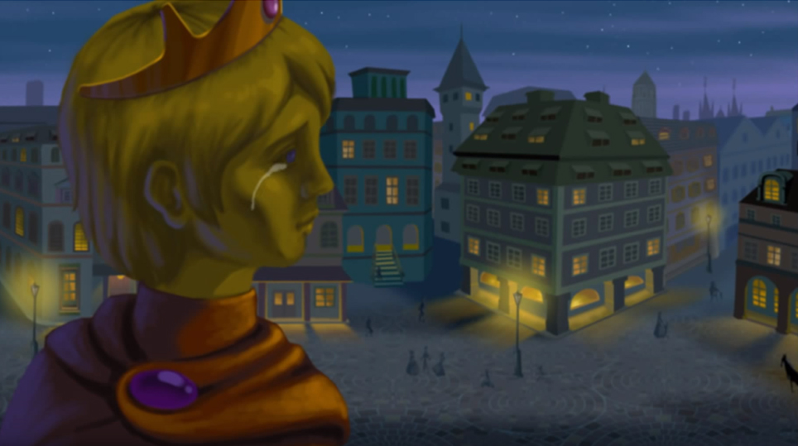
The swallow discovered that the Prince was weeping at the sight of the poverty and misery of the poor people in his city.

Slide 3
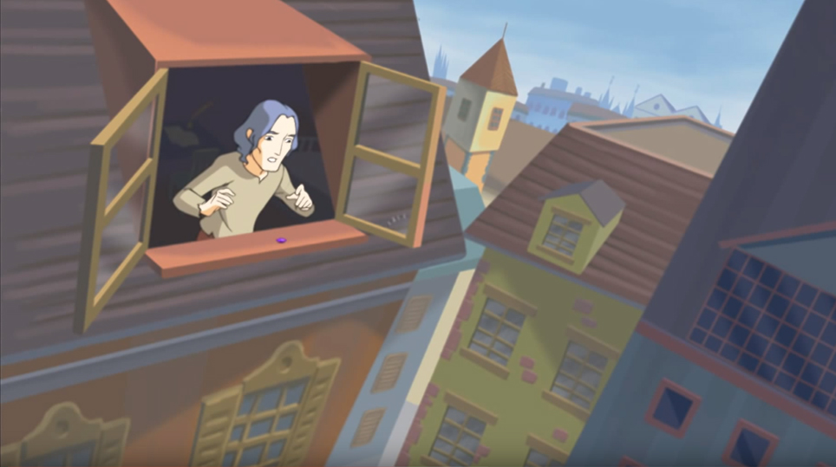
Then the swallow carried one sapphire eye to a starving writer in a cold attic.

Slide 4
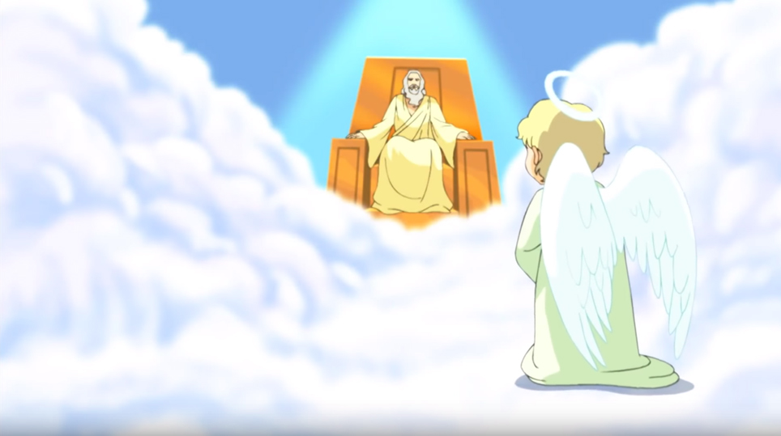
‘Bring me the two most precious things in the city,’ said God to one of his angels.

Slide 5
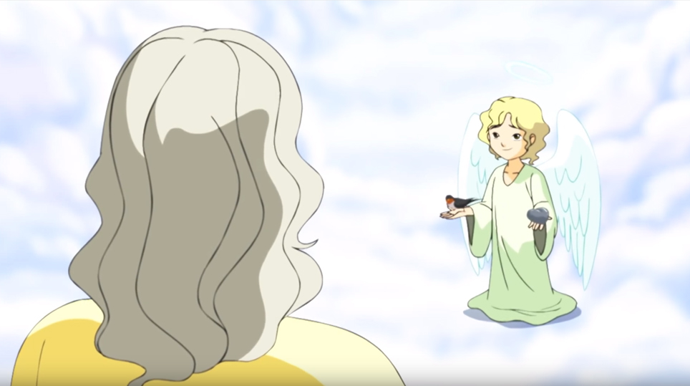
And the angel brought him the leaden heart of the Prince and the dead bird.

Slide 6
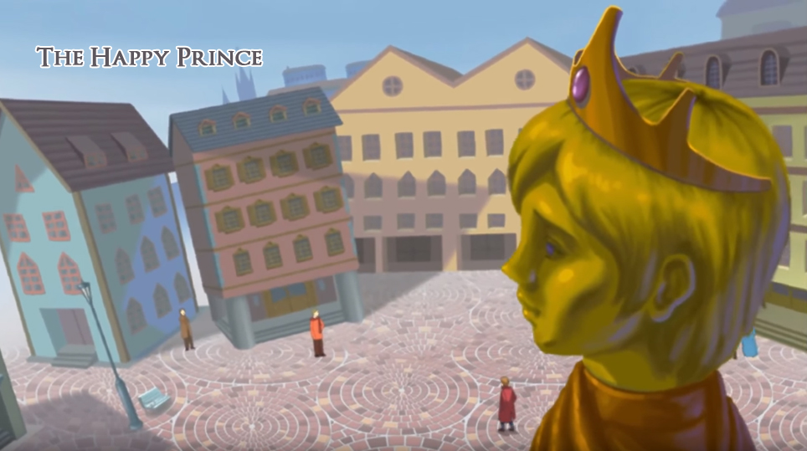
High above the city on a tall column stood the statue of The Happy Prince. He was covered with thin leaves of fine gold; his eyes were two sapphires and a large red ruby was on his sword hilt.

Slide 7
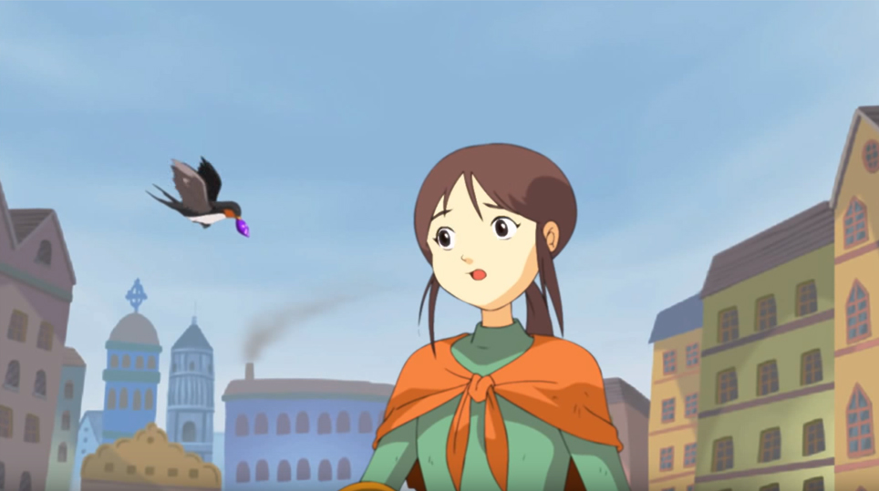
The other sapphire eye was flown to a little homeless girl.

Slide 8
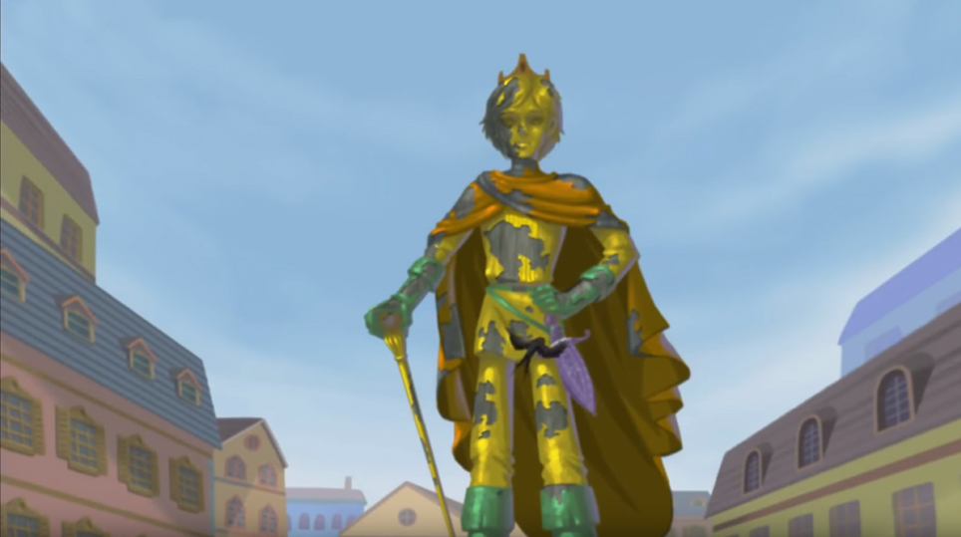
Then, one by one, the swallow carried all the leaves of gold that covered the Prince’s body to give aid to poor people.

Slide 9
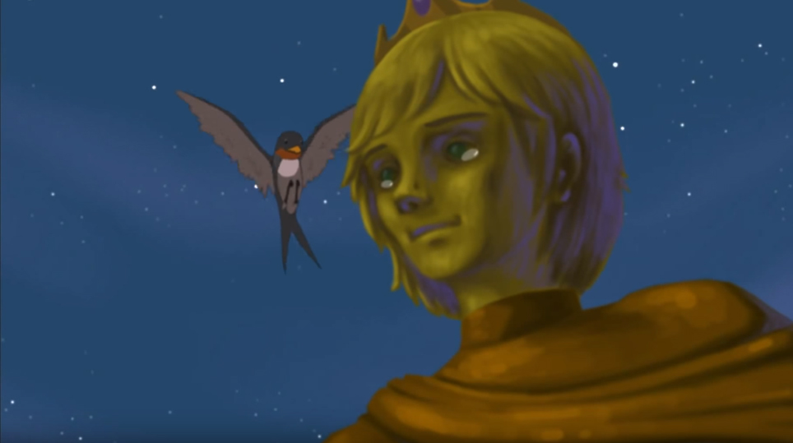
So, the swallow was persuaded to stay long enough to help the Prince give his gold to the poor.

Slide 10
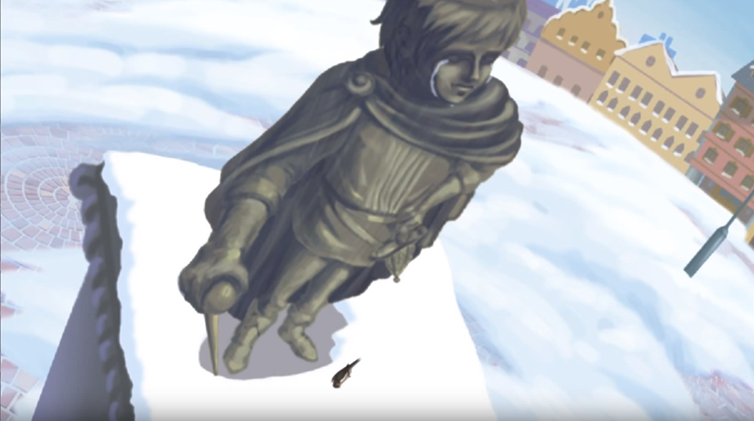
One day, in the cold of the winter, the swallow died and the prince’s leaden heart cracked.

Slide 11
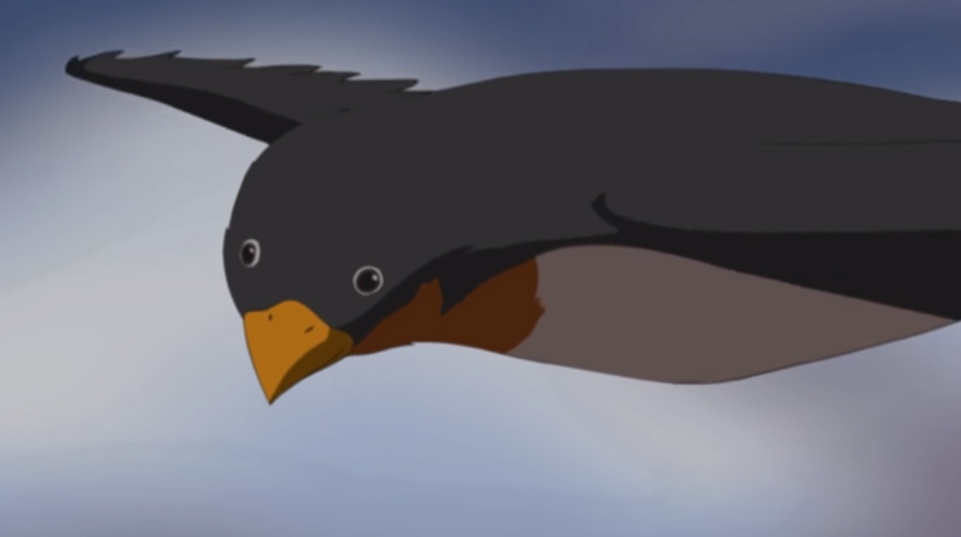
One day a swallow came and decided to spend the night between the feet of the statue.

Slide 12
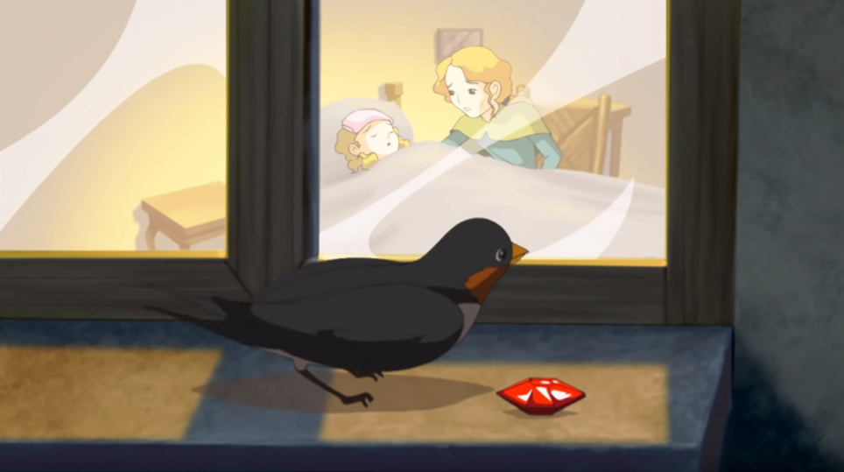
First, the swallow took the ruby to a mother with a sick child.

