Slide 1
An to Z of Internet

Slide 2
A – all email addresses have the @ symbol @ = at in English . = dot in English My email address is …

Slide 3
B – a type of diary that you put on Internet is called a blog

Slide 4
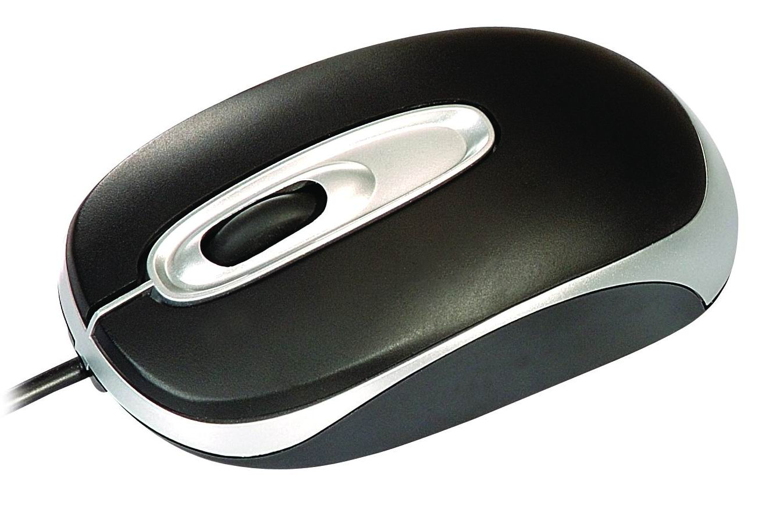
C – you click with the mouse to make your computer do something

Slide 5
D – when you take text, music or video from Internet, you download it

Slide 6
E – you use email (electronic mail) to send and receive messages on your computer via internet

Slide 7
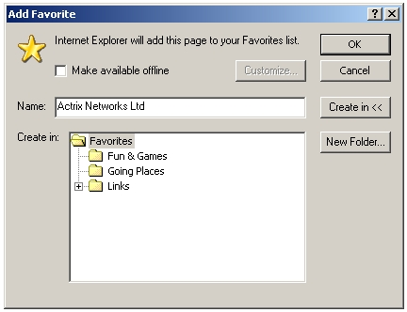
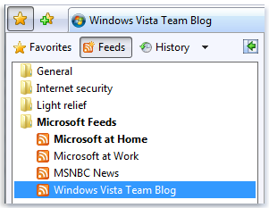
F – you can keep a list of your favourite websites (called favourites) on your computer

Slide 8
G – you click Go to start a search on Internet

Slide 9
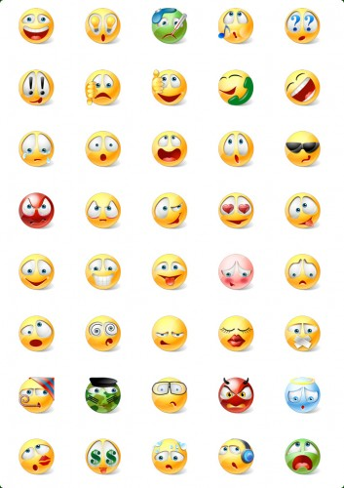
H – you can use symbols to add humour to your email messages. For example: :-) = amused | :-( = sad | :-)) = very happy | :-O = surprised

Slide 10
I – you can use Internet for instant messaging. You send a message and you receive a reply immediately. It’s like a written conversation

Slide 11
J – you sometimes receive emails that you didn’t ask for and didn’t want. This is junk mail or spam.

Slide 12
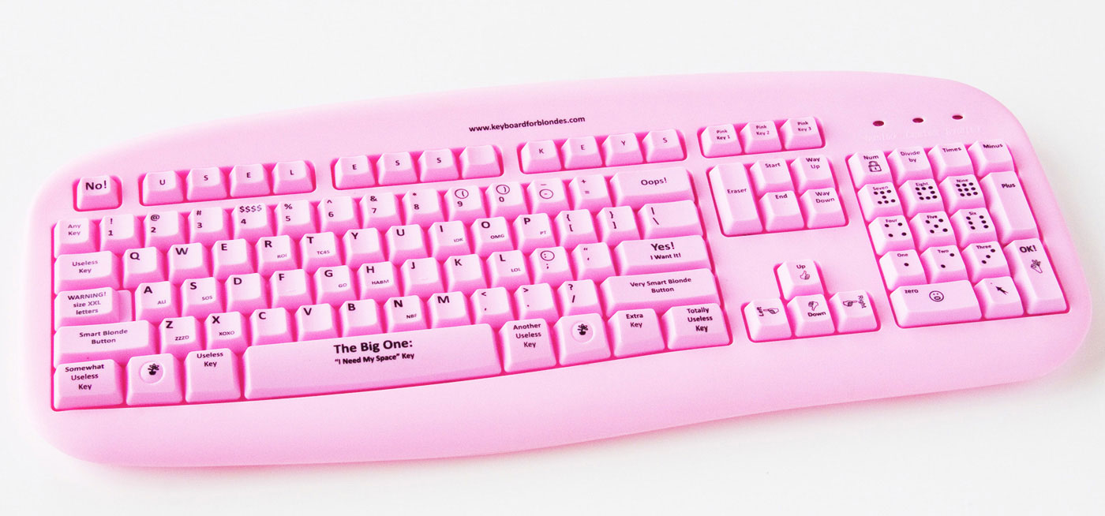
K – you use the keyboard to type messages

Slide 13
L – a link connects one web page to another. It’s usually a word or phrase in blue and underlined

Slide 14
M – you use the mouse to move around the screen of your computer

Slide 15
N – the Net in another word for Internet

Slide 16
O – online means connected to Internet

Slide 17
P – you can download a podcast (a radio programme or a video) from Internet and play it on your iPod (mp3 player)

Slide 18
Q – when you quit a computer program, you close it

Slide 19
R – you send a message and you receive a reply

Slide 20
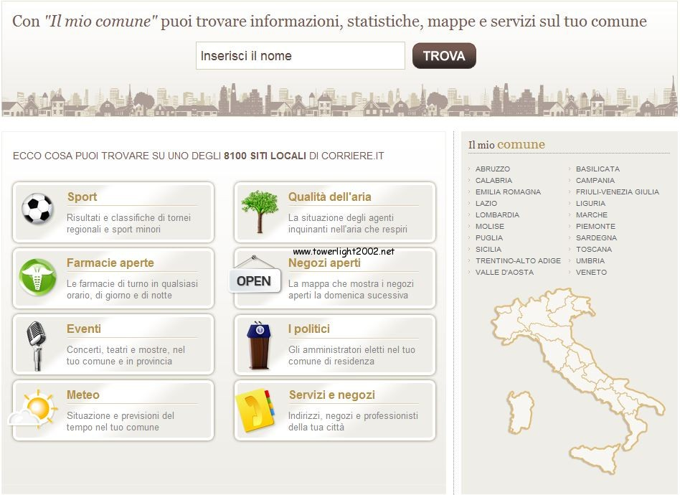
S – you surf Internet to find information

Slide 21
T – there are tools. They’re on the toolbar

Slide 22
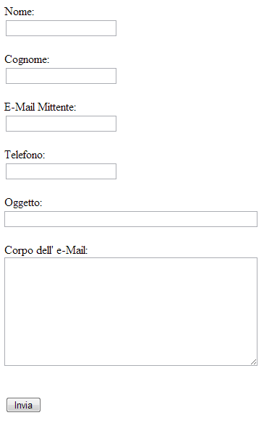
U – your username is your email name, e. g. spiderman@italweb.net

Slide 23
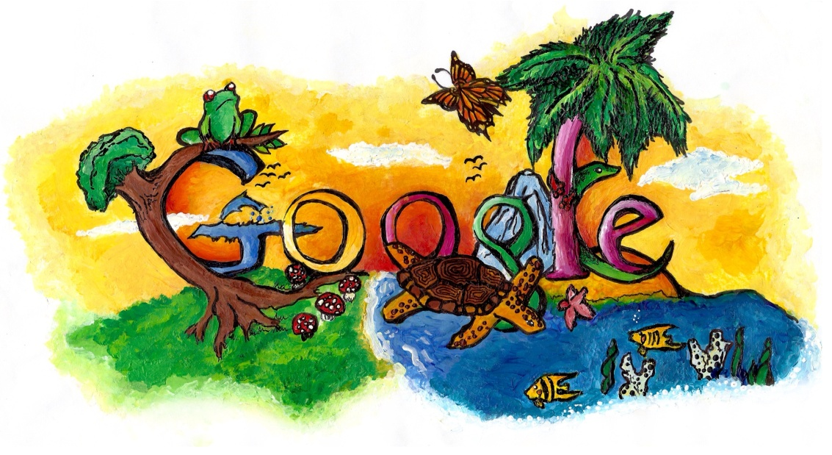
V – type ‘virtual tour of London’ into Google and explore the capital of Great Britain!

Slide 24
W – a webcam is a camera connected to a computer

Slide 25
X – you can write the letter x at the end of your emails to send a kiss

Slide 26
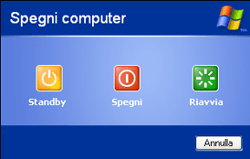
Z – don’t stay up late surfing Internet. Go to bed!

Slide 27
A project by : aurora

