Slide 1
MY PERSONAL ENGLISH ALPHABET

Slide 2
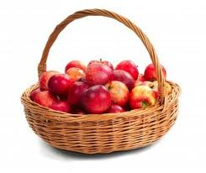
A …. I eat an apple every day

Slide 3
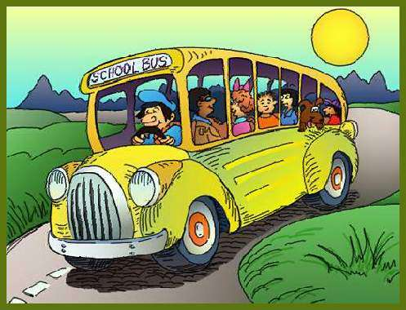
B… I go to school by bus

Slide 4
C….I have cheese for lunch

Slide 5
D…I go to the cinema with my dad

Slide 6
E…I listen to music every day

Slide 7
F… I play the piano with my friends

Slide 8
G…There are 30 glasses in my cupboard

Slide 9
H… I sleep in the hotel on holiday

Slide 10
I…I am intelligent

Slide 11
J…his name is Jack

Slide 12
k…It is a koala

Slide 13
L…My name is Luisella

Slide 14
M…My mum is beautiful

Slide 15
N…In my kitchen there is a notice board

Slide 16
O…I have an orange bracelet

Slide 17
P…I play the violin on Monday

Slide 18
Q…I go to bed at quarter to ten

Slide 19
R…I read magazine every day

Slide 20
S…I study English three times a week

Slide 21
T…I go to the church on Tuesday

Slide 22
U…I am not ungenial

Slide 23
W…I go to sea at the weekend

Slide 24
Y…yesterday I went to swimming-pool

Slide 25
Z…I go to the zoo with my family

Slide 26
Project by
Luisella Tortora

