Slide 1
Martin Luther King, a great man and this is his story

Slide 2
THE SLAVERY
From the 16th century slave traders took African men, women and children from their country to
work on the large plantations of the southern states of America. The slaves were very cheap
labour for the plantation owners. The slaves worked until they died. They were not free as they
belonged to the plantation owners.
In 1865 slavery was abolished in all parts of the USA. By the 20th century, black Americans were no
longer slaves, but they were not equal to American citizens. They could not vote; they could not sit
on the same buses or in the same restaurants as white Americans or go to the same schools. They
were second‐class citizens.

Slide 3
This changed with Martin Luther King…
King was born in Atlanta, Georgia, in 1929. He studied in Philadelphia where he
became enthusiastic about Gandhi and his policy of non‐violence

Slide 4
Mohandas Gandhi was India’s most important political and spiritual leader. The Indian people called
Gandhi 'Mahatma', meaning Great Soul. He is honored in India as Father of the Nation. His non‐violent
protests led to independence for India from the British. His beliefs and actions have inspired civil rights
movements all over the world. He developed a method of action based upon the principles of courage,
nonviolence and truth called Satyagraha. He is an icon of world peace. His birthday, 2nd October, is
commemorated worldwide as the International Day of Non‐Violence.
“‘Nonviolence is the first article of my faith. It is also the last article of my creed’

Slide 5
In 1954, in Montgomery, where he was a minister in a small Negro church, he carried out the first
non‐violent demonstration against racial discrimination.

Slide 6
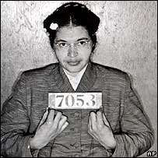
This followed an incident when a black
lady called Rosa Parks was arrested for sitting in a seat on a bus reserved for white people and
refusing to give it to a white man. For a year black people walked, cycled or used cars instead of
taking the bus. In 1956 segregation was declared illegal on buses in Alabama.

Slide 7
Martin Luther King
won his first battle.

Slide 8
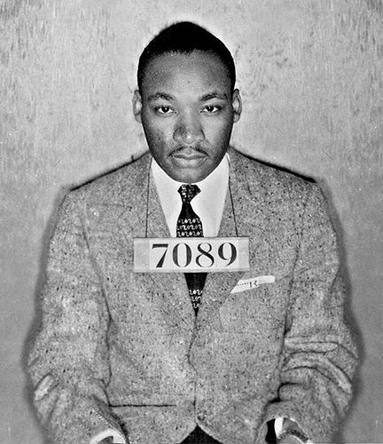
Martin Luther king became famous for the Black Freedom Movement. He was arrested and
imprisoned many times for his beliefs but he never stopped his campaign and continued to work
for equality.

Slide 9
On August 28th 1963 Martin Luther king led a peaceful march to Washington. About two hundred
and fifty thousand people sang, prayed and listened to his famous speech called I Have a Dream.
In it he talked about his dreams for the future when black and white children would play together
and slaves and slave owners would sit down to eat together.

Slide 10
There was no violence during the
demonstration.

Slide 11
Martin Luther King won the Nobel Peace Prize in 1964.

Slide 12
This great man was assassinated in
Memphis in 1968, but…

Slide 13
…before this happened he saw the abolition of racial discrimination laws in
1964‐1965.

Slide 14
By Simona Ruggiero, Erica D’Uva, Aurora Albino, Giorgio Francesca, Valentina Grazioso, Angela Maria Cardinali, Barbara Attianese
E Alfonso Tramontano

